Slide 1
Work, Power and Conservation of Energy

Slide 2
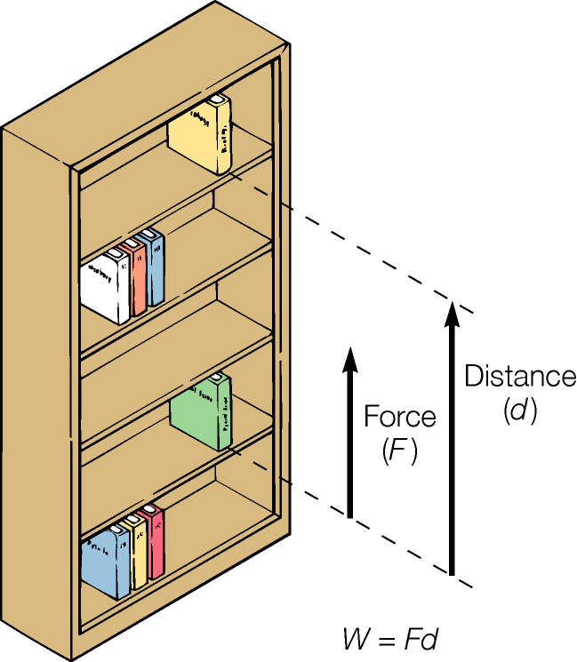
Work
An applied force acting through a distance parallel to the force
Units of work (and energy) = joule (J)
Zero distance, no work
Displacement perpendicular to applied force, no work

Slide 3
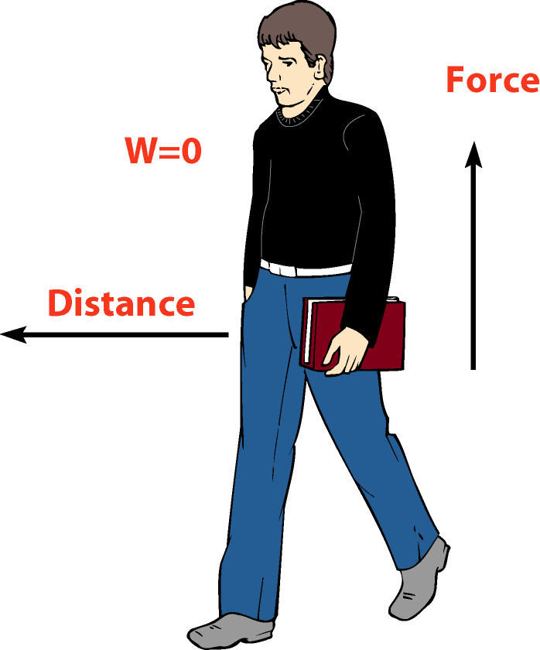
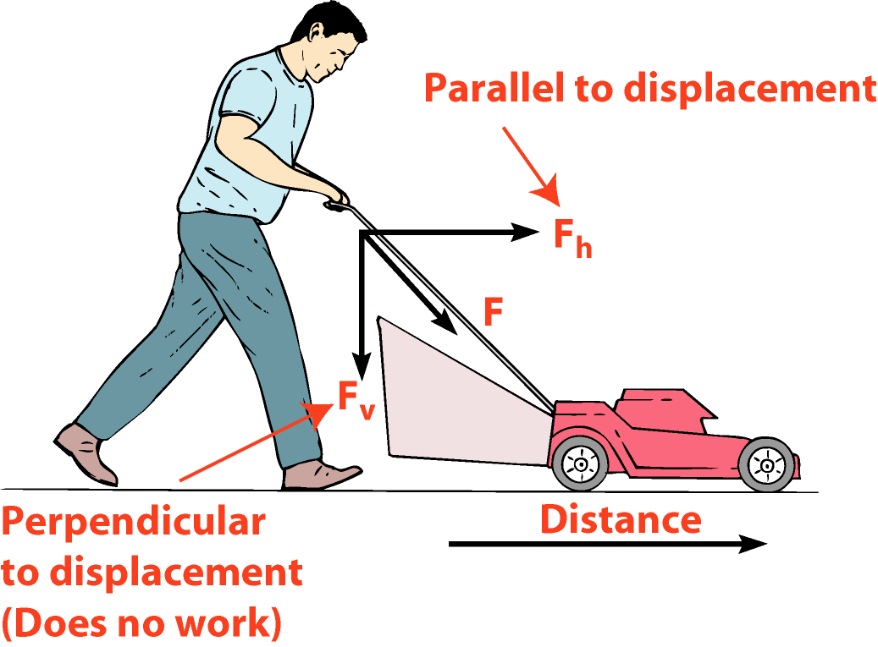
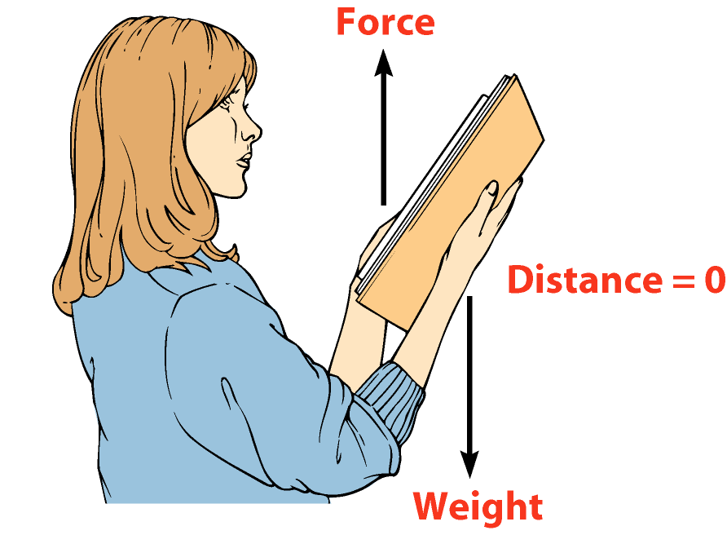
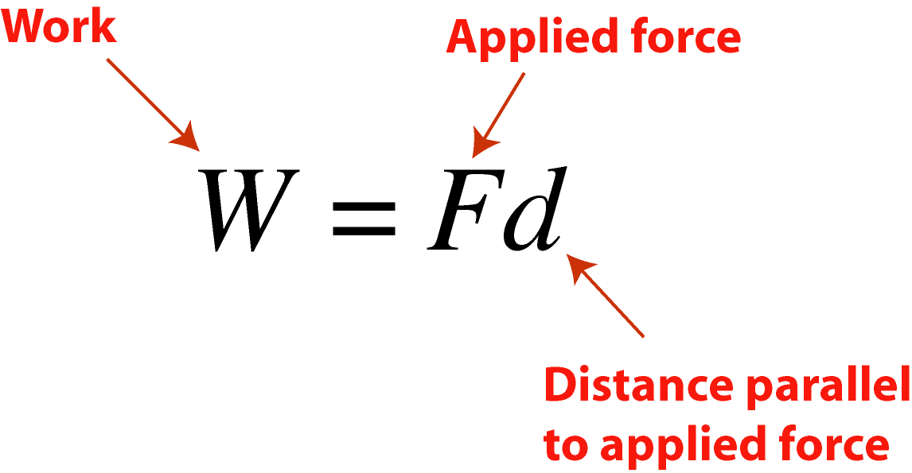
Work

Slide 4
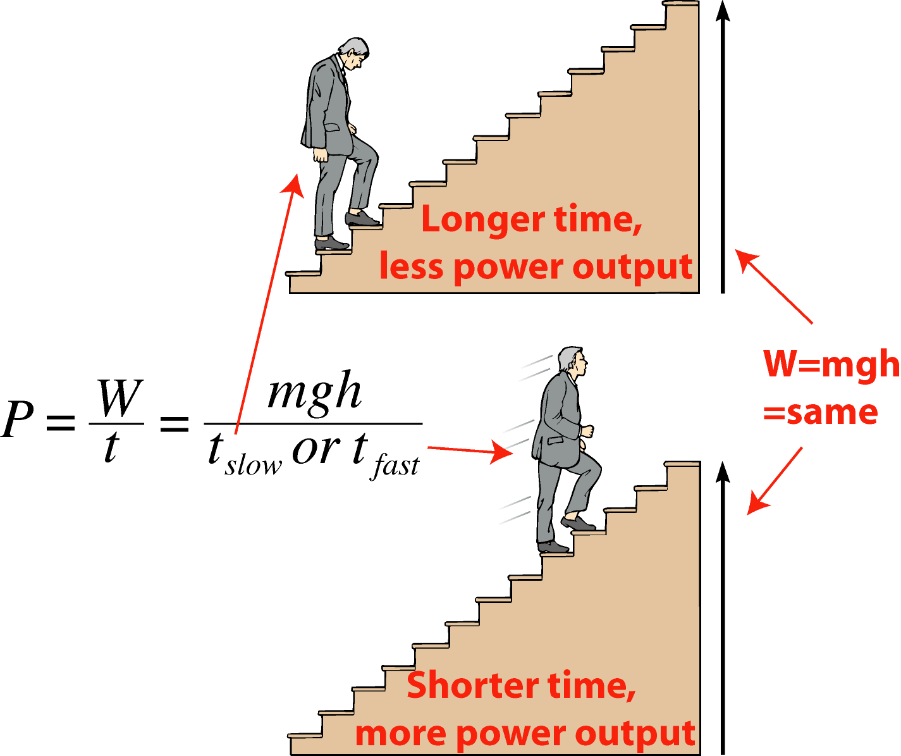
Power
The rate at which work is done
Units: watts (W), horsepower (hp)
Example: Walking versus running upstairs
The “power bill” - you pay for energy

Slide 5
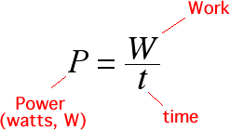
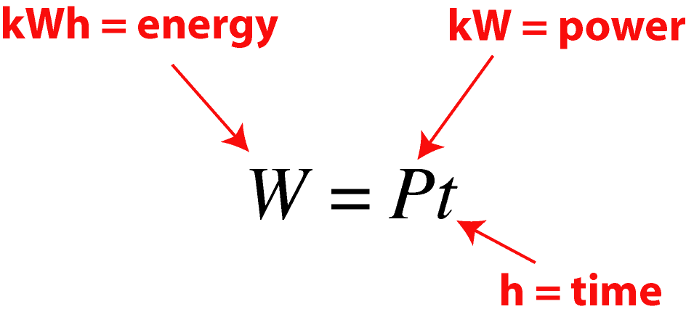
Power

Slide 6
Motion, position and energy
Work and energy related
Energy = ability to do work
Work = process of changing energy
Next:
Relationship between work and energy associated with position
Relationship between work and energy of motion

Slide 7
Potential energy
Energy associated with position
Gravitational potential energy
  Measuring h - need reference height
Also: elastic (springs) and electric (charges) potential energy
Work can change PE
Kinetic energy can change into potential energy

Slide 8
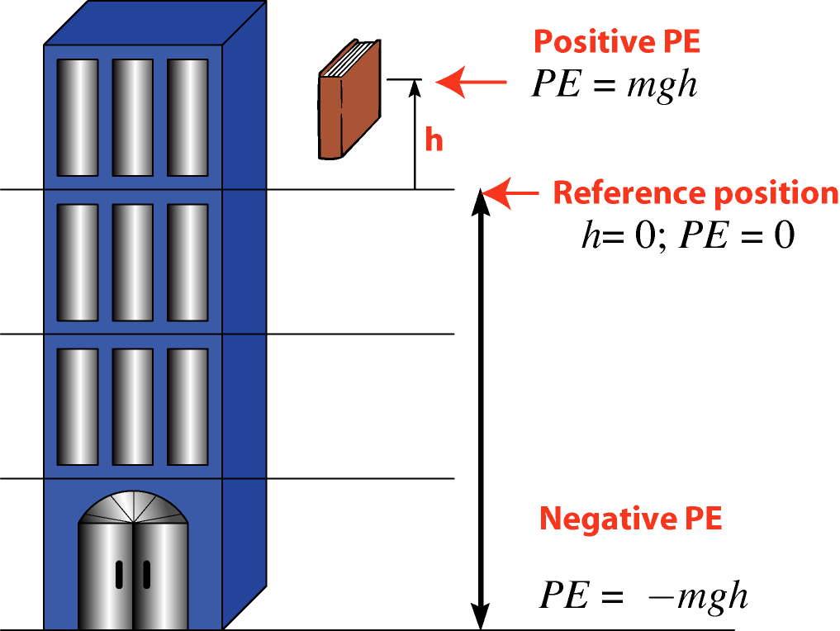
Potential energy

Slide 9
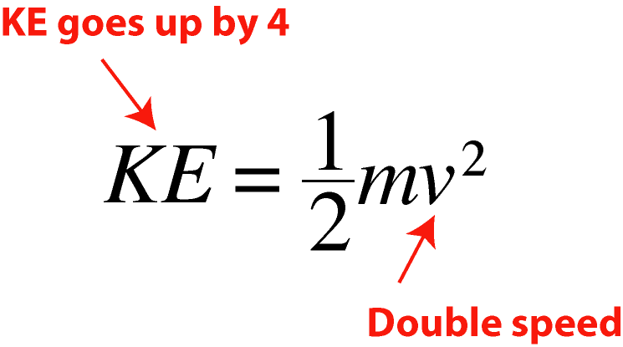
Kinetic energy
Energy associated with motion
Results from work or change in potential energy
Speed squared! (Double speed, KE increases by 4)

Slide 10
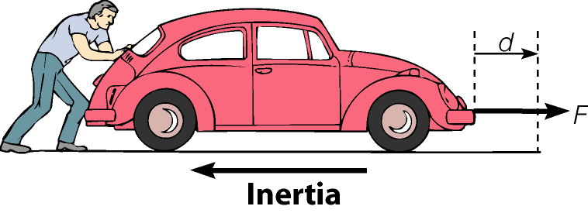
Energy flow
Energy can do work as
Work to add E_{K}
Work to add E_{G}
Work against friction
Work on a spring
Work against combinations of above

Slide 11
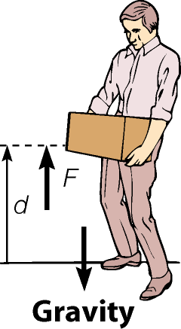
Energy flow
Energy can do work as
Work to add E_{K}
Work to add E_{G}
Work against friction
Work on a spring
Work against combinations of above

Slide 12
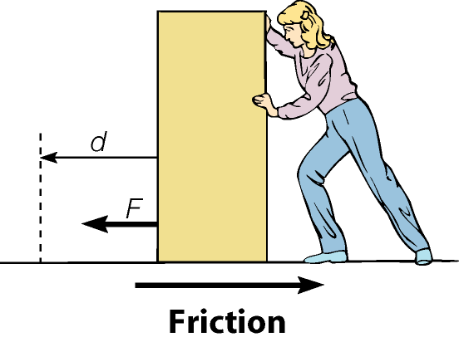
Energy flow
Energy can do work as
Work to add E_{K}
Work to add E_{G}
Work against friction
Work on a spring
Work against combinations of above

Slide 13
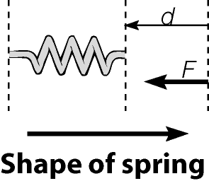
Energy flow
Energy can do work as
Work to add E_{K}
Work to add E_{G}
Work against friction
Work on a spring
Work against combinations of above

Slide 14
Energy forms
Mechanical energy
Kinetic energy (E_{K})
Potential energy (E_{G})
Electrical energy
Charges, currents, etc.
Chemical energy
Energy involved in chemical reactions
Radiant energy
Electromagnetic energy
Visible light = small part of full spectrum
Nuclear energy
Energy involving the nucleus and nuclear reactions

Slide 15
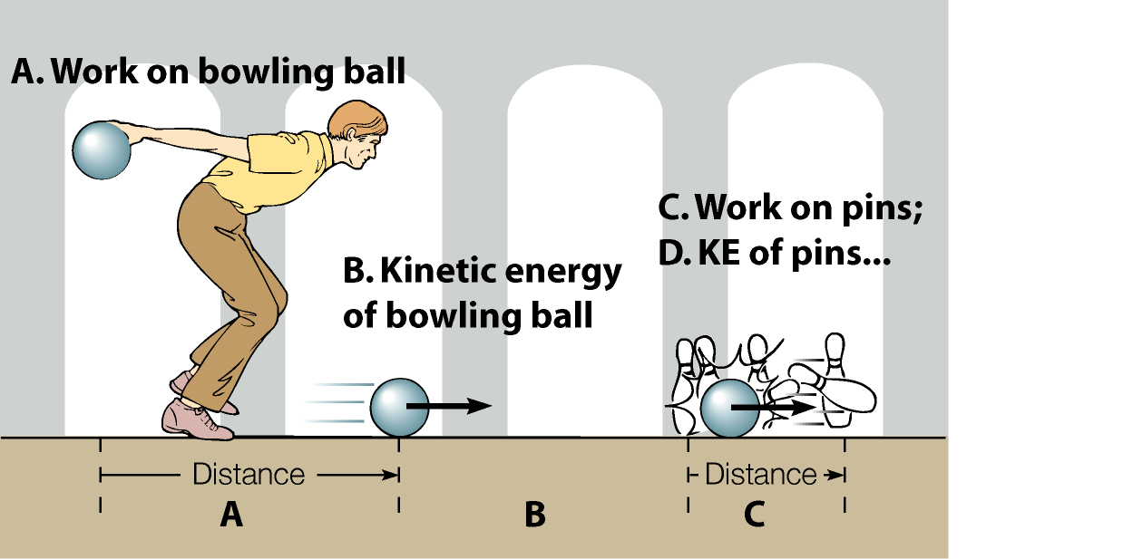
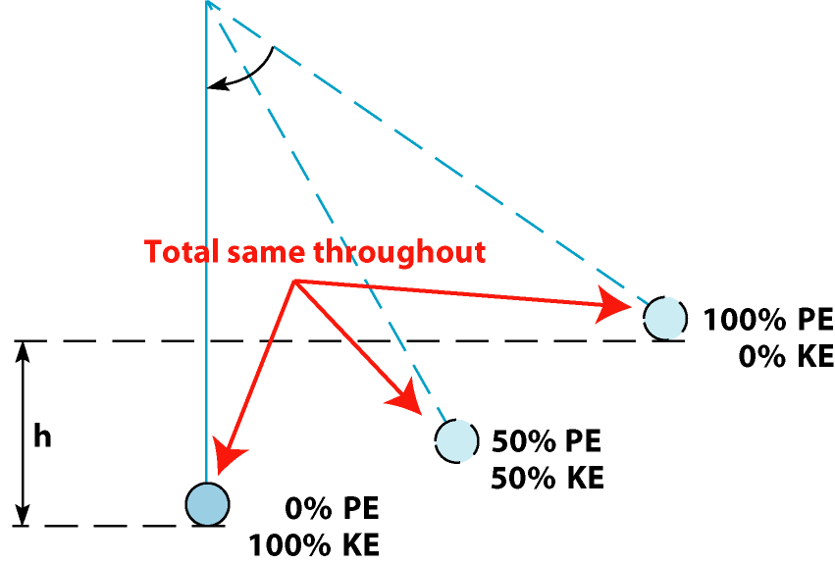
Energy conversion
Any form of energy can be converted into another form
Energy flows from one form to another in natural processes
Example - pendulum

Slide 16
Energy conversion
Any form of energy can be converted into another form
Energy flows from one form to another in natural processes
Example - pendulum

Slide 17
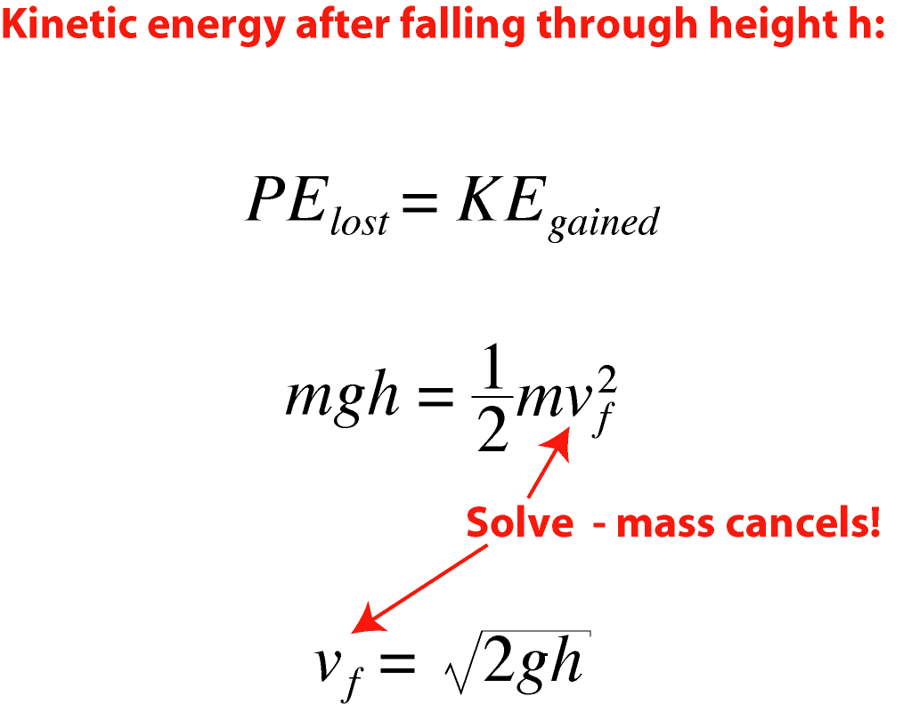
Energy conservation
Energy is never created or destroyed
Energy can be converted from one form to another but the total mechanical energy remains constant.
Example: free-fall
Energy transfer mechanisms: work and/or heat

Slide 18
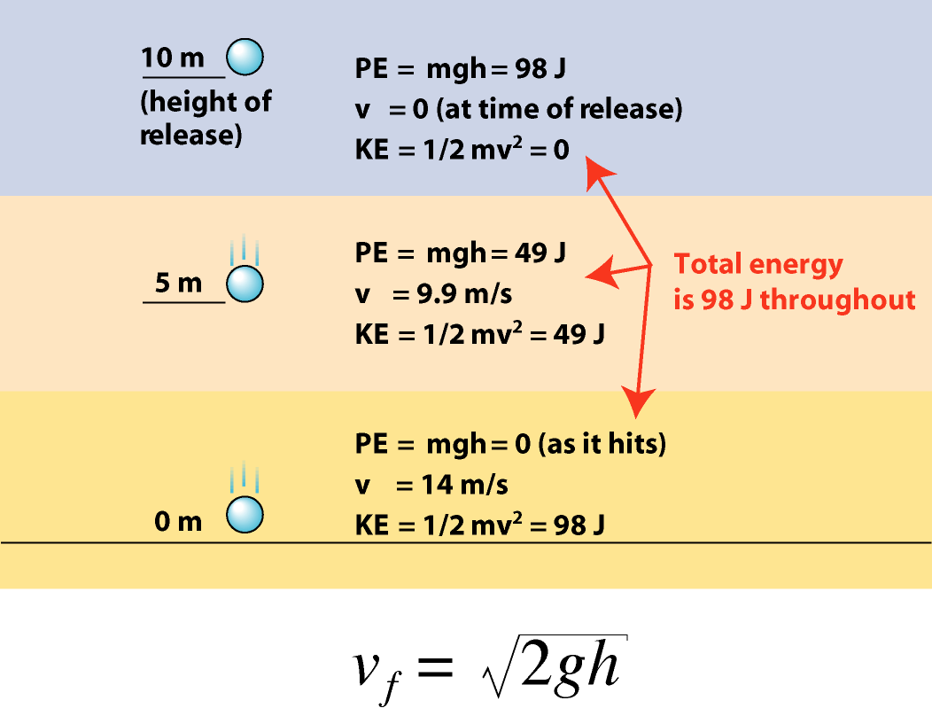
Energy conservation

Slide 19
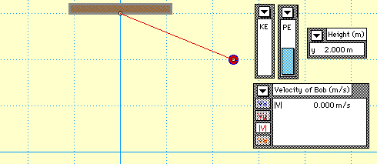
Conservation of Energy

Slide 20
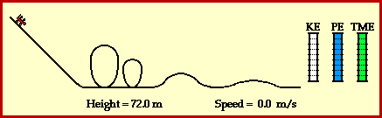
Conservation of Energy

Slide 21
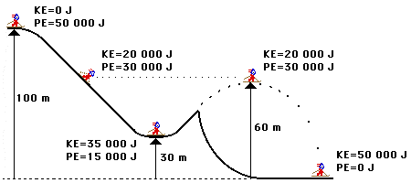
Conservation of Energy

Slide 22
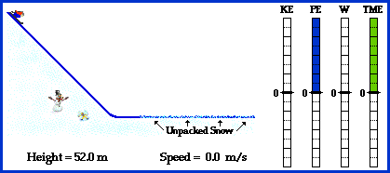
Conservation of Energy

Slide 23
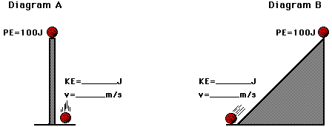
Conservation of Energy

Slide 24
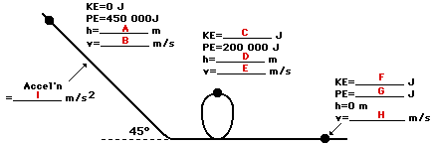
Conservation of Energy
Mass = 1000 kg

