Slide 1
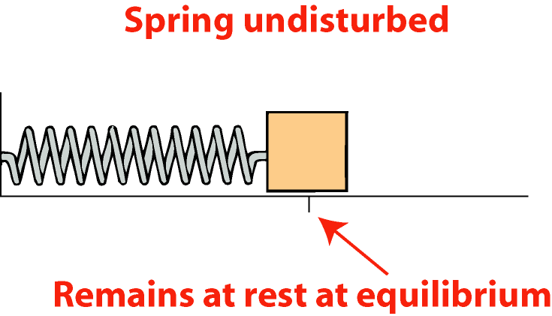
Forces and vibrations
Vibration - repetitive back and forth motion
Periodic motion - a motion that repeats itself
When disturbed from equilibrium position, restoring force acts toward equilibrium
Carried by momentum past equilibrium to other extreme

Slide 2
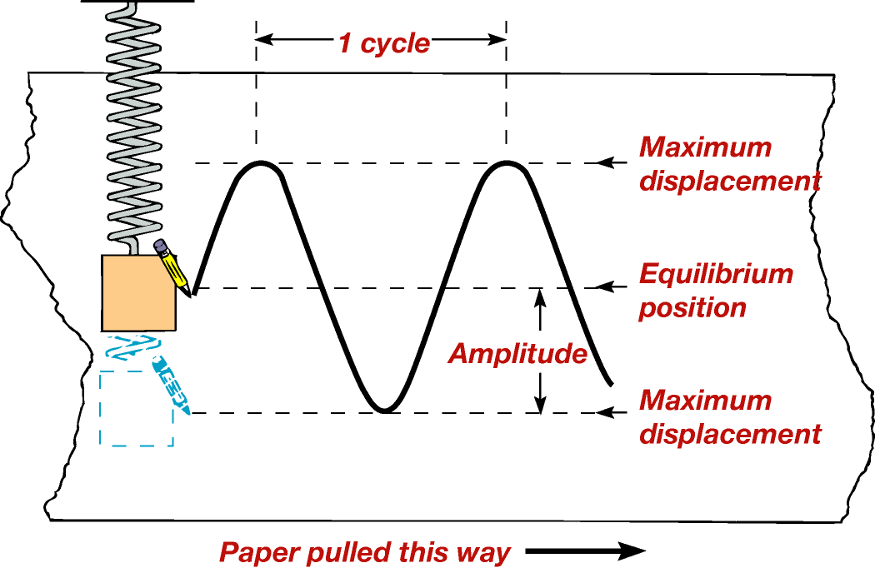
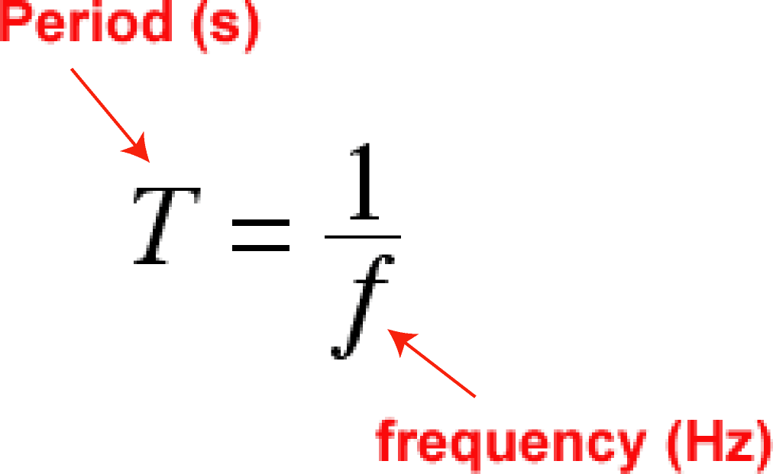
Describing vibrations
Amplitude - maximum extent of displacement from equilibrium
Cycle - one complete vibration
Period - time for one cycle
Frequency - number of cycles per second (units = hertz, Hz)
Period and frequency inversely related
http://id.mind.net/~zona/mstm/physics/waves/partsOfAWave/waveParts.htm

Slide 3
Waves
Periodic disturbances transporting energy
Causes
Period motion disturbing surroundings
Pulse disturbance of short duration
Mechanical waves
Require medium for propagation
Waves move through medium
Medium remains in place

Slide 4
Kinds of waves
Longitudinal waves
Vibration direction parallel to wave propagation direction
Particles in medium move closer together/farther apart
Example: sound waves
Gases and liquids - support only longitudinal waves

Slide 6
Kinds of waves

Slide 7
Kinds of waves, cont.
Transverse waves
Vibration direction perpendicular to wave propagation direction
Example: plucked string
Solids - support both longitudinal and transverse waves
Surface water waves
Combination of both
Particle motion = circular

Slide 9
Kinds of waves, cont.

Slide 10
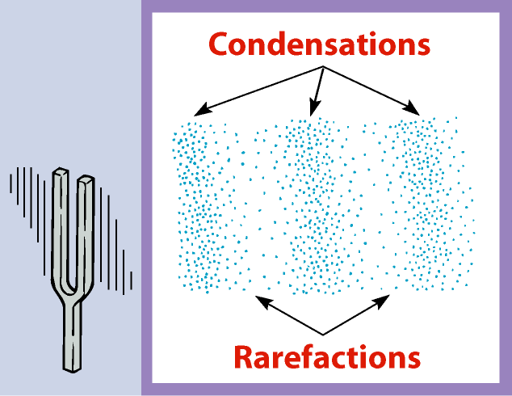
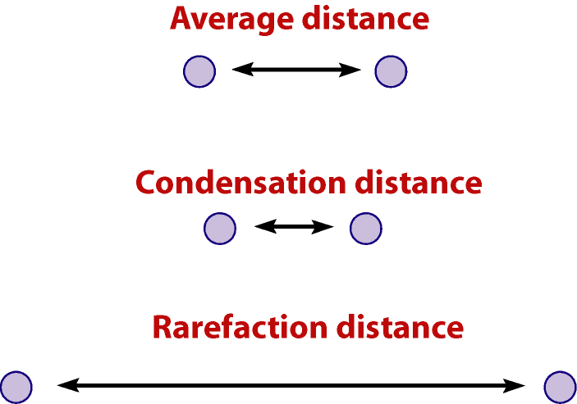
Waves in air
Longitudinal waves only
Large scale - swinging door creates macroscopic currents
Small scale - tuning fork creates sound waves
Series of condensations (overpressures) and rarefactions (underpressures)

Slide 11
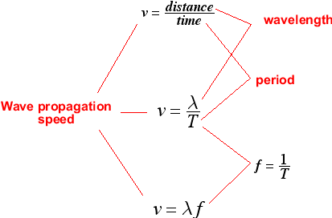
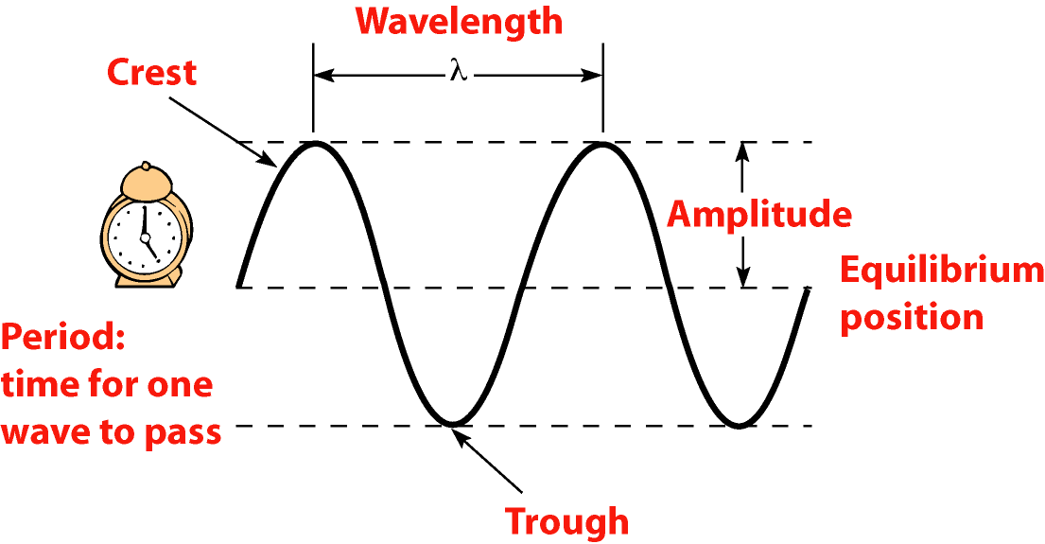
Describing waves
Graphical representation
Pure harmonic waves = sines or cosines
Wave terminology
Wavelength
Amplitude
Frequency
Period
Wave propagation speed

Slide 12
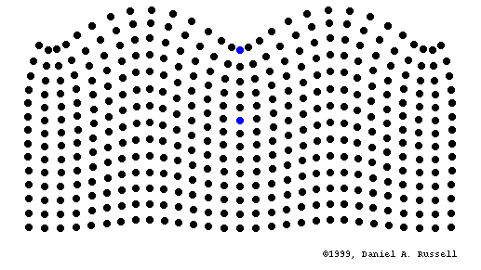
Surface: http://www.kettering.edu/~drussell/Demos/waves/wavemotion.html
Back

Slide 13
Refraction and reflection
Boundary effects
Reflection - wave bounces off boundary
Refraction - direction of wave front changes
Absorption - wave energy dissipated high frequencies dissipate easier than low frequencies
Types of boundaries
Between different materials
Between regions of the same material under different conditions (temperature, pressure)

Slide 14
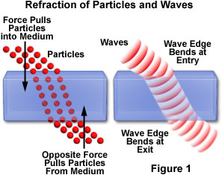
Refraction
Bending of wave fronts upon encountering a boundary
Between two different media
Between different physical circumstances in the same medium
Example - temperature gradient in air

Slide 15
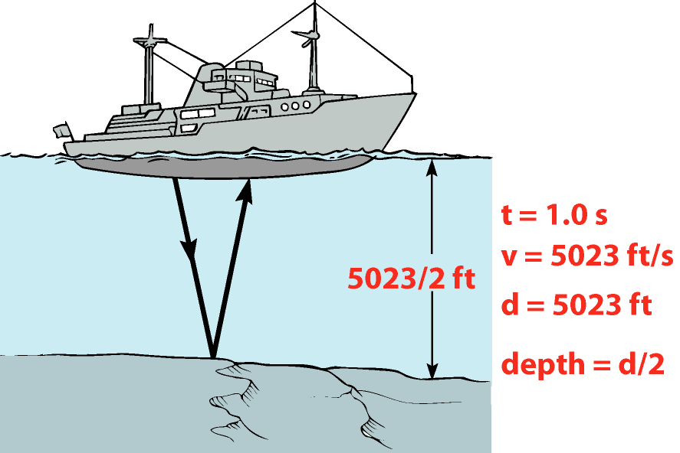
Reflection
Wave rebounding off boundary surface
Reverberation - sound enhancement from mixing of original and reflected sound waves
Echo
Can be distinguished by human ear if time delay between original and reflected sound is greater then 0.1 s
Used in sonar and ultrasonic imaging

Slide 16
Interference
Two or more waves combine
Constructive interference
Peaks aligned with peaks; troughs aligned with troughs
Total amplitude is increased
peak = crest dip = trough

Slide 17
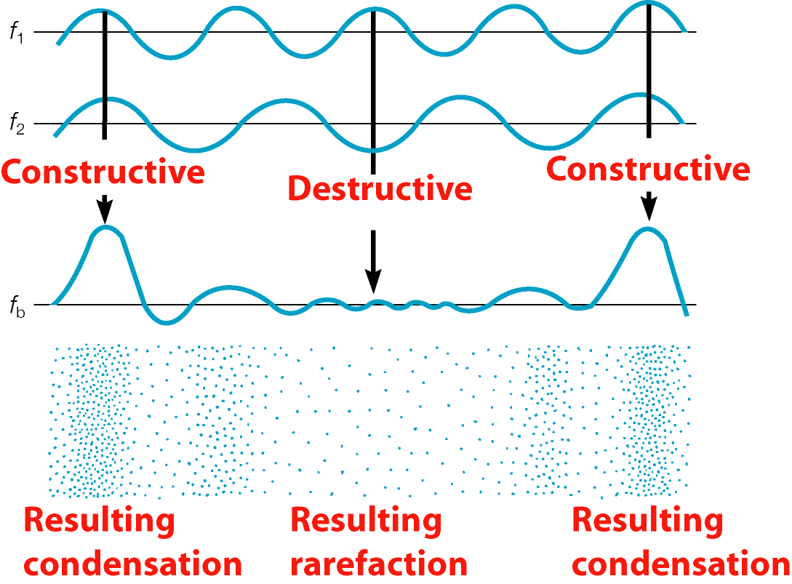
Interference, cont.
Destructive interference
Peaks aligned with troughs
Cancellation leads to diminished wave

Slide 18
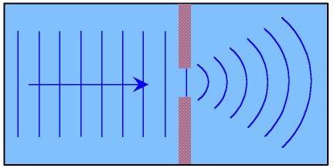
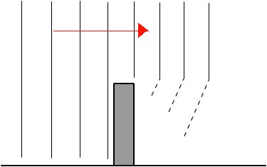
Diffraction
This is another process in which we see waves change direction.
When waves pass through a narrow opening they will spread out as they go through the other side.
Diffraction can also be seen when waves are impeded by an object.
The waves will bend around the object into the shadow.

Slide 19
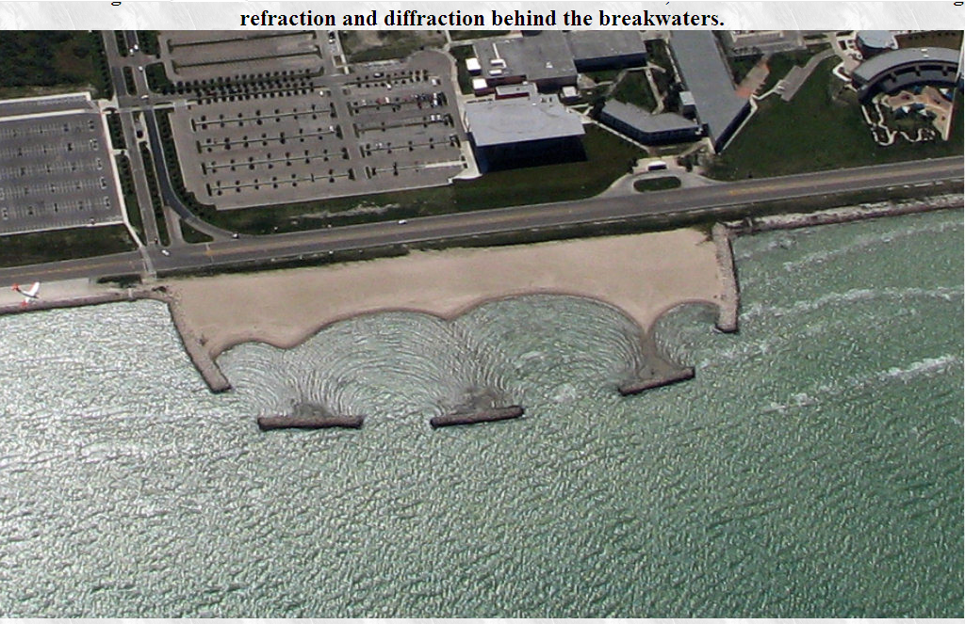

Slide 20
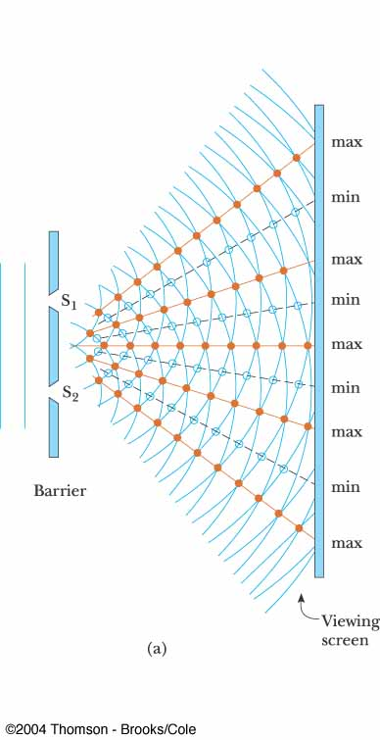
Diffractions and Interference
When waves pass through two adjacent narrow splits the spreading waves will overlap as they come through the other side
Where the crests or troughs meet there will be constructive interference.
Where a crest and trough meets there will be destructive interference.

Slide 21
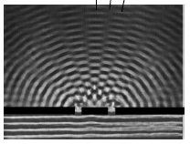

Slide 22
Sound waves
Require medium for transmission
Speed varies with
Inertia of molecules
Interaction strength
Temperature
Various speeds of sound
Medium | m/s | ft/s
Air (0°C) | 331 | 1087
Hydrogen (0°C) | 1284 | 4213
Water (25°C) | 1497 | 4911
Lead | 1960 | 6430
Steel | 5940 | 19488

Slide 23
Waves in air and hearing
Range of human hearing: 20-20,000 Hz
Infrasonic
Below 20 Hz
When you feel the sound in your chest
Ultrasonic
Above 20,000 Hz
Dogs, cats, rats & bats
Used in imaging

Slide 24
Velocity of sound in air
Increases with increase in temperature
Increases with increase in humidity
Faster in solid and liquids
Greater kinetic energy -> sound impulse transmitted faster
Increase factor (units!): 0.6 m/s/°C; 2.0 ft/s/°C
Why??

Slide 25
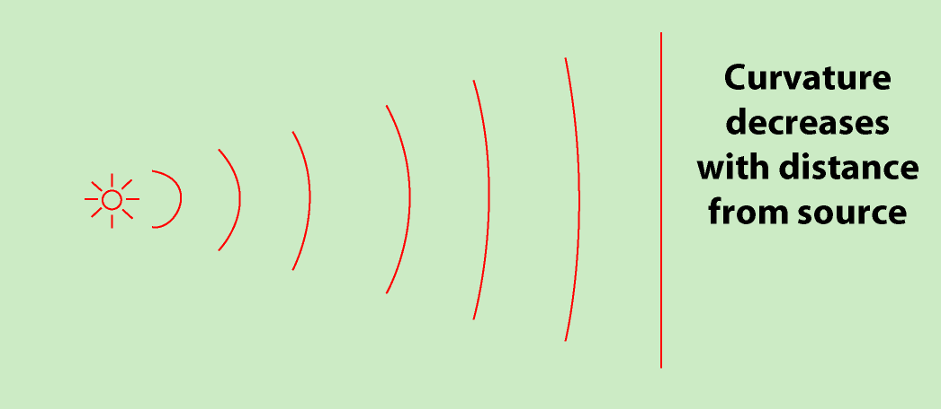
Visualization of waves
Sound = spherical wave moving out from source
Each crest = wave front
Wave motion traced with wave fronts
Far from source, wave front becomes planar

Slide 26
Energy of waves
Intensity
Proportional to amplitude of sound wave, squared
Subjective perception related to
Energy of vibrating object
Atmospheric conditions
Distance from source
Intensity range of human hearing (decreases with age!)

Slide 27
Decibel scale
Better reflects relationship between perceived loudness and intensity
Example | Decibels | Intensity (W/m²)
Threshold | 0 | 1×10⁻¹²
Calm day | 10 | 1×10⁻¹¹
whisper | 20 | 1×10⁻¹⁰
Library | 40 | 1×10⁻⁸
Talking | 65 | 3×10⁻⁶
Heavy traffic | 70 | 1×10⁻⁵
Pneumatic drill | 95 | 3×10⁻³
Jet aircraft | 120 | 1

Slide 28
Sources of sound
Vibrating objects are the source of all sounds
Irregular, chaotic vibrations produce noise
Regular, controlled vibration can produce music
All sound is a combination of pure frequencies

Slide 29
Sounds from moving sources
sharp change of pressure in a narrow region traveling through a medium, especially air, caused by explosion or by a body moving faster than sound.
sonic boom is the sound associated with the shock waves
Doppler effect – Apparent shift in observed frequency due to the motion of the source, the observer, or both
Approaching - shifted to higher frequency
Receding - shifted to lower frequency
Supersonic speed - shock wave and sonic boom produced

Slide 30
Sounds from moving sources

Slide 31
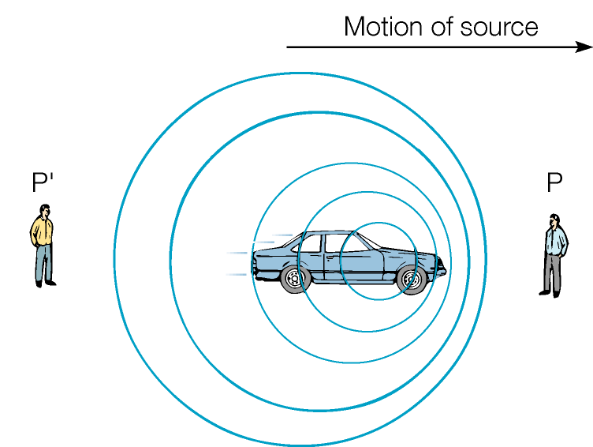
Sounds from moving sources

Slide 32
Light
http://www.youtube.com/watch?v=cfXzwh3KadE

Slide 34
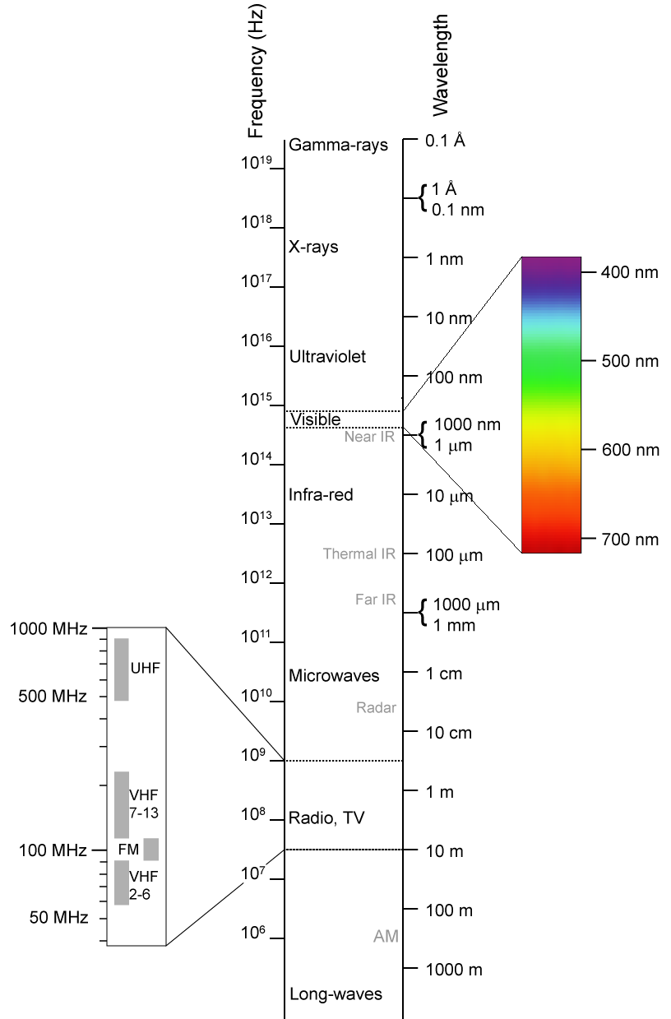

Slide 35
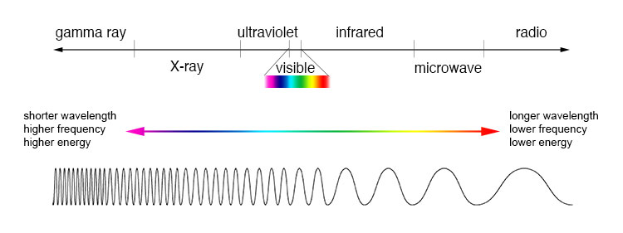

Slide 36
Sources of light
Matter constantly emits and absorbs radiation
Emission mechanism
Accelerated, oscillating charges produce electromagnetic waves
Absorption mechanism
Oscillating electromagnetic waves accelerate charges within matter
Different accelerations lead to different frequencies
Luminous
Producing light
The Sun versus the nonluminous Moon
Incandescent
Glowing with visible light from high temperatures
Examples: flames, incandescent light bulbs

Slide 37
Blackbody radiation
Blackbody
Ideal absorber/emitter of light
Radiation originates from oscillation of near-surface charges
Increasing temperature
Amount of radiation increases
Peak in emission spectrum moves to higher frequency
Spectrum of the Sun

Slide 38
Light interacts with matter
Interaction begins at surface and depends on
Smoothness of surface
Nature of the material
Angle of incidence
Possible interactions
Absorption and transmission
Reflection
Refraction

Slide 39
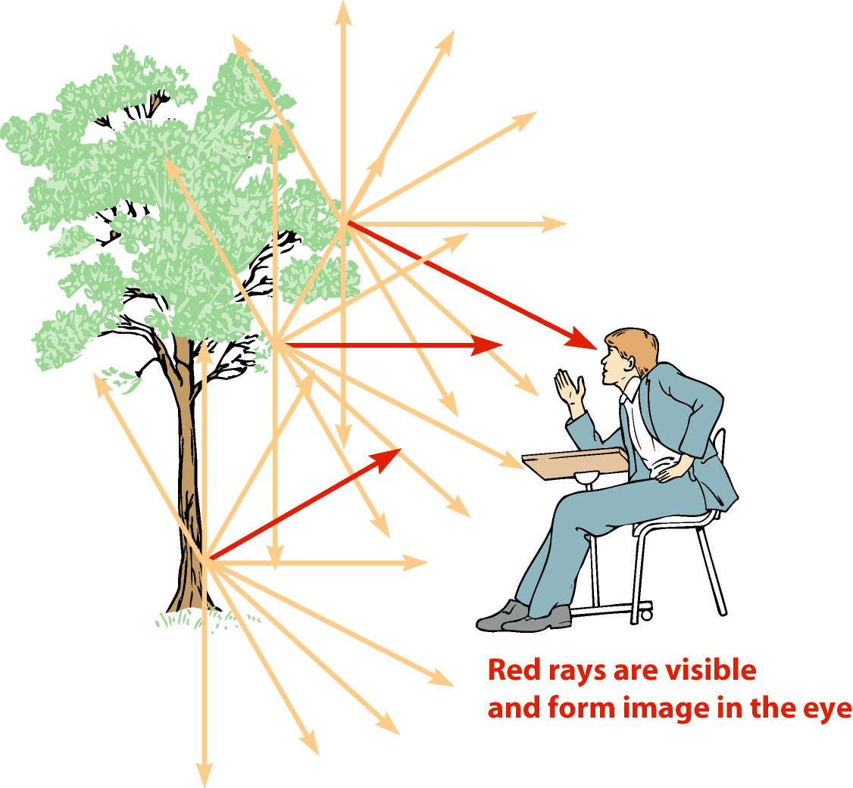
Diffuse reflection
Most common visibility mechanism
Each point reflects light in all directions
Bundles of light from object are seen by the eye
Colors result from selective wavelength reflection/absorption

Slide 40
Reflection details
Angles measured with respect to the “surface normal”
Line perpendicular to the surface
Law of reflection
θ₁ = θ₂

Slide 41
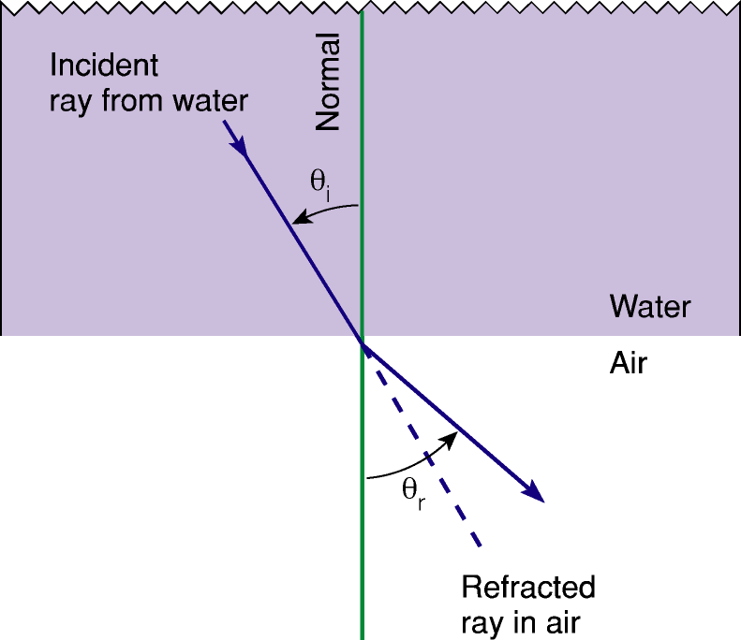
Refraction
Light crossing a boundary surface and changing direction
Reason: change in light propagation speed
Moving to a medium with a slower propagation speed
Light bends toward surface normal
Moving to a medium with a faster propagation speed
Light bends away from the normal

Slide 42
Refraction

Slide 43
Refraction

Slide 44
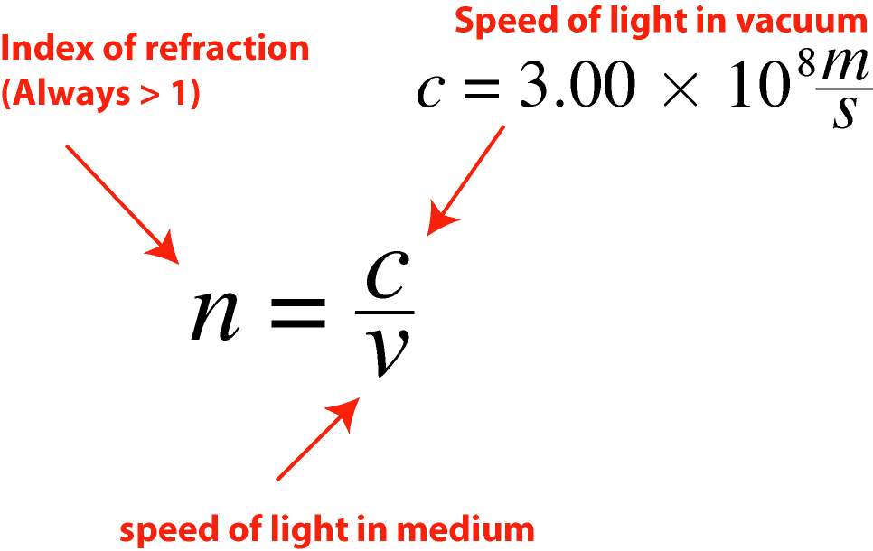
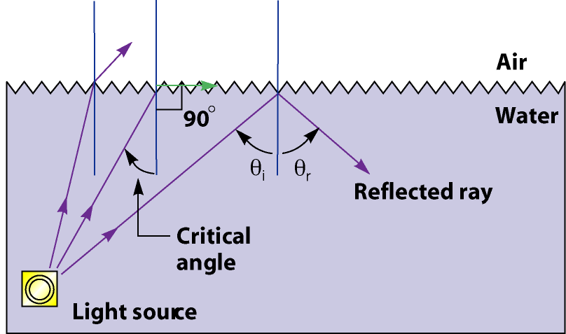
Refraction, cont.
Mirages
Critical angle
Light refracted parallel to surface
No light passes through surface - “total internal reflection”
Applications - fiber optics, gemstone brilliance
Index of refraction
A measure of light speed

Slide 45
Refraction cont…
Substance | Index of refraction | Light speed
Air | Approx. 1 | ~c
Water | 1.333 | 0.75c
Glass | 1.5 | 0.67c
Diamond | 2.4 | 0.42c
BE condensate | 18,000,000 | 38 mph!

Slide 46
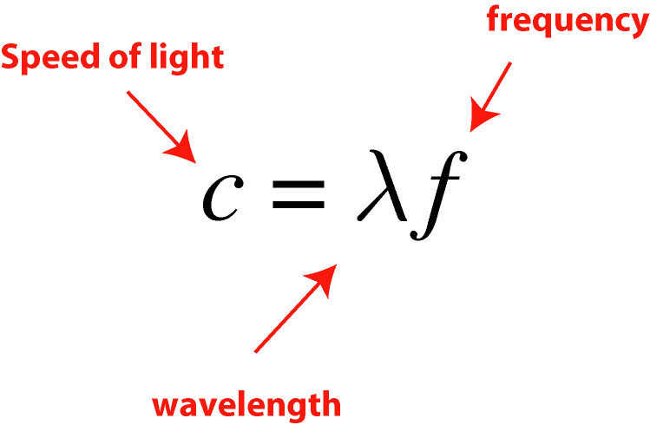
Dispersion and colors
White light
Mixture of colors in sunlight
Separated with a prism
Dispersion
Index of refraction varies with wavelength
Different wavelengths refract at different angles
Violet refracted most (blue sky)
Red refracted least (red sunsets)
Example: rainbows
Wavelength/frequency related

