Slide 1
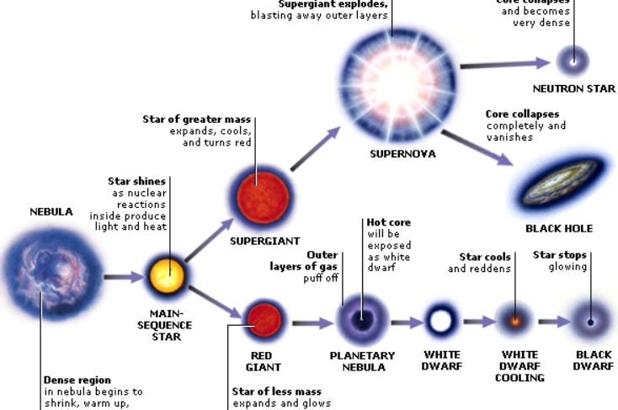
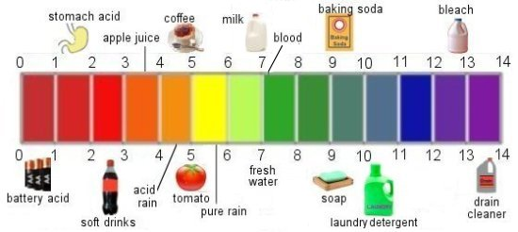
Unit 14 – Stars and Solutions
(our last unit together!!!! ☹)
How do scientists use graphs to study patterns of the stars and solutions?
How can we use quantitative correlations to draw conclusions about stars/solutions and make predictions about chemical behavior?
What practical application do acids, bases, and concentration have in the lab?

Slide 2
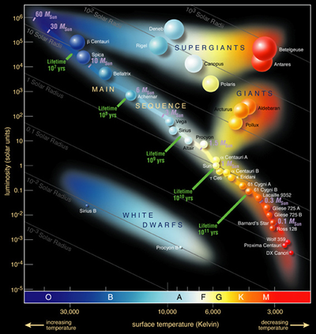

Slide 3
A ____________ is a homogenous mixture of 2 or more substances
solution
solute
The ___________ is(are) the substance(s) present in the smaller amount(s)
The _____________ is the substance present in the larger amount
solvent
Solution
Solvent
Solute
Soft drink (l)
H₂O
Sugar, CO₂
Air (g)
N₂
O₂, Ar, CH₄
Soft Solder (s)
Pb
Sn
4.1

Slide 4
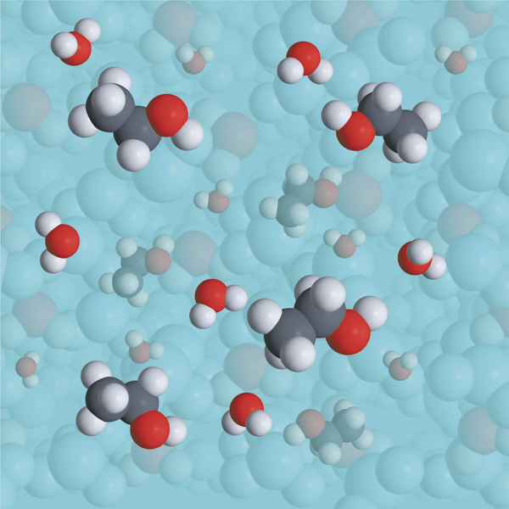
Solutions
Solvent
solute
When the solvent is water the solution is said to be aqueous

Slide 5
Concentration of Solutions
What does it mean to be “concentrated” or “dilute”?
Molarity
_____________ (M), or molar concentration, is defined as the number of moles of solute per liter of solution.
Other common
rearrangements:

Slide 6
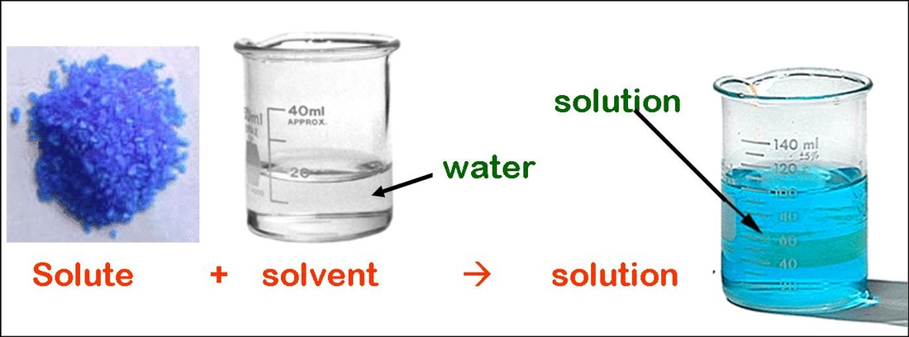
For an aqueous solution of sodium chloride, determine the molarity of 2.00 L of a solution that contains 50.0 g of sodium chloride.
1) Convert to appropriate units.
50.0g NaCl
1 mol NaCl
58.5g NaCl
= 0.855 mol NaCl
2) Solve for unknown.
0.855 mol NaCl
= 0.427 M NaCl
2.00 L
3) Apply significant figures.

Slide 7
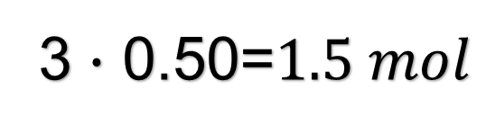
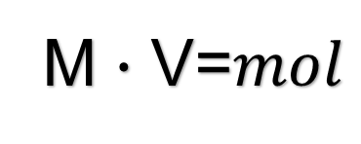
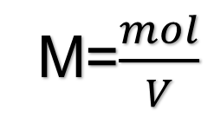
What mass is needed to prepare a 3M solution of CuSO₄ if you require 0.50 L for a lab?
1) Convert to appropriate units.
2) Solve for unknown.
M=$\frac{mol}{V}$
M $∙$ V=$mol$
3 $∙$ 0.50=$1.5 mol$
1.5molCuSO₄
159.61g CuSO₄
= 239 g CuSO₄
1molCuSO₄
3) Apply significant figures.
= 200 g CuSO₄

Slide 8
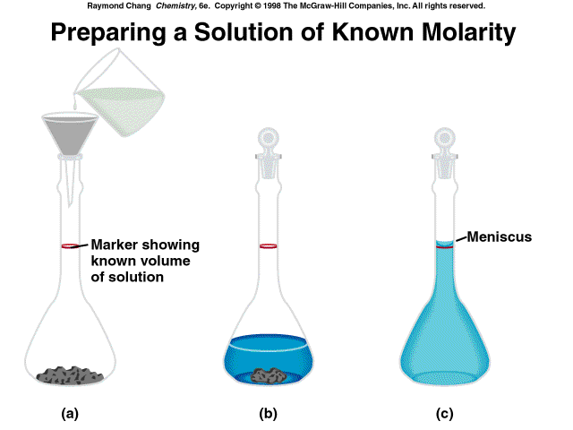
4.5

Slide 9
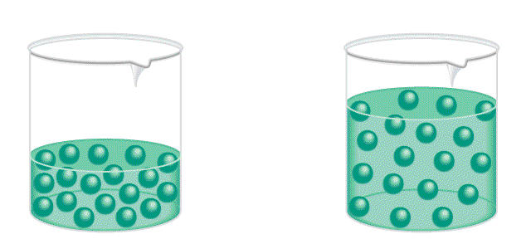
How can we “dilute” something?is the procedure for preparing a less concentrated solution from a more concentrated solution.
Dilution
Add Solvent
[HCl] = 3
[HCl] = 1
Moles of solute
before dilution (i)
=
Moles of solute
after dilution (f)
Some notations to know:
  [brackets] = molarity, or concentration
  Stock solution = concentrated, used to dilute
M_{i}V_{i}
=
M_{f}V_{f}
4.5

Slide 10
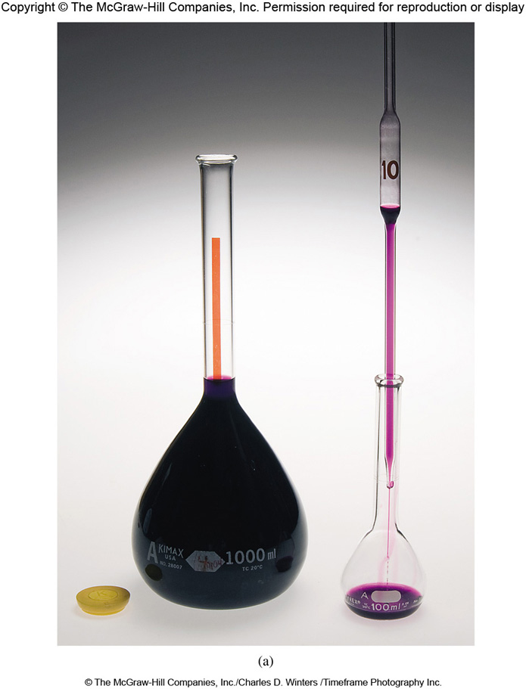
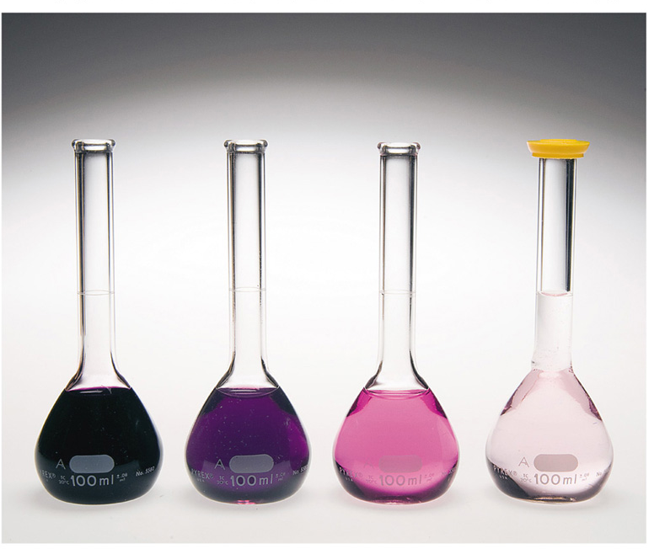
Concentration of Solutions
Dilution
_______________ is the process of preparing a less concentrated solution from a more concentrated one.

Slide 11
How would you prepare 0.06 L of 0.2 M
HNO₃ from a stock solution of 4.00 M HNO₃?
M_{i}V_{i} = M_{f}V_{f}
M_{i} = 4.00
M_{f} = 0.2
V_{f} = 0.06 L
V_{i} = ? L
M_{f}V_{f}
0.200 x 0.06
V_{i} =
=
= 0.003 L = 3 mL
M_{i}
4.00
3 mL of acid
+ 57 mL of water
= 60 mL of solution
Because most volumes measured in the laboratory are in milliliters rather than liters, it is worth pointing out that the equation can use any unit of volume, as long as they are consistent

Slide 12
Acids → typically “donate” hydrogens; contain hydrogen (usually written first in the formula)
Bases → typically “accept” hydrogens; typically contain hydroxide (usually written last in the formula)
HCl
H2SO4
NaOH
HF
Ca(OH)2
acid
acid
base
acid
base

Slide 13
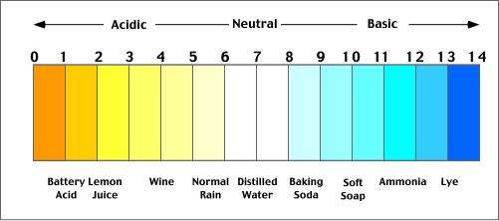
pH is a concept used to measure _____________.
acidity

Slide 14
pH = -log[H⁺]
So for example if a solution has 0.1 M of H⁺, what is its pH?
pH = -log [ 0.1 ] = 1.00
VERY ACIDIC

Slide 15
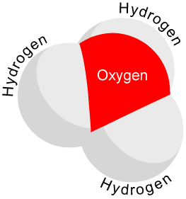
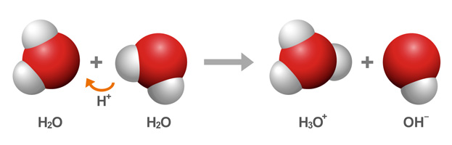
In water/aqueous solutions, hydrogen ions (H⁺) bond to water molecules to create…
Hydronium ions = H3O⁺
Auto-ionization of water
_______________________→ process by which water molecules are constantly forming hydronium and hydroxide ions

Slide 16
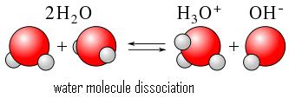
Water has ions… so how is it neutral?
This is in ______________… what does that mean?
It’s going “back and forth” constantly, but keeping a “balance”
equilibrium
Water is neutral because the amounts [concentrations] of OH⁻ (hydroxide) and hydronium (H3O⁺) are equal
[H3O⁺] and [OH⁻] in neutral water are THE SAME

Slide 17
Find the pH of the following scenarios and describe whether they are acidic or basic:
  [H3O+] = .045 M
  [H3O+] = .000015 M
  [H3O+] = .0000000042 M
1. –log[.045]=
1.3
2. –log[.000015]=
4.8
3. –log[.0000000042]=
8.4

Slide 18
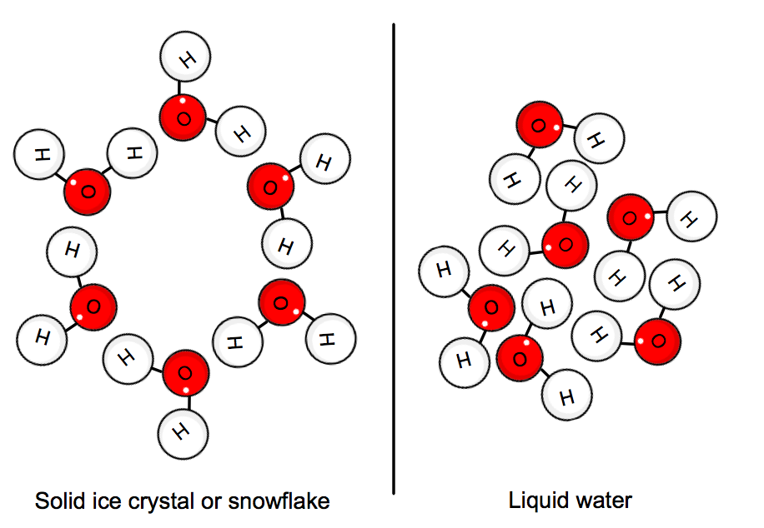
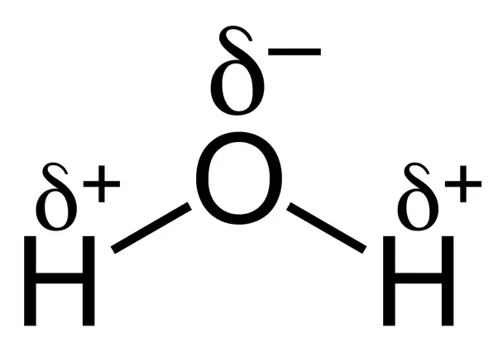
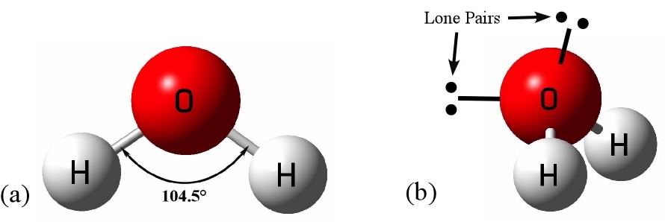
Properties of water
less
Solid phase ______ dense than liquid
High __________ heat
  Heat retention
High latent heat of _______________
  Evaporative cooling
  Sweating
“______________ solvent”
  Dissolves most molecules
All result from water’s chemical structure
specific
vaporization
Universal

Slide 19
Solutions - further details…
Limits of solubility
  ____________ solutions – no more solute can be dissolved
  Insoluble substances, no noticeable dissolving
Simple rule: “Like dissolves _______”
  _______ substances dissolve each other
  Polar substances can be dissolved by polar solvents
  Nonpolar substances are dissolved by __________ solvents.
Fluids: gases and liquids
  ____________ fluids
    Can mix in any proportions w/o separating
  Immiscible fluids do not _______
Saturated
like
Similar
nonpolar
Miscible
mix

Slide 20
Liquid solvents and solids
“Like dissolves like”
Oil and grease are not __________ in water; but the salt is. Why?
  Attraction between the ions of the salt crystal and the polar ends of the water molecules.
Soap - provides both polar and nonpolar environments
soluble

Slide 21
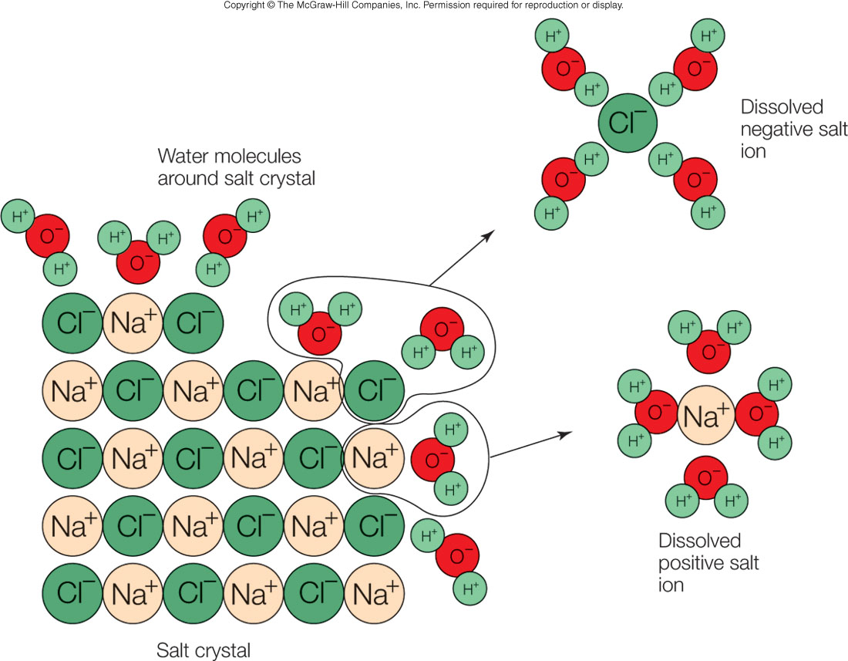

Slide 22
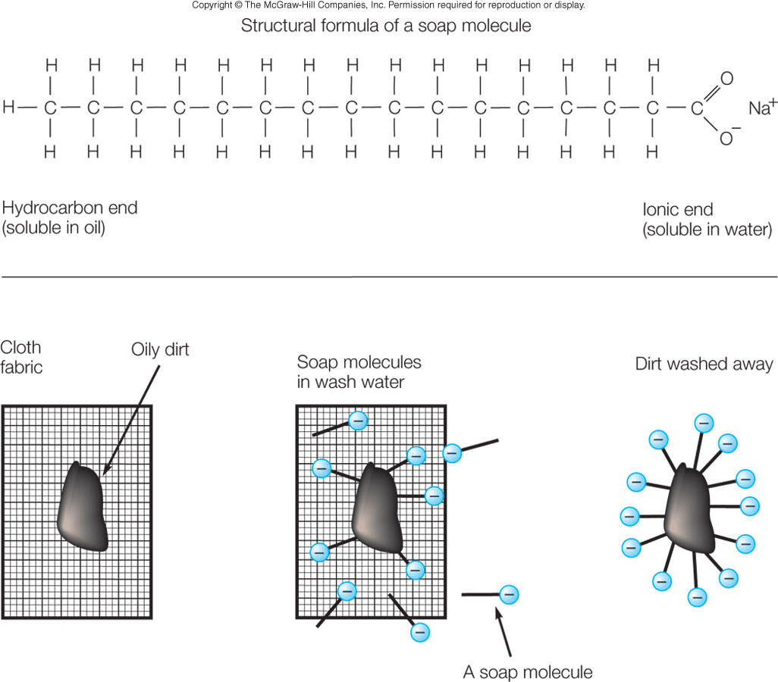

Slide 23
Solubility
Saturation
  Solute dissolving _______
  ______________ between going in and out of solution
Solubility
  ____________________ of saturated solution
  Depends on __________________
  Gases: ____________ with temperature; ___________with pressure
limit
Equilibrium
Concentration
temperature
decreases
increases

Slide 24
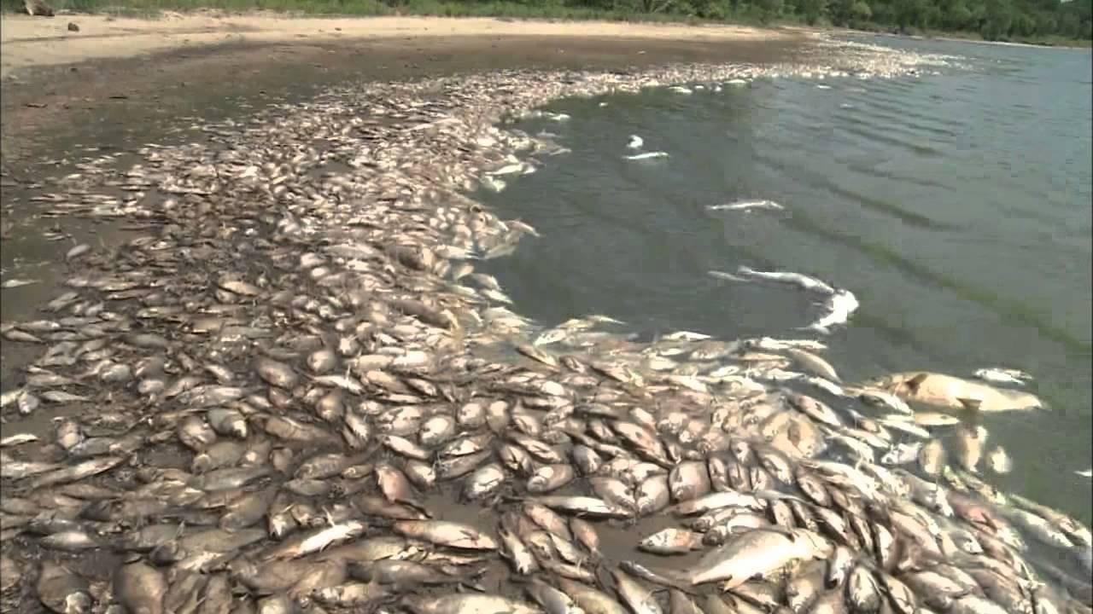
“Fishkill”

Slide 25
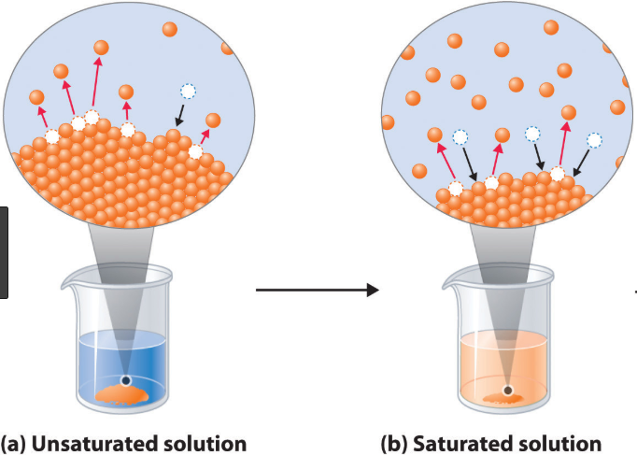

Slide 26
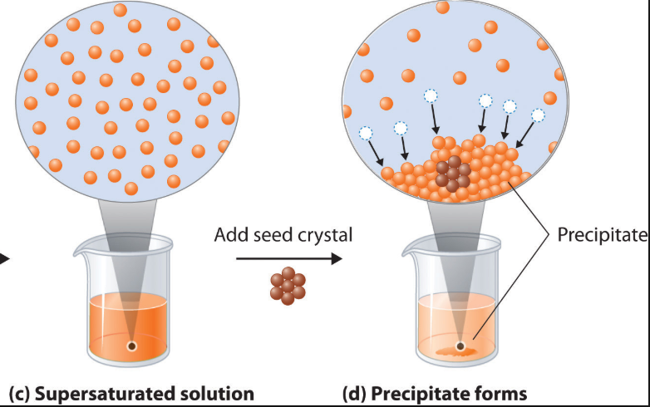

Slide 27
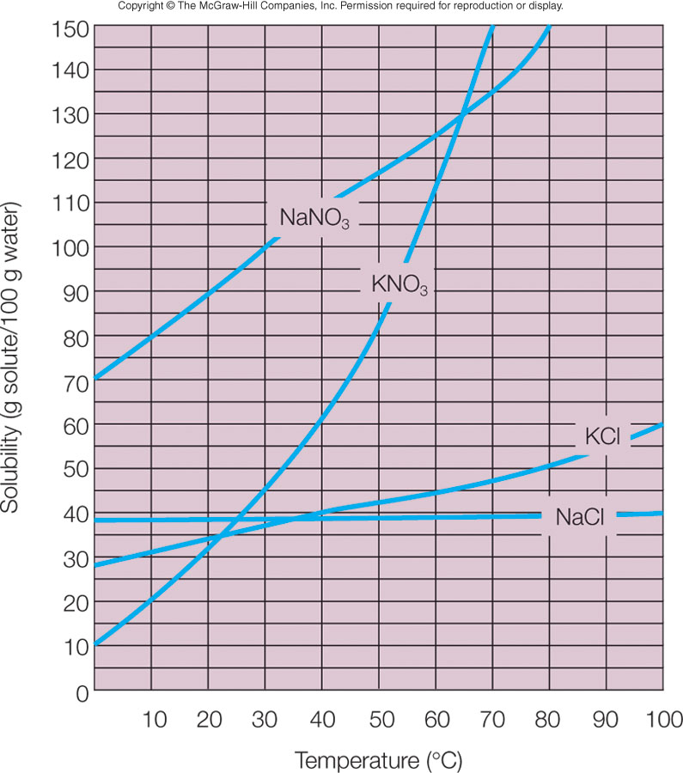

Slide 28
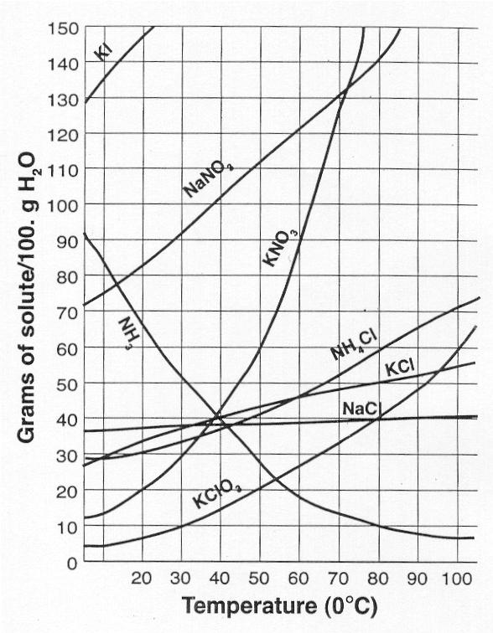
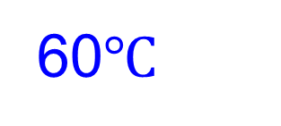
Solubility Curve
Which salt shows the greatest increase in solubility from 0-60ºC? _______
At 50ºC, 70 g of KNO₃ is dissolved in 100 g of water. Is the solution saturated, unsaturated or supersaturated? ___________________
Which salt is least soluble in water at 60ºC? ___________________
Which is the most soluble salt at 20ºC? ___________________
What is the solubility of KCl at 80ºC? ___________________
What it the temperature at which KNO₃ has a solubility of 90g/100g of water? ________________
KNO₃
KI
60$℃$

Slide 29
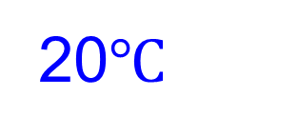
Solubility Curve
Which salt is most soluble in water at 60ºC? ___________________
Which salt shows the least increase in solubility from 0-60ºC? _______
At 50ºC, 40 g of KCl is dissolved in 100 g of water. Is the solution saturated, unsaturated or supersaturated? ___________________
Which is the least soluble salt at 20ºC? ___________________
What is the solubility of KCl at 20ºC? ___________________
What it the temperature at which KNO₃ has a solubility of 20g/100g of water? ________________
NaCl
KClO₃
20$℃$

