Slide 1
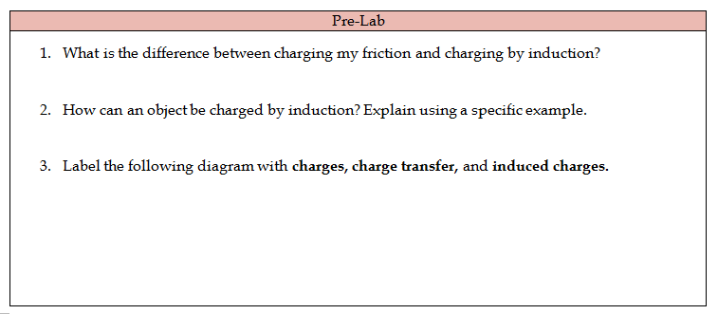
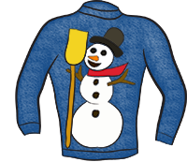
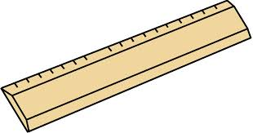
by
Contact not required, no transfer, realignment of charge/electrons in material
By contact, and transfers electrons
Eg. The paper scraps; a negative object near a neutral object, electrons push away, positive end attracted to negative object
Charge transfer
Induced charges
attraction
repulsion

Slide 2
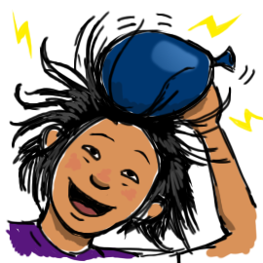
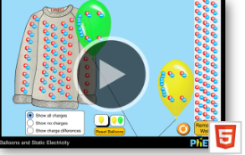
Work your Quarter 2 lab groups
Complete exit ticket and turn into tray before you leave!!! ☺

