Slide 1
Scientific Notation
Scientific notation takes the form: M x 10^{n}
M is a number between ___________
n represents the factor of 10 you are multiplying by
A positive n indicates _______________________
A negative n indicates that the number is a _________________________________________

Slide 2
Converting to Scientific Notation
If there is no decimal shown, it is located after the last 0 at the right side of the number.
If you move the decimal to the _______ the exponent is _________ and if you move the decimal to the _________ the exponent is ________________
Example 1: 750000000 =
Example 2: 0.00000354 =

Slide 3
Examples
Convert the following to scientific notation
869000000 =
50500 =
0.00907 =
0.576 =
Convert the following to standard notation
8.23 x 10³ =
7.12 x 10⁻⁶ =
3.67 x 10⁸ =
2.003 x 10⁻² =

Slide 4
Significant Figures
Different measuring instruments are able to make measurements with a large number of decimal places.
For example a bathroom scale can only measure to maybe the half lb, while a digital scale can measure to the 1/100 lb (.01 lb).
Precision is the degree of exactness of a measurement, how many decimal places an instrument can measure.
For example if I have two tape measures one is marked every 0.1 m and the other is marked every 0.001 m. Which tape measure is more precise?

Slide 5
Precision
Measured quantities are always reported in a way that shows the precision of the measurement.
_______________________________________________________________________________________________________________

Slide 6
Accuracy
Accuracy is the extent at which a __________________________________________________________________________

Slide 7
Comparing Precision and Accuracy
Good accuracy and good precision
Good accuracy and poor precision
Poor accuracy and good precision
Poor accuracy and poor precision

Slide 8
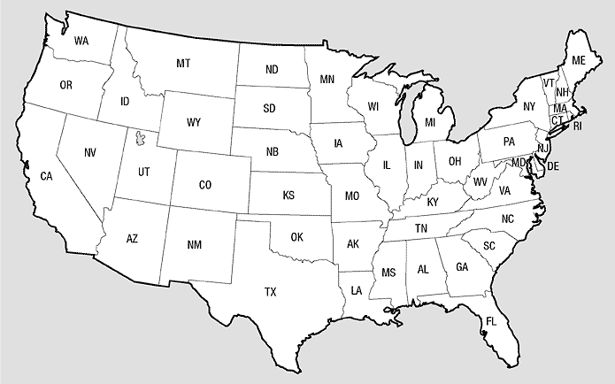
Significant Figures
Pacific Side
Decimal is present
Atlantic Side
Decimal is absent
If the decimal is present start from the left side and start counting digits when you see a number from 1-9.
If the decimal is absent start form the right side and start counting digits when you see a number from 1-9.
Example 1: 0.000030050 =
Example 2: 20500000 =

Slide 9
Examples
Write the number of significant figures.
2005000 =
3.040 x 10⁴ =
0.0004005 =
0.1 x 10⁻⁹ =

Slide 10
Calculations Using Significant Figures
When multiplying or dividing, round to the ______________________________________in any of the factors.
Example: 23.0cm x 432 cm x 19cm = __________
When adding or subtracting, round your answer _________________ with the least number of significant digits in any of the numbers that makes up your answer.
Example: 123.25ml + 46.0ml + 86.257ml = _______________

Slide 11
Examples
Perform the following calculations expressing the answer in the correct number of significant figures.
2.005 m x 1.2 m =
3.5 cm x 2.50 cm x 4.505 cm =
15.50 cm³ ÷ 3.2 cm =
2.004 m/s + 14.3 m/s =
150 ml – 23.5 ml =

