Slide 1
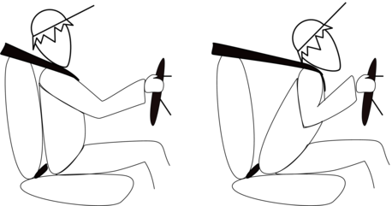
Inertia → property of matter which resists change to motion
Newton’s first law – the Law of Inertia states that an object at rest will stay at rest unless acted on by an outside force. An object in motion will stay in motion unless acted on by an outside force.
https://www.youtube.com/watch?v=8iKhLGK7HGk

Slide 2
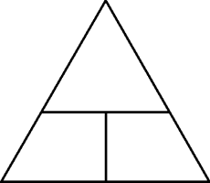
Newton’s second law →
Acceleration is produced when a force acts on a mass. The greater the mass (of the object being accelerated) the greater the amount of force needed (to accelerate the object).
F
m
a
$$F=m∙a$$
What is the acceleration if the force applied on a 5 kg ball is 50 N?
$a= \frac{F}{m}= \frac{50 N}{5 kg}$ =
10 m/s²

Slide 3
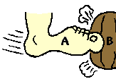
Newton’s third law → For every action there is an equal and opposite reaction.
Forces occur in action-reaction pairs.

Slide 4
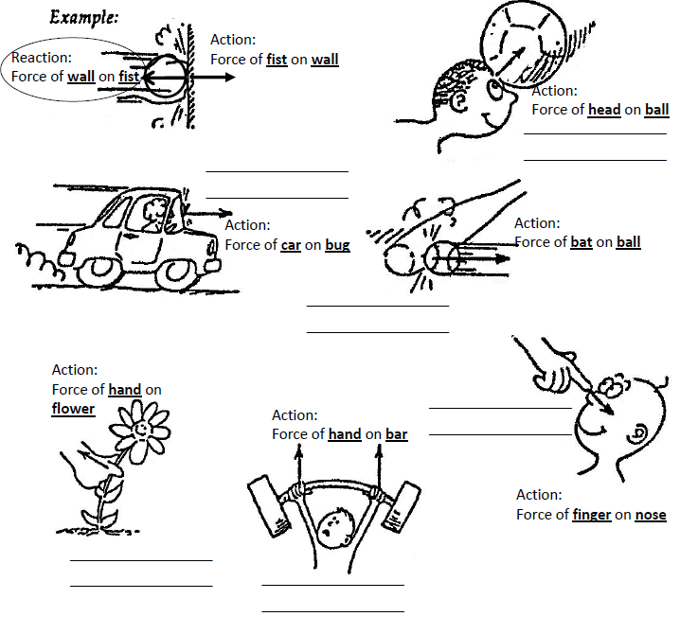

Slide 5
What are free body diagrams?
What are the forces involved?
Normal force
Gravitational force
Applied force
Frictional force
Tension force

Slide 6
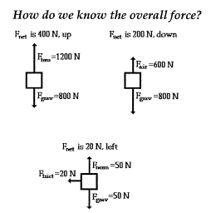

Slide 7
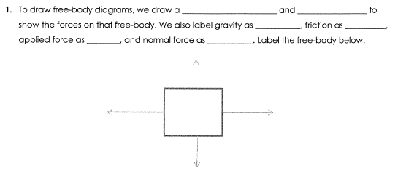
box
arrows
Fg
Ff
Fa
Fn
Fn
Fa
Ff
Fg

Slide 8
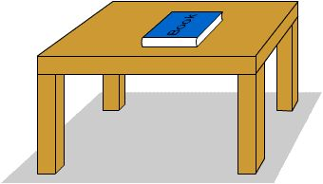
Problem 1
A book is at rest on a table top. Diagram the forces acting on the book.

Slide 9
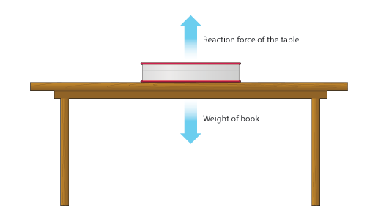
Problem 1
In this diagram, there are normal and gravitational forces on the book.

Slide 10
Problem 2
An egg is free-falling from a nest in a tree. Neglect air resistance. Draw a free-body diagram showing the forces involved.

Slide 11
Gravity is the only force acting on the egg as it falls.

Slide 12
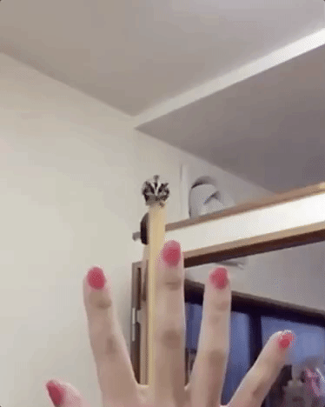
Problem 3
A flying squirrel is gliding (no wing flaps) from a tree to the ground at constant velocity. Consider air resistance. A free body diagram for this situation looks like…

Slide 13
Gravity pulls down on the squirrel while air resistance pushes up on the squirrel while it falls.

Slide 14
Problem 4
A rightward force is applied to a book in order to move it across a desk. Consider frictional forces. Neglect air resistance. Construct a free-body diagram. Let’s see what this one looks like.

Slide 15
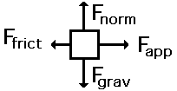
Note the applied force arrow pointing to the right. Notice how friction force points in the opposite direction. Finally, there is still gravity and normal forces involved.

Slide 16
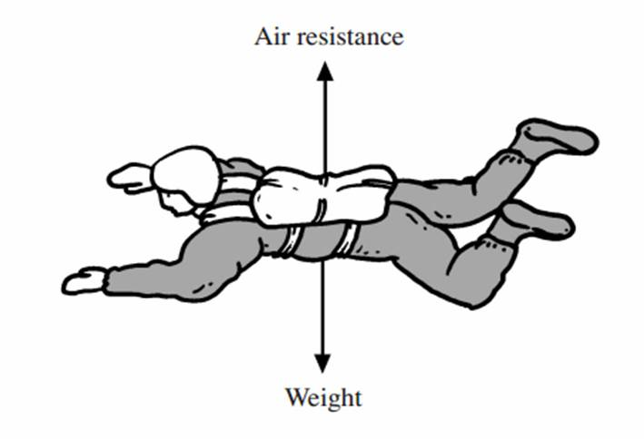
Problem 5
A skydiver is descending with a constant velocity. Consider air resistance. Draw a free-body diagram.

Slide 17
Gravity pulls down on the skydiver, while air resistance pushes up as she falls.

Slide 18
Problem 6
A man drags a sled across loosely packed snow with a rightward acceleration. Draw a free-body diagram.

Slide 19
The rightward force arrow points to the right. Friction slows his progress and pulls in the opposite direction. Normal forces still apply as does gravitational force since we are on planet Earth.

Slide 20
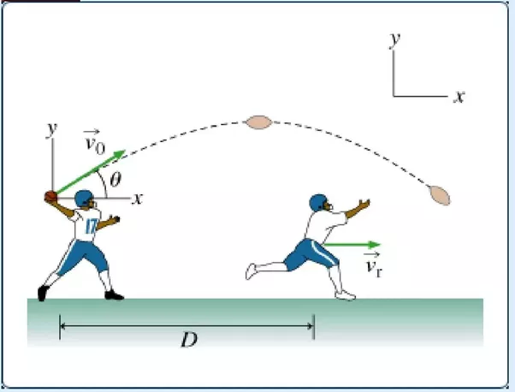
Problem 7
A football is moving upwards toward its peak after having been booted by the punter. Draw a free-body diagram.

Slide 21
The force of gravity is the only force acting on the ball while it is in the air. Once it has left the punter’s foot, he is no longer pushing on the ball.

Slide 22
Problem 8
A car runs out of gas and is coasting along a road.

Slide 23
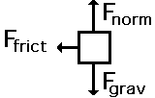
Even though the car is coasting down the road, there is only the friction of the road acting to slow it down, in addition to the gravity and normal forces.

