Slide 1
Unit 2 - Motion
Mathematical relationships provide a deeper understanding of movement of objects in space and time.

Slide 2
How can you tell an object is moving?
What is relative motion?
It is movement in relation to a frame of reference.
- An object must change position with respect to a stationary background called a reference point.

Slide 3
Distance vs. Displacement
Distance is the length of the path between two points
Displacement includes ____________.
How is displacement different from distance?
Distance is how far you move overall, displacement is how far it is from your starting point to your ending point
What is the displacement of a roller coaster after one complete trip around the track?
direction

Slide 4
Speed
What is the difference between average speed and instantaneous speed?
Average speed is the total distance divided by the total time
Instantaneous is the rate at a given moment
What does a police radar gun measure, instantaneous or average velocity?

Slide 5
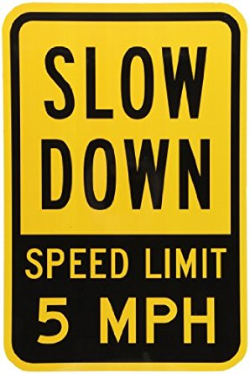
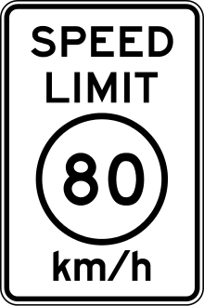
Calculating Speed
What units do you measure speed in?
In general, the units are units of distance divided by units of time, i.e. distance per time
We measure the speed of our cars and list highway speed limits in miles/hour (mph).
However in science, we measure speed using the SI units of meters/second (m/s).
Most other countries have highway speed limits posted in kilometers/hour (km/hr), which is also a metric unit.

Slide 6
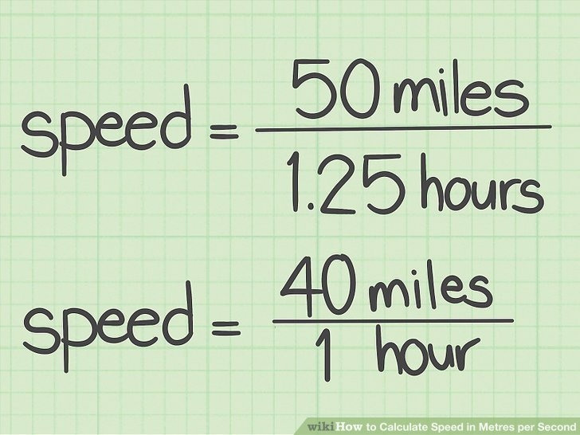
Calculating Speed
Speed =
Distance
Time

Slide 7
Calculating Velocity
Is there a difference between calculating the speed of an object and the velocity of an object?
Usually they are the same, unless the object is not travelling in a straight line or is changing its direction
Average Velocity =
Displacement
Time

Slide 8
Speed vs. Velocity
What’s the difference between speed and velocity?
Speed is how fast an object is moving
Velocity also must include the direction that the object is travelling
Velocity is the speed of an object in a given direction
Speed is the number, or magnitude, for velocity

Slide 10
Example Problem
A car traveled 350 miles toward New York City for 5 hours. What was the velocity of the car in mph?

Slide 11
Example Problem
A car traveled 35 miles/hour for 4 hours toward Chicago. How far did the car travel in miles?

Slide 12
Example Problem
A plane travels 3080 kilometers toward Colorado at a velocity of 550 km/hour. How much time has the plane been traveling in hours?

Slide 13
Work on the speed, velocity, and displacement problems on your own or with 1 other person!

Slide 14
Acceleration
What happens to you when you slam on the brakes in a car?
What happens if you speed up very fast like on the top-thrill dragster at Cedar Point?
Acceleration is defined as a change in ___________ divided by the _________ ___________ for the change to happen.
velocity
time
interval

Slide 15
Calculating Acceleration
Change in velocity
Acceleration =
Time interval
Δ (delta) is “the change in” some quantity
Δ v
a =
Δ v = v_{f} - v_{i} = a*t
Δ t
v_{f} = v_{i} + a*t
What units do you measure acceleration in?
Units of speed divided by units of time

Slide 16
Example Problem
The Top Thrill Dragster at Cedar Point goes from 0 to 120 mph in 4 seconds. What is its acceleration in mph/s?

Slide 17
Example Problem
A car traveling home at a velocity of 15.6 m/s slams on its brakes and comes to a stop to avoid a dog. If it takes 0.91 seconds to stop, what is the car’s acceleration?

Slide 18
Example Problem
A Porsche has an acceleration of 4.51 m/s². If the car starts from rest, how much time would it take for the car to reach a final velocity of 22.5 m/s?

Slide 19
Example Problem
A bicyclist is moving at 1.4 m/s and accelerates at 0.89 m/s² for a 5.0 s interval. What is the change in velocity of the bicyclist and bicycle?

Slide 20
Example Problem
A golf ball thrown from the top of the Willis Tower accelerates at 9.8 m/s² toward the ground and lands on the pavement 5.2 seconds later. If the ball’s final speed is 93.0 m/s what was the speed with which the ball was initial thrown?

