Slide 1
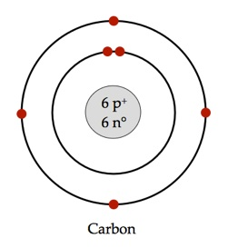
Bellwork 1. What are valence electrons? 2. How can you figure out valence electrons?
Electrons in outermost shell
Bohr model or group number

Slide 2
3. Each column is called a “____________________” 4. Each period represents an energy level within the atom. 5. Each element in a group has the same number of _______________________ in their outer ________________________ ________________________ (the valence level). 6. Electrons in the outer shell are called ________________________ ______________________.
group
electrons
energy
level
valence
electrons

Slide 3
7.Valence electrons are the electrons in the ______________________ occupied energy level of the atom. 8.Valence are the only electrons generally involved in _______________ ____________________________________.
highest
bond
formation

Slide 4
Bohr Atomic Structures 9.The first energy level can contain _________ electrons. 10.The second and third levels can contain _________ electrons.
2
8

Slide 5
Lewis Dot Diagrams 11. Lewis Dot diagrams are a notation showing the ________________ __________________ surrounding the atomic ___________________________.
valence
electrons
symbol

Slide 6
Lewis Dot Diagrams 12. First, find out which ______________________________ your element is in. 13.This will tell you the _________________________ of _______________________ electrons your element has. 14.You will ONLY draw the valence electrons.
group
number
valence

Slide 7
Lewis Dot Diagrams Let’s try carbon.
C

Slide 8
Using your periodic table, try the element in your notes.

