Slide 1
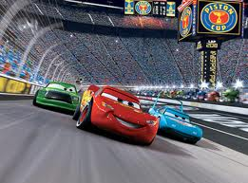
Unit 3 - Forces and Motion
Relationships between forces and motion create predictable patterns in time and space.

Slide 2
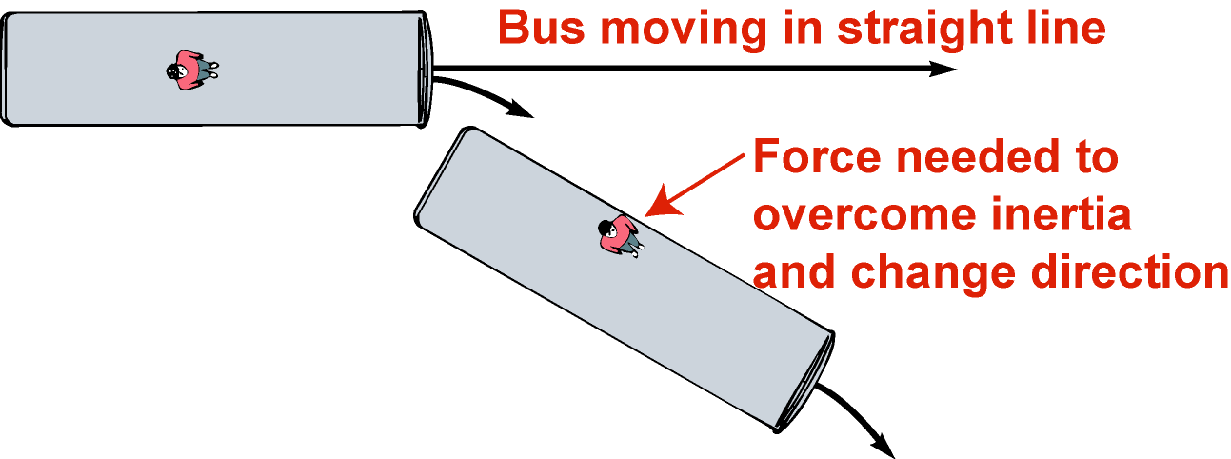
Newton’s 1st law of motion
inertia
“The law of ____________________”
An object at rest will remain at rest and an object in motion will remain in motion at a _________________ ___________________ unless it is acted upon by an ______________________ (net) external force
Inertia ______________ any changes in motion
constant
velocity
unbalanced
resists

Slide 3
Newton’s 1st law of motion

Slide 4
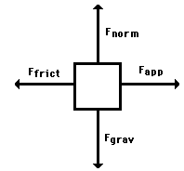
Free-body diagrams
Free-body diagrams are used to show the relative magnitude and direction of all forces acting on an object.

Slide 5
This diagram shows four forces acting upon an object. There aren’t always four forces, For example, there could be one, two, or three forces.

Slide 6
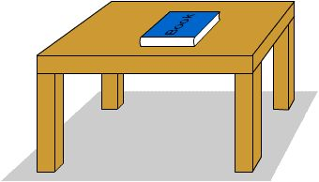
Problem 1
A book is at rest on a table top. Diagram the forces acting on the book.

Slide 7
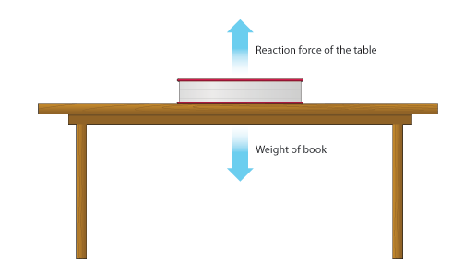
Problem 1
In this diagram, there are normal and gravitational forces on the book.

Slide 8
Problem 2
An egg is free-falling from a nest in a tree. Neglect air resistance. Draw a free-body diagram showing the forces involved.

Slide 9
Gravity is the only force acting on the egg as it falls.

Slide 10
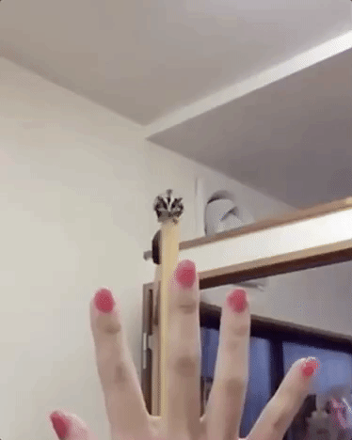
Problem 3
A flying squirrel is gliding (no wing flaps) from a tree to the ground at constant velocity. Consider air resistance. A free body diagram for this situation looks like…

Slide 11
Gravity pulls down on the squirrel while air resistance pushes up on the squirrel while it falls.

Slide 12
Problem 4
A rightward force is applied to a book in order to move it across a desk. Consider frictional forces. Neglect air resistance. Construct a free-body diagram. Let’s see what this one looks like.

Slide 13
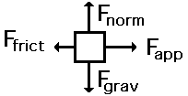
Note the applied force arrow pointing to the right. Notice how friction force points in the opposite direction. Finally, there is still gravity and normal forces involved.

Slide 14
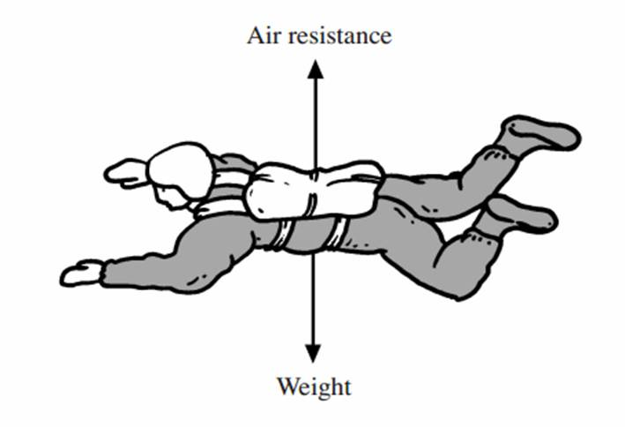
Problem 5
A skydiver is descending with a constant velocity. Consider air resistance. Draw a free-body diagram.

Slide 15
Gravity pulls down on the skydiver, while air resistance pushes up as she falls.

Slide 16
Problem 6
A man drags a sled across loosely packed snow with a rightward acceleration. Draw a free-body diagram.

Slide 17
The rightward force arrow points to the right. Friction slows his progress and pulls in the opposite direction. Normal forces still apply as does gravitational force since we are on planet Earth.

Slide 18
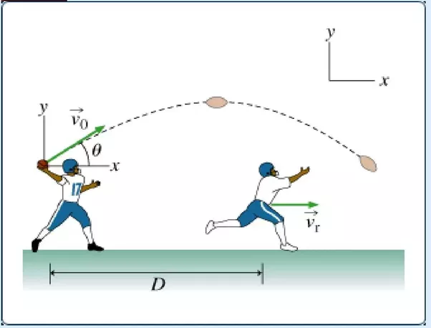
Problem 7
A football is moving upwards toward its peak after having been booted by the punter. Draw a free-body diagram.

Slide 19
The force of gravity is the only force acting on the ball while it is in the air. Once it has left the punter’s foot, he is no longer pushing on the ball.

Slide 20
Problem 8
A car runs out of gas and is coasting along a road.

Slide 21
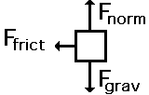
Even though the car is coasting down the road, there is only the friction of the road acting to slow it down, in addition to the gravity and normal forces.

Slide 22
Net Force
Now let’s take a look at what happens when unbalanced forces do not become completely balanced (or cancelled) by other individual forces.
An unbalanced forces exists when the vertical and horizontal forces do not cancel each other out.

Slide 23
Example 1
Notice the upward force of 1200 Newtons (N) is more than gravity (800 N). The net force is 400 N up.

Slide 24
Example 2
Notice that while the normal force and gravitation forces are balanced (each are 50 N) the force of friction results in unbalanced force on the horizontal axis. The net force is 20 N left.

Slide 25
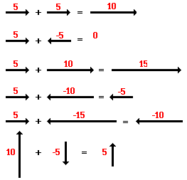
Another way to look at balanced and unbalanced forces

Slide 26
Balanced or unbalanced?
unbalanced
balanced
unbalanced

Slide 27
Balanced or Unbalanced?
unbalanced
balanced
unbalanced

Slide 28
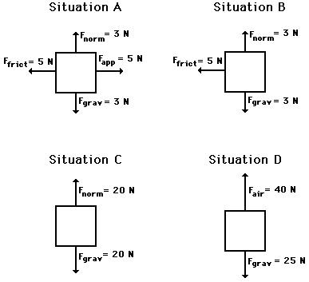
balanced
unbalanced
balanced
unbalanced

Slide 29
Newton’s 2nd law of motion
net force
An unbalanced __________ on an object causes an _______________ that is _______________to the __________, ____________ _____________ to the mass, and in the _________________ of the _______________ __________.
acceleration
proportional
net force
inversely
proportional
direction
unbalanced
net force

Slide 30
Newton’s 2nd law of motion
Forces cause ____________________
Units = _______________
Proportionality constant = _________
More force, _________ acceleration
More mass, _________ acceleration
acceleration
Newtons (N)
mass
more
less

Slide 31
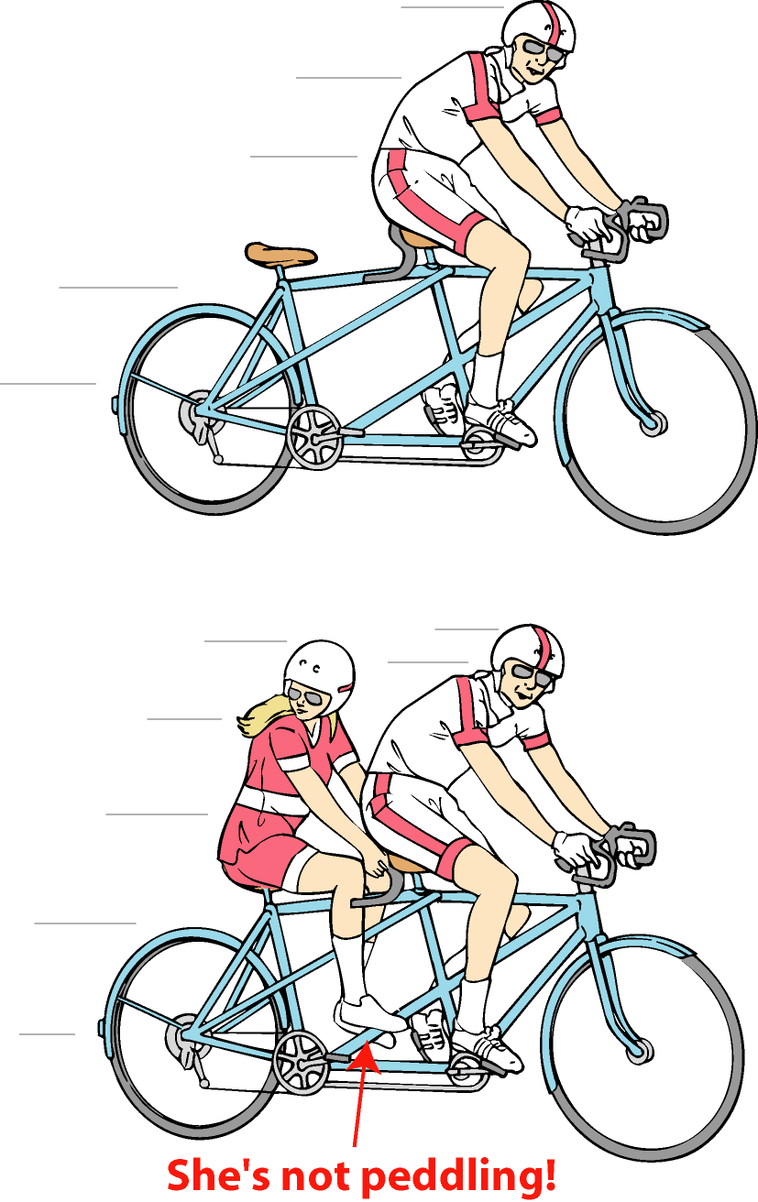
Examples - Newton’s 2nd
More mass, ________ acceleration, again
Focus on net force
Net force zero here
Air resistance + tire friction match applied force
Result: no acceleration; _____________ velocity
less
constant
She’s not pedaling

Slide 32
Weight and mass
Mass = quantitative measure of inertia; the ___________ of matter
Weight = force of _____________ acting on the mass
Pounds and Newtons measure of _________
Kilogram = measure of _________
amount
gravity
force
mass (inertia)

Slide 33
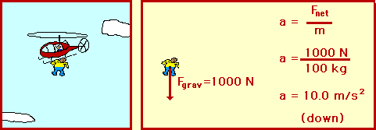
Skydiving and Terminal Velocity

Slide 34
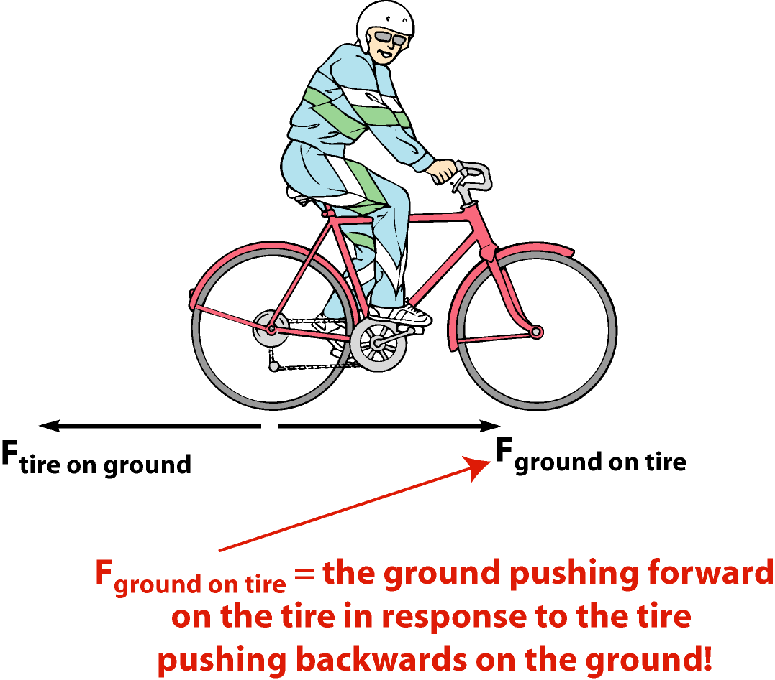
Newton’s 3rd law of motion
Source of force - other objects
3rd law - relates forces between objects
“Whenever two objects interact, the force exerted on one object is __________ in size and _______________ in direction to the force exerted on the other object.”
equal
opposite

Slide 35
Momentum
Important property closely related to Newton’s 2nd law
Includes effects of both motion (velocity) and inertia (mass)

Slide 36
Conservation of momentum
The total momentum of a group of interacting objects remains the same in the absence of external forces
Applications: Collisions, analyzing action/reaction interactions

Slide 37
Conservation of momentum
Definition – “Total linear momentum of an isolated system remains the same when there are no external and unbalanced forces acting on the system”
Collisions
Total ‘P’ before collision = Total ‘P’ after collision
P_{i} = P_{f}
P_{i} = ΣP_{f} = P₁ + P₂ +P₃ ……

Slide 38
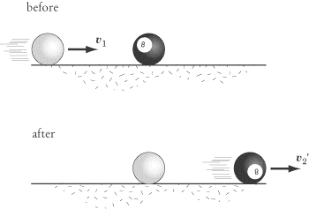
Conservation of momentum
Elastic collisions:
Objects rebound without lasting deformation or generation of _______________.
Example - When a moving billiard ball collides head-on with another billiard ball at rest, the moving ball comes to rest, and the other ball moves with the same speed as the colliding billiard ball.
heat energy

Slide 39
Conservation of momentum
momentum
Inelastic collisions are collisions in which ____________ is conserved but _________________ is not
Objects collide resulting in deformation, generation of heat or both.
When two objects collide in an inelastic collision, if one object is at rest the momentum will be __________________.
If two objects are moving in opposite directions, one of the momentum must be ________________ and one must be _______________.
If the objects stick together, we call this a ________________ inelastic collision or a ______________ inelastic collision.
kinetic energy
split between them
positive
negative
perfectly
totally

Slide 40
Impulse
A force acting on an object for some time (t)
An impulse produces a _________ in momentum
Applications: airbags, padding for elbows and knees, protective plastic barrels on highways
change

Slide 41
Forces and circular motion
Without a centripetal force, an object in motion continues along a straight-line path.
With a centripetal force, an object in motion will be accelerated and change its direction.

Slide 42
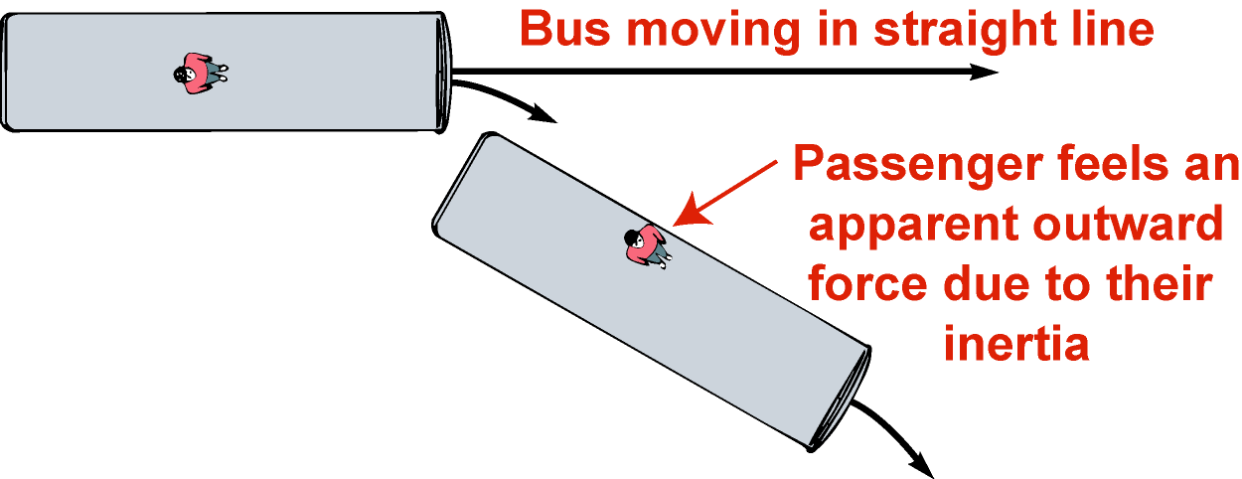
Forces and circular motion
Circular motion = accelerated motion (direction changing)
Centripetal acceleration present
Centripetal force must be acting
Centrifugal force – “apparent” outward tug as direction changes
Centripetal force ends: motion = straight line

Slide 43
Forces and circular motion

Slide 44
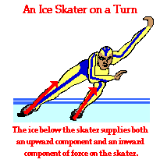
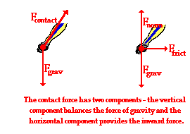
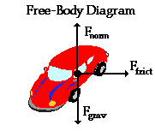
Forces and circular motion

Slide 45
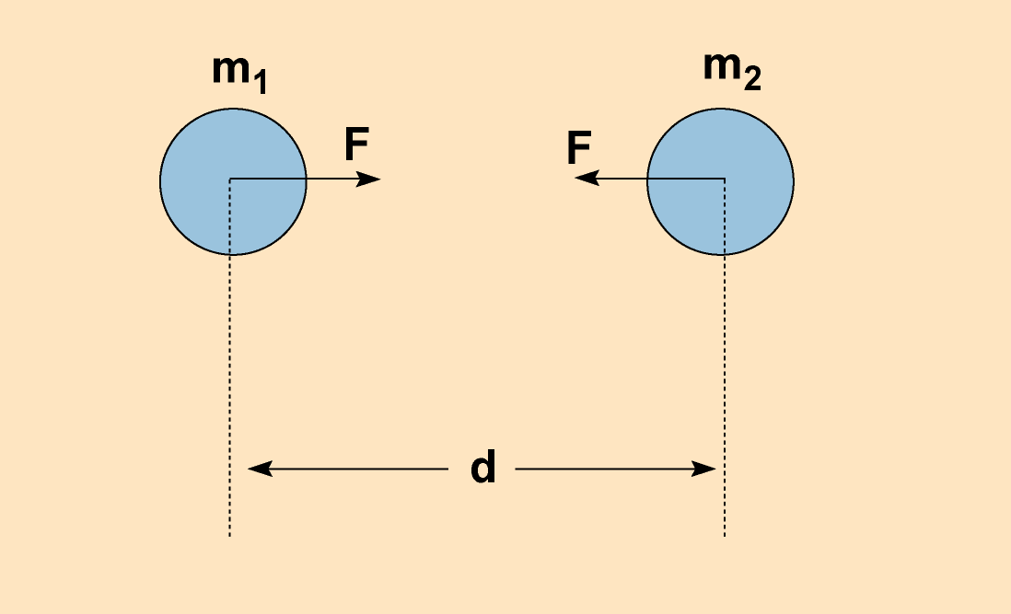
Newton’s law of gravitation
Attractive force between all masses
_________________ to product of the masses
___________________ proportional to separation distance _____________
Explains why g=9.8m/s²
Provides centripetal force for ____________ motion
Proportional
Inversely
squared
satellite

Slide 46
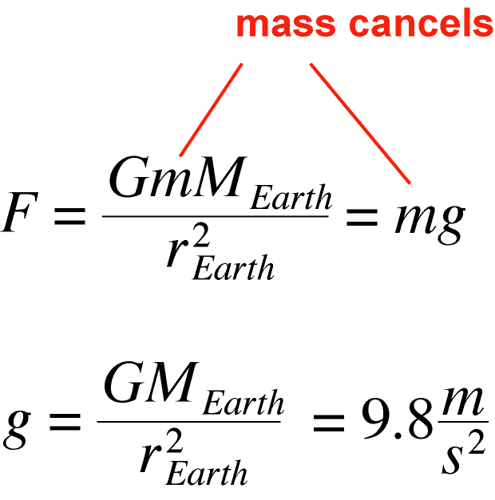
Newton’s law of gravitation

Slide 47
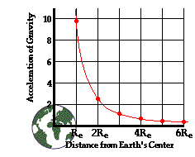
Newton’s law of gravitation

Slide 48
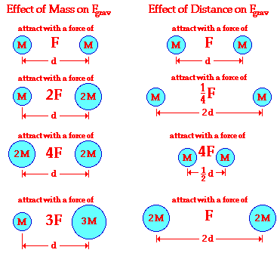
Newton’s law of gravitation

Slide 49
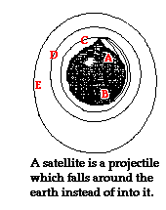
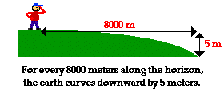
Circular Motion Principles for Satellites

Slide 50
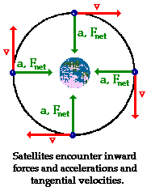
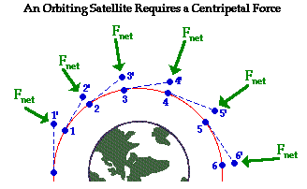
Circular Motion Principles for Satellites

Slide 51
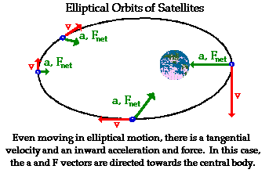
Circular Motion Principles for Satellites

