Slide 1
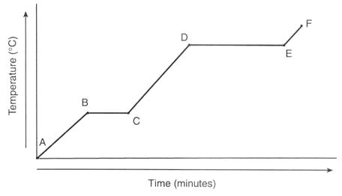
Heating curve - WATER
condensation
vapor
100˚C -
evaporation
liquid
0˚C -
melting
freezing
solid

