Slide 1
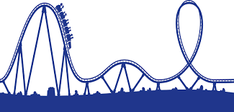
Bellwork
Acceleration in the form of a change in direction only can be shown by the example of a ________________________________.
Acceleration in the form of a change in speed only can be shown by the example of a ________________________________.
Acceleration in the form of a change in speed and direction can be shown by the example of a ________________________________.
carousel
Free fall
Roller coaster

Slide 2
Acceleration
positive
4. A ______________________ acceleration means the velocity is changing positively. This usually means the object is ___________________________________.
5. A ______________________ acceleration means the velocity is changing negatively. This usually means the object is ___________________________________.
6. What two things in a car can change your acceleration by changing the speed?
7. What can change your acceleration by changing the direction in a car?
Speeding up
negative
Slowing down
Brake and gas
Steering wheel

Slide 3
Let’s try a tough problem that you have to find the velocity first. You are going down a big hill on a roller coaster. At the top (your initial velocity), you are stopped for a moment. You zoom down 150 meters in 6 seconds. What is your acceleration if the whole drop takes you 3 seconds?
V_{i}= 0m/s
t= 6s
Given:
Unknown:
vf=?
a =?
d= 150m
Total t= 3s
Step 1: vf
= 25 m/s
S= $\frac{150 m}{6 s}$
Step 2: a
a = $\frac{(vf−vi)}{t}=\frac{25−0}{3s}=$
8.33
m/s²
Write acceleration including direction:
8.33m/s² down

