Slide 1
I can…
Define and list the steps to the scientific method. Construct and evaluate a hypothesis.

Slide 2
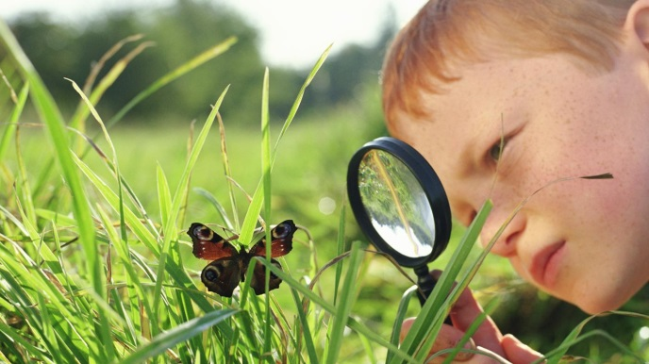
BELLWORK – What is an observation? Make an observation with a neighbor right now.

Slide 3
1. Which is heavier, the block or the cylinder? Discuss with a partner what you think and WHY.
2. We just used ______________________________ to gather data, and created an ______________________________ to test our _________________________!
observations
experiment
hypothesis

Slide 4
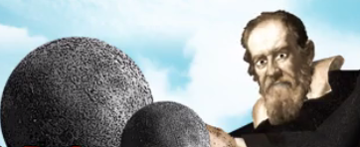
3. The video will review the steps of the scientific method. He will list them more than once. Record them below.
Question
Hypothesis
Experiment
Analyze results
Conclusion
Communicate results

Slide 5
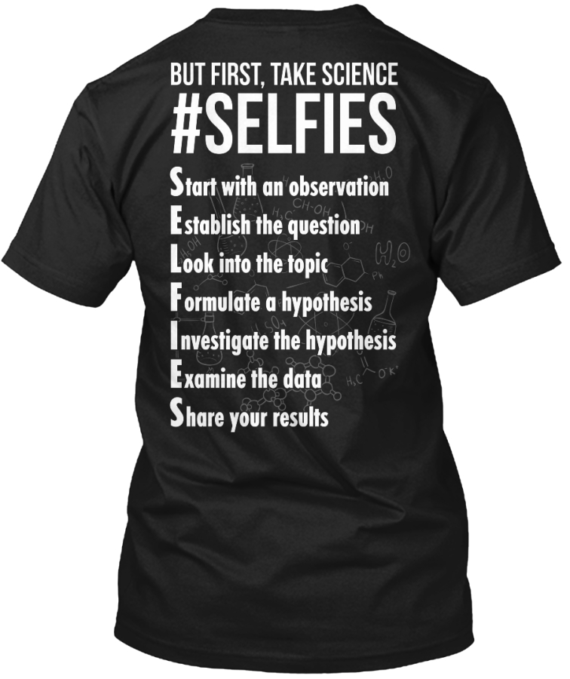

Slide 6
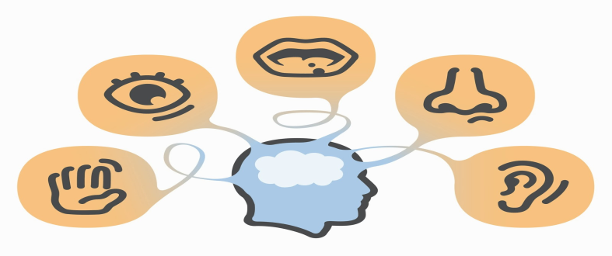
5. Let’s create some hypotheses using limited data. The Bucket of Fate has some objects in it. You may use ONE sense, NOT sight. Can we guess what’s inside? Hypothesis: _________________________________________________________
With two senses now…
Hypothesis:__________________________________________________________
Three…
Hypothesis:__________________________________________________________
Okay, look inside!
What’s in there?
Recap: why is the scientific method important? ____________________________________________________________________

Slide 7
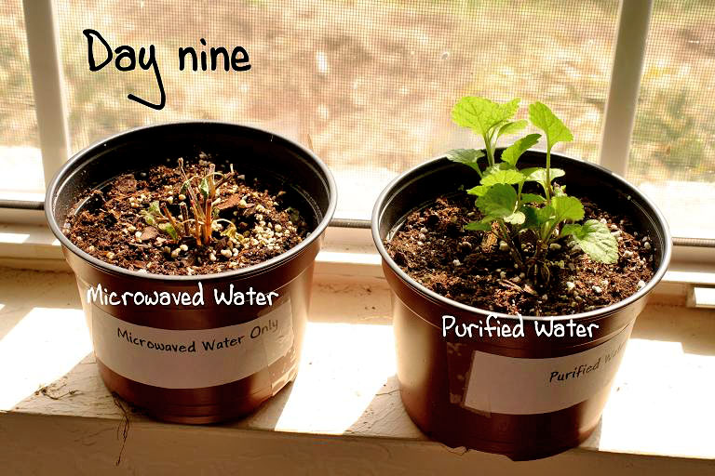
6. What is a variable? _______________________________________
A factor that can be changed

Slide 8
Work on the directed reading on pages 6-18.

