Slide 1
Measurement
Unit
time
speed
distance
meters per second
meters
seconds

Slide 2
 | Measures | SI Unit
Speed
Velocity
Acceleration
How fast an object moves
m/s
How fast an object moves and direction of motion
m/s and direction
How fast an object changes speed and direction of motion
m/s² and direction

Slide 3
 | Measures
Distance
Displacement
Motion
Total path travelled
Change from initial position to final position
Change in object’s position over time relative to a reference point

Slide 4
A vector is…
Measurement with a number and direction
displacement
velocity
acceleration

Slide 5
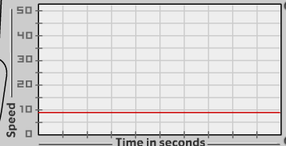
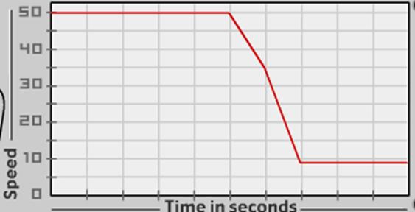
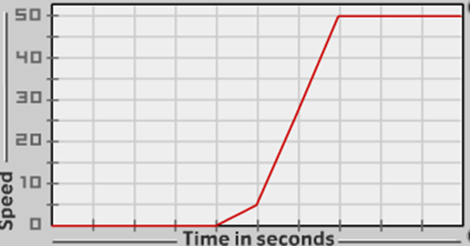
Graph | What it means
Constant speed (10 m/s)
Slowing down (50 to 10 m/s)
Speeding up (0 to 50 m/s)

Slide 6
1. A dog runs 20 meters in 30 seconds. What is its speed?

Slide 7
2. A bird flies northbound 1,600 meters in 7,200 seconds. What is its velocity?

Slide 8
3. What is your velocity if you walk 300 meters south to school and it takes you 3,600 seconds?

Slide 9
4. What is the time it takes you to walk 70 meters at a speed of 30 meters per second?

Slide 10
5. How far will you drive if you are in a car that is going a speed of 40 meters per second for 2,000 seconds?

Slide 11
6. You live 6,000 meters away from the doctor’s office. Your house is west from the office, and it takes you 4,120 seconds to get there. What is your velocity?

