Slide 1
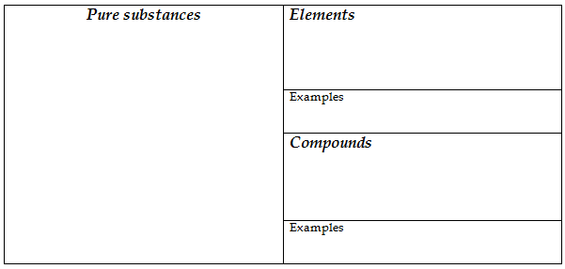
a substance that cannot be separated or broken down into simpler substances.
matter that always has exactly the same fixed and uniform composition.
Sodium, oxygen, hydrogen
is made of atoms of two or more different elements that are chemically combined.
Water, salt

Slide 2
study of the composition, structure, properties, and changes of matter
anything that has mass and takes up space
smallest unit of an element that maintains the properties of that element.

Slide 3
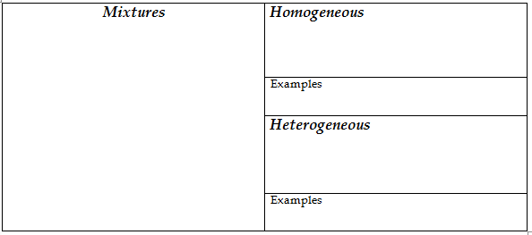
difficult to see the different parts. Same throughout.
a combination of two or more substances that are not chemically combined.
Kool-aid
NOT mixed uniformly.
Supreme Pizza

Slide 4
characteristic of a material that can be observed or measured without changing the composition

Slide 5
ability of a solid to be shaped or molded without shattering
ability of a solid to be pulled or stretched
determined by comparing materials to one another.
material’s ability to allow heat to flow

Slide 6
when the substances of a piece of matter are changing into different substances

Slide 7
the temperature that solids change to liquids
The temperature at which a liquid changes into a gas
ratio of mass to volume.
tendency of a liquid to keep from flowing; thickness

Slide 8
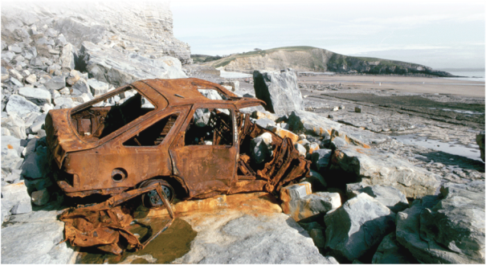
material’s ability to burn in the presence of oxygen
how easily a substance combines chemically with other substances

Slide 9
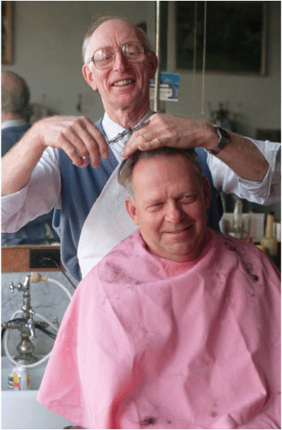
Chemical composition of a substance changes
properties of a material change, but the substances in the material remain the same

