Slide 1
Bell work – What do you think a physical property is??

Slide 2
physical property
A. A _________________________ is any characteristic of a material that can be observed or measured ________________________ of the substances in the material.
without changing the composition
The way something is made up

Slide 3
2) SKIP TO NUMBER 3

Slide 4
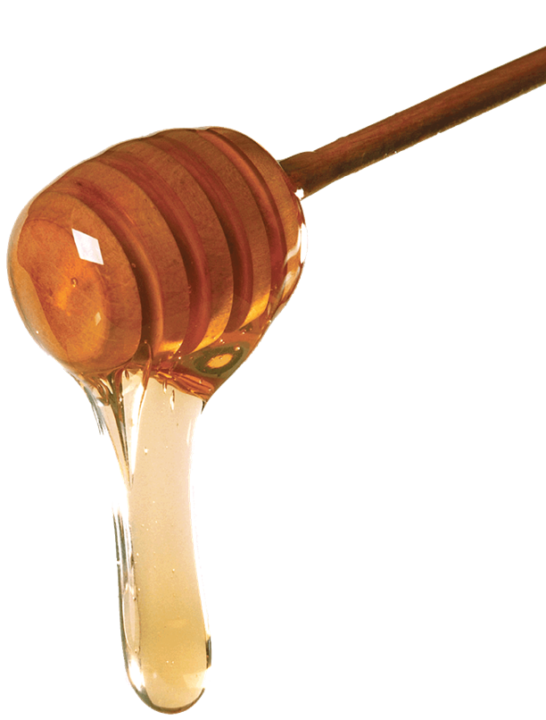
VISCOSITY | THICKNESS OF A LIQUID
 | TENDENCY TO not FLOW

Slide 5
CONDUCTIVITY | Ability to flow heat and electrons
 | Metals

Slide 6
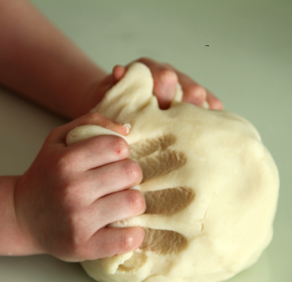
MALLEABILITY | Ability to be shaped without shattering
 | Foil
 | Opposite= brittle

Slide 7
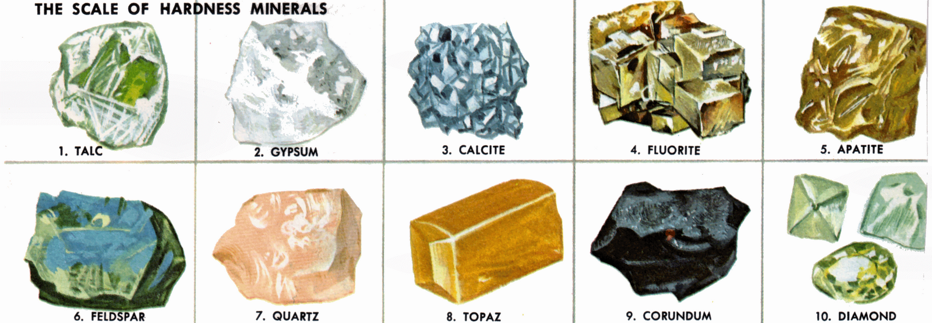
HARDNESS | Comparing materials
 | Diamond is harder than glass

Slide 8
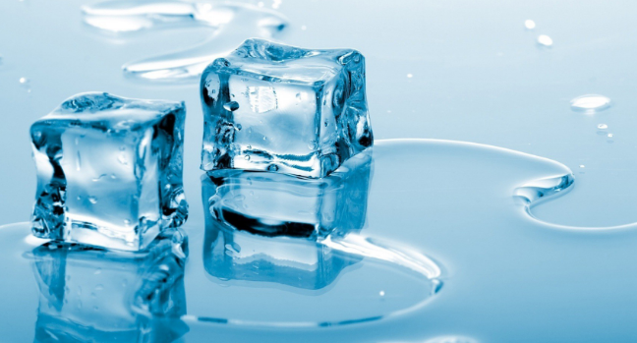
Melting Point | Temperature solids change to liquid

Slide 9
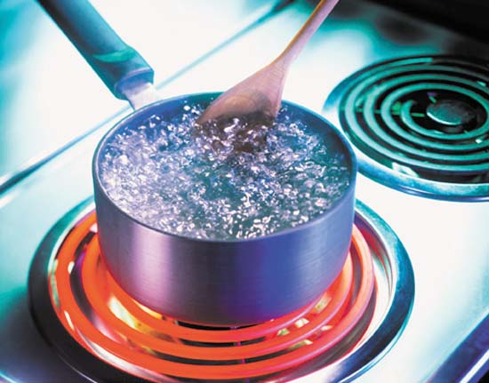
Boiling point | Temperature liquids change to gases

Slide 10
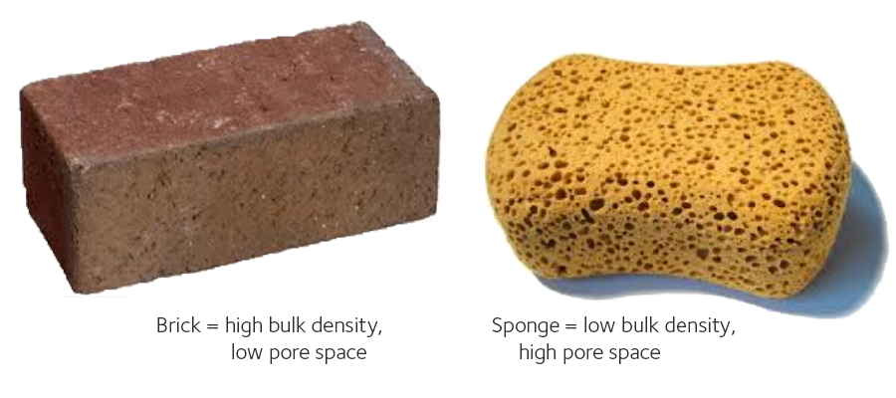
Density | Mass to volume ratio
 | Tightness of particles

Slide 11
4) How can knowing the physical properties of matter be useful???

Slide 12
Okay let’s make some mixtures… get out the “GPS – Heterogeneous and Homogeneous mixtures” sheet!!!! ☺

