Slide 1
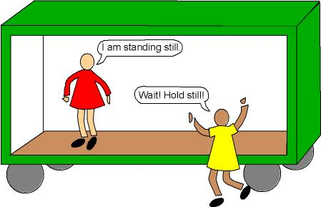
Bellwork
What is reference point?

Slide 2
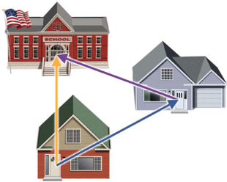
Motion
_______________________ is an object’s change in position relative to a _______________________.
_______________________ is the change in the position of an object.
_______________ measures the total path taken.
Displacement is the change of an object’s position. Displacement must always indicate _____________________.
reference point
Displacement
Distance
direction

Slide 3
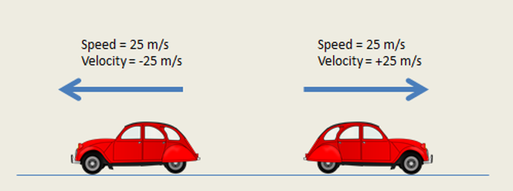
number
5. A quantity that has a _________________ (magnitude) and a ____________________ is called a vector.
6. A quantity that ONLY has a _______________ is called a ___________________ quantity.
direction
number
scalar

Slide 4
Speed
7. ___________________ is the distance traveled divided by the _________________ interval
during which the motion occurred. Speed describes how _________ an object moves.
8. Speed measurements involve _________________ and _______________.
9. The SI units for speed are _________________ per _____________ (m/s).
10. When an object covers equal distances in equal amount of time, it is moving at a ______________________________.
time
fast
distance
time
meter
second
Constant speed

Slide 5
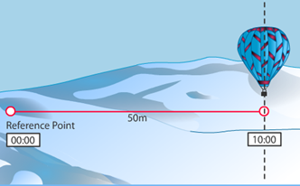
$$Speed= \frac{distance}{time}= \frac{ }{ }= \frac{ }{ }$$

Slide 6
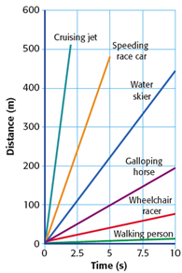
11. Speed can be studied with graphs and equations. Speed can be determined from a distance-time graph. When an object’s motion is graphed by plotting _______________ on the y-axis and __________ on the x-axis, the slope of the graph is speed.
distance
time

Slide 7
Velocity
12. __________________________ is the speed of an object in a particular _____________________.
13. Velocity describes both __________________ and the ___________________.
direction
speed
direction

Slide 8
Little Timmy rides his bicycle to school each day. He rides 1600 meters west. It takes him 3600 seconds (an hour). Find the kid’s velocity in meters per second (m/s). Remember to include direction.

Slide 9
Let’s try Speed Problem Worksheet independently.

