Slide 1
Today I can…
Create and distinguish different types of graphs.

Slide 2
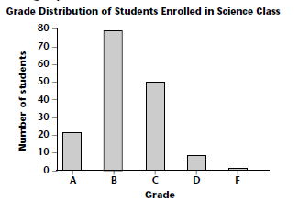
Introduction to Graphing Types of Graphs
A ___________ allows us to compare data between ___________.
bar graph
groups

Slide 3
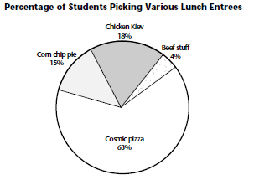
A ___________ allows us to compare ______ to the ___________, or percentages.
pie graph
parts
whole

Slide 4
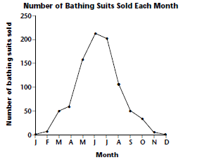
A ___________ allows us to track __________, often over __________.
line graph
changes
time

Slide 5
What should each graph have?
Graph Title
Axes titles
Consistent scale

Slide 6
Let’s Practice!!
Complete “Introduction to Graphing” Sheet on your own. ☺

