Slide 1
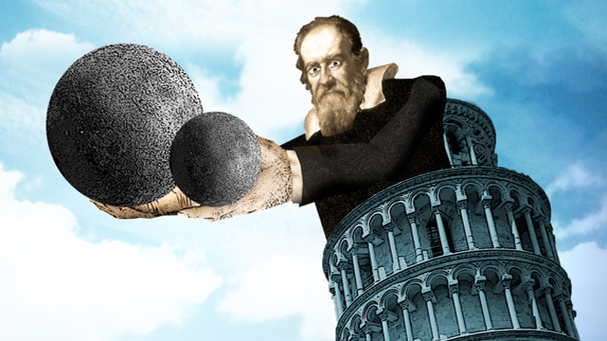
Bellwork: What are the steps to the scientific method? Why is it important to make good observations?

Slide 2
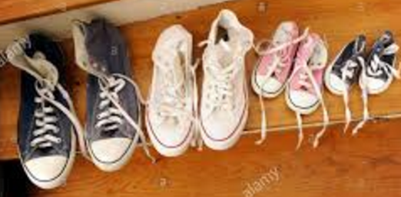
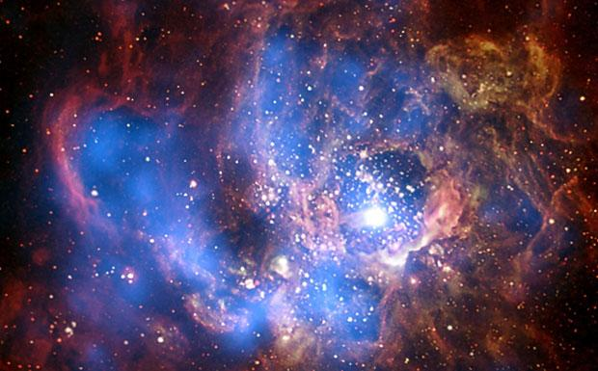
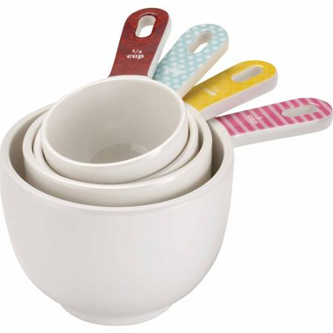
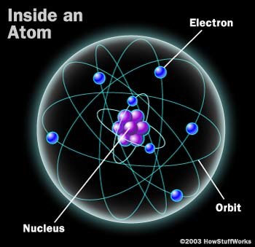
1. What are some things you measure in your daily life? Why?
2. What are some things we measure in science?

Slide 3
3. Let’s hear what Bill Nye has to say about measurement. ☺

Slide 4
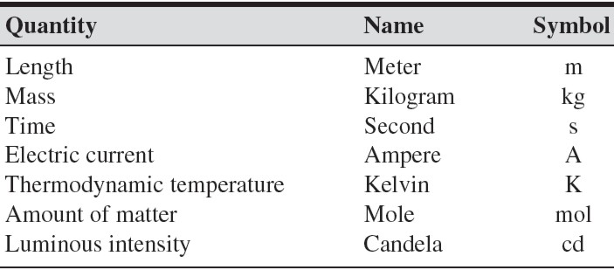
4. Why is it important to have a standard system of measurement?
Système Internationale
Derived Units
Volume of liquid -- milliliter

Slide 5
Metric Conversion
King Henry Died by Drinking Chocolate Milk
kilo hecta deka BASE deci centi milli
meter, liter, gram
1000 100 10 1 0.1 0.01 0.001

Slide 6
Metric Conversion
King Henry Died by Drinking Chocolate Milk
kilo hecta deka BASE deci centi milli
meter, liter, gram
1000 100 10 1 0.1 0.01 0.001

Slide 7
milliliter
1) Unit to measure a cup of water __________________
2) Unit to measure speed ___________________
3) Unit to measure matter _____________________
4) Quantity measured in kilograms _______________________
5) Quantity measured in Kelvin ________________________
6) Unit to measure time ________________________
7) Unit to measure area _____________________
8) Quantity measured in moles ________________________
9) Quantity measured amperes _______________________
10) Quantity measure in g/ml _________________________
Meter per second
mole
mass
temperature
second
Square meter
matter
Luminous intensity
density

