Slide 1
Bellwork Questions – Complete quietly on your own first!
decreases
1. What happens to the volume of a gas if we decrease the temperature? 2. What happens to the pressure of a gas if we decrease the volume?
increases

Slide 2
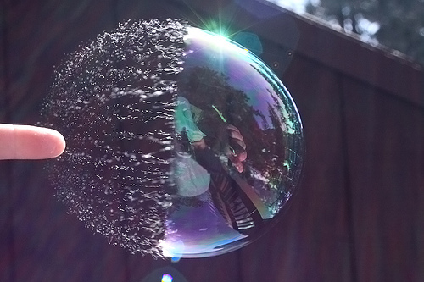
3. Boyle’s Law
Volume and Pressure

Slide 3
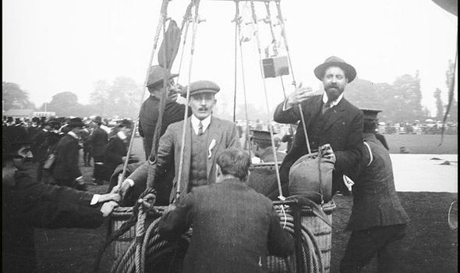
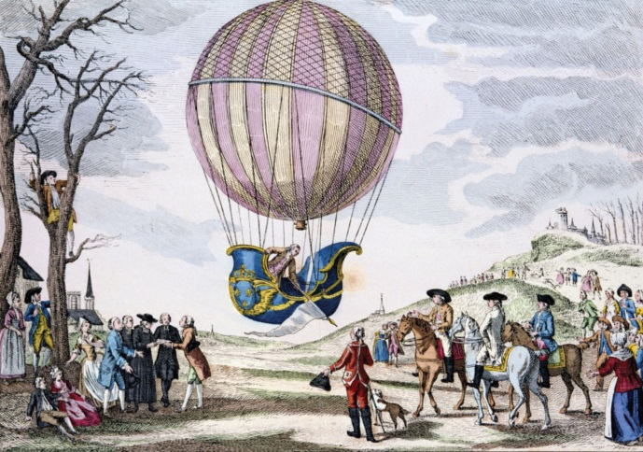
4. Charles’s Law
Temperature and volume

Slide 4
5. Complete the practice quiz and make an index card to use on the cheat sheet. THEN: -Make quiz corrections -Extra credit word search

