Slide 1
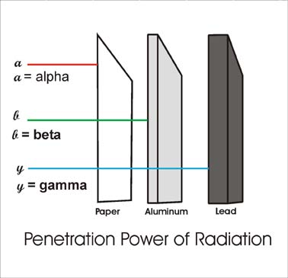
1. What are the three types of decay we walked about yesterday?
Alpha, beta, gamma

Slide 2
2. When an atom is radioactive, it is…
Unstable due to the number of neutrons, and will decay

Slide 3
3. Half-life of radioactive Isotopes
The length of time it takes half of the atoms of a sample of the radioactive isotope to decay
Varies from fractions of a second to billions of years
Do you remember Plutonium’s half-life?
24,000 yrs

Slide 4
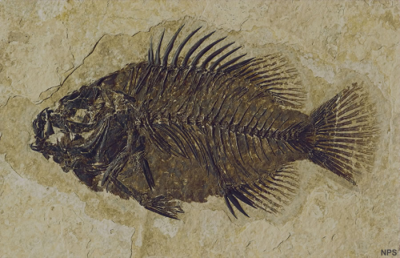
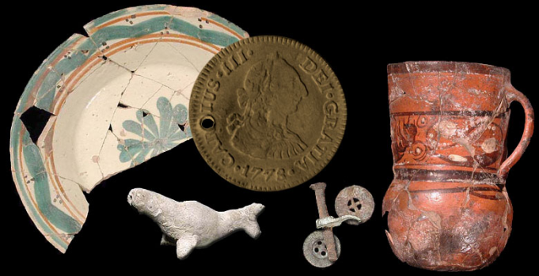
4. How can we use radioactive half-lives?
Can be used to determine the age of old objects, such as:
Fossils
Rocks
Artifacts

Slide 5
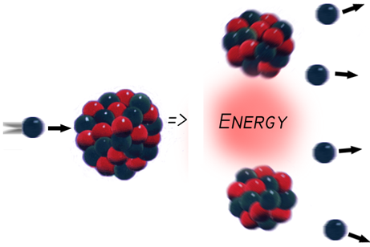
5. Nuclear fission
process of splitting a nucleus into two nuclei with smaller masses

Slide 6
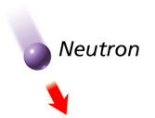
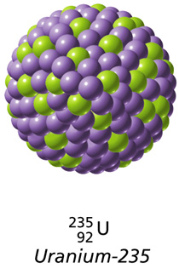
6. Chain reaction – an ongoing series of Fission reactions

Slide 7
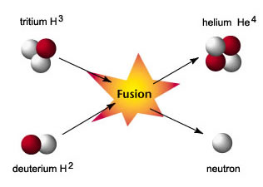
7. Nuclear Fusion
Two nuclei with low masses are combined to form one larger nucleus

Slide 8
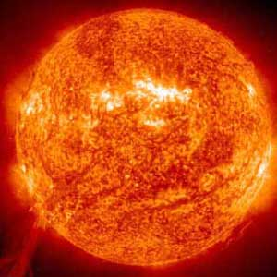
Can only happen when nuclei are moving fast
Temperature must be high as the temperature of a star

