Slide 1
Today I can…
Explain the effect of gravity and air resistance.

Slide 2
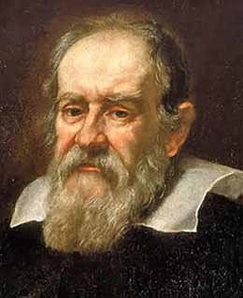
Gravity and falling objects
A young Italian scientist ______________________ argued that falling objects fall at the same rate.
Galileo Galilei

Slide 3
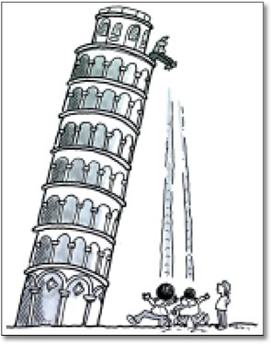
Gravity and falling objects
The story goes that he dropped two ___________ from the Leaning Tower of Pisa.
cannonballs

Slide 4
Gravity and falling objects
Observers were amazed that they fell at the _________.
Same time

Slide 5
____________ due to gravity is _______________.
Acceleration
9.8 m/s²
This is the same for all objects because it depends on ___________ and ___________.
force
mass

Slide 6
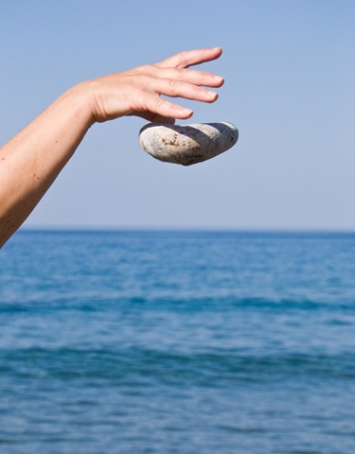
To find the velocity of falling objects, use the equation:
Velocity = gravity x time
A stone is dropped from a cliff and hits the ground after 3 sec. What is the velocity when it hits the ground?
Velocity = (9.8m/s²) x (3 s)
Velocity = 29.4 m/s

Slide 7
Air resistance is the __________ that opposes ____________ of objects through ___________.
force
motion
air
Label the forces below.
Air resistance
Net force
gravity

Slide 8
Complete the problems.
Work ahead! Complete the section summary (page 157).

