Slide 1
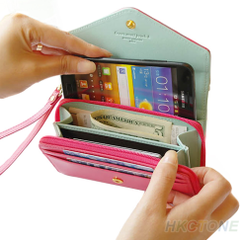
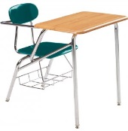
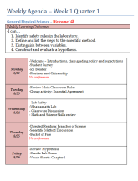
Each day as class begins…
Grab your folder from our crate
Phone away, sit at your assigned desk
Take out today’s materials from folder
Mondays we read our agenda
Put your name on all new materials
If you were absent… find materials in your folder and see Ms. Perry or Ms. Crowley for help.

Slide 3
Be On Time
Be Prepared To Learn
All Electronics Must Remain Away
Be Respectful of All Teachers and Staff
Return All Materials at the End of Class

Slide 4
Get with two people sitting near you
5 groups of 3
Write 5-7 rules you think are important for class
Then we will vote and post them as our Essential Class Agreement

Slide 5
Citizenship/Participation grade
1-5pts per day
5
4
5
3
5
22
5
4
4
4
5
22
22

