Slide 1
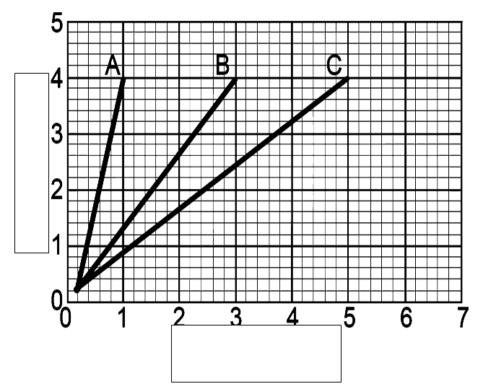
Distance vs. Time Graphs
distance
y-axis =________________
x-axis = _______________
Slope = _____________________
Steep →______________
More flat →____________
distance
time
speed
fast
Slow/stopped
time

Slide 2
Let’s try Practice problems independently.
Lab tomorrow – we’ll work with partners tomorrow ☺

