Slide 1
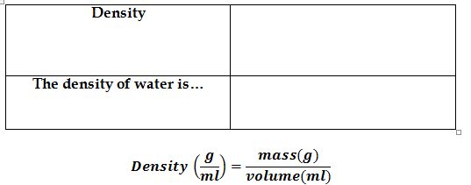
-Ratio of mass to volume
-Measured in grams/milliliters (g/mL)
-1 g/mL

Slide 2
Its density is more than 1
Its density is less than 1

Slide 3
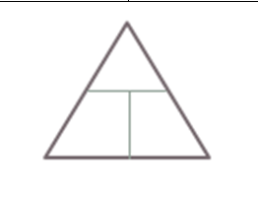

Slide 4
A force applied over a distance
The force and motion MUST be in the same direction

Slide 5
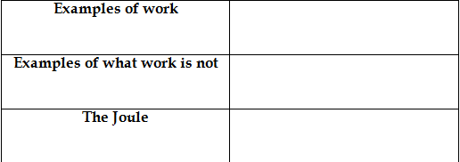
Lifting object straight up
Pushing object across
Carrying object across (motion and force not in same direction)
Unit for Work
Named after James Prescott Joule

Slide 6
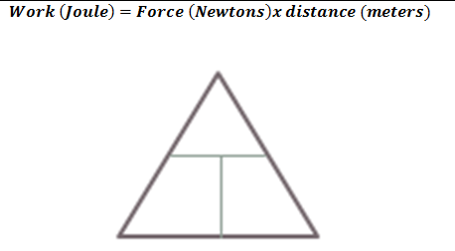

Slide 7
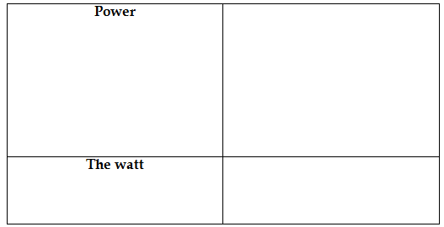
Work done per unit of time
Something MORE powerful does MORE work in LESS time
Unit for power
Named after James Watt

Slide 8
