Slide 1
Bell work – Define these familiar terms:
1 – Matter→
2 – Atom →
3 – Chemistry →
4 – Elements →

Slide 2
Elements vs. Compounds
Atoms
1. _______________ combine chemically to form a ____________.
Molecule
Compound
2. A ______________ is made of atoms of two or more different elements that are chemically combined.

Slide 3
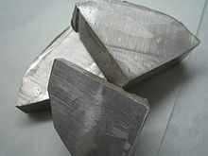
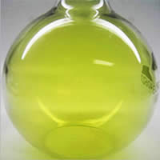
3) Compare the chemical properties of an element with the chemical properties of the compound.
Sodium (Na) element
Chlorine (Cl) element
Soft, gray metal
Poisonous green gas

Slide 4
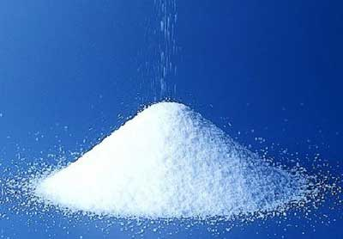
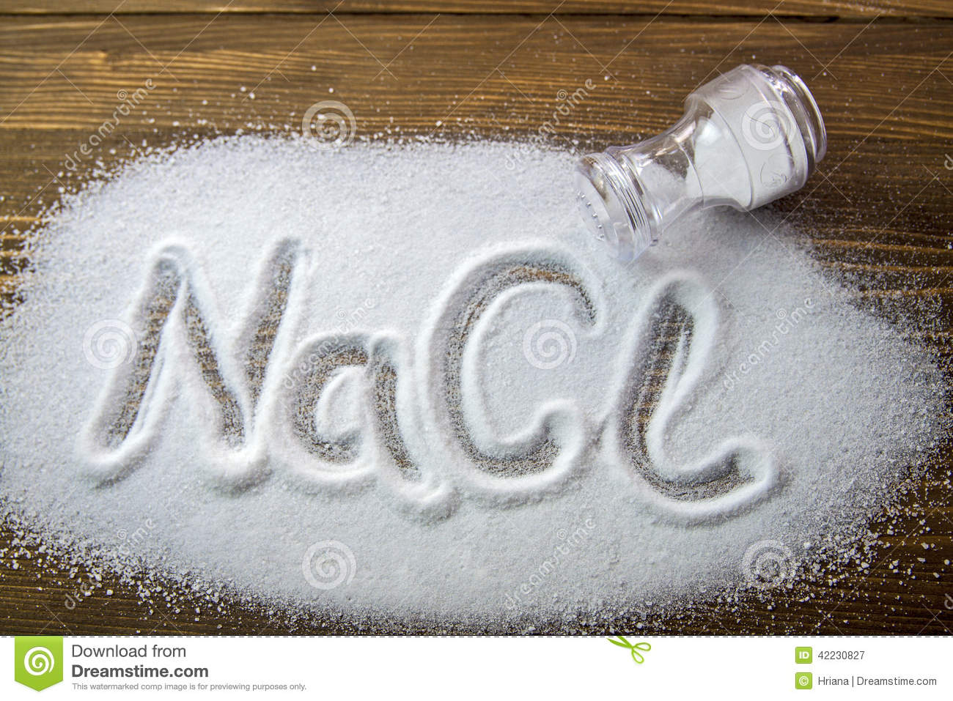
3) Compare the chemical properties of an element with the chemical properties of the compound.
Compound properties– Na combined with Cl
Sodium chloride

Slide 5
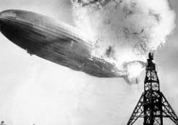
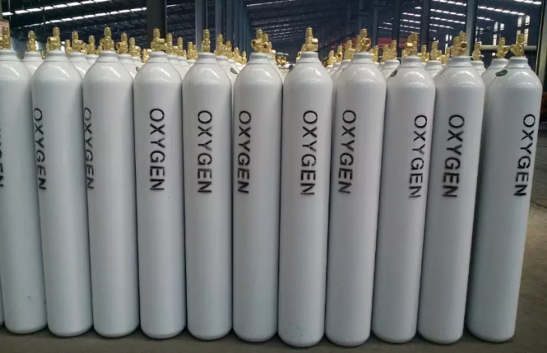
3) Compare the chemical properties of an element with the chemical properties of the compound.
Hydrogen (H) element
Oxygen (O) element
Flammable gas
Colorless gas

Slide 6
3) Compare the chemical properties of an element with the chemical properties of the compound.
Compound properties– H combined with O
H₂O (water)

Slide 7
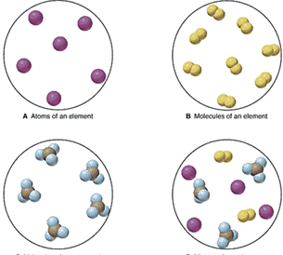
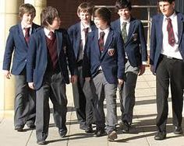
Example____________ Example____________
4) What is a pure substance?
Matter that has fixed, uniform composition
water
salt

Slide 8
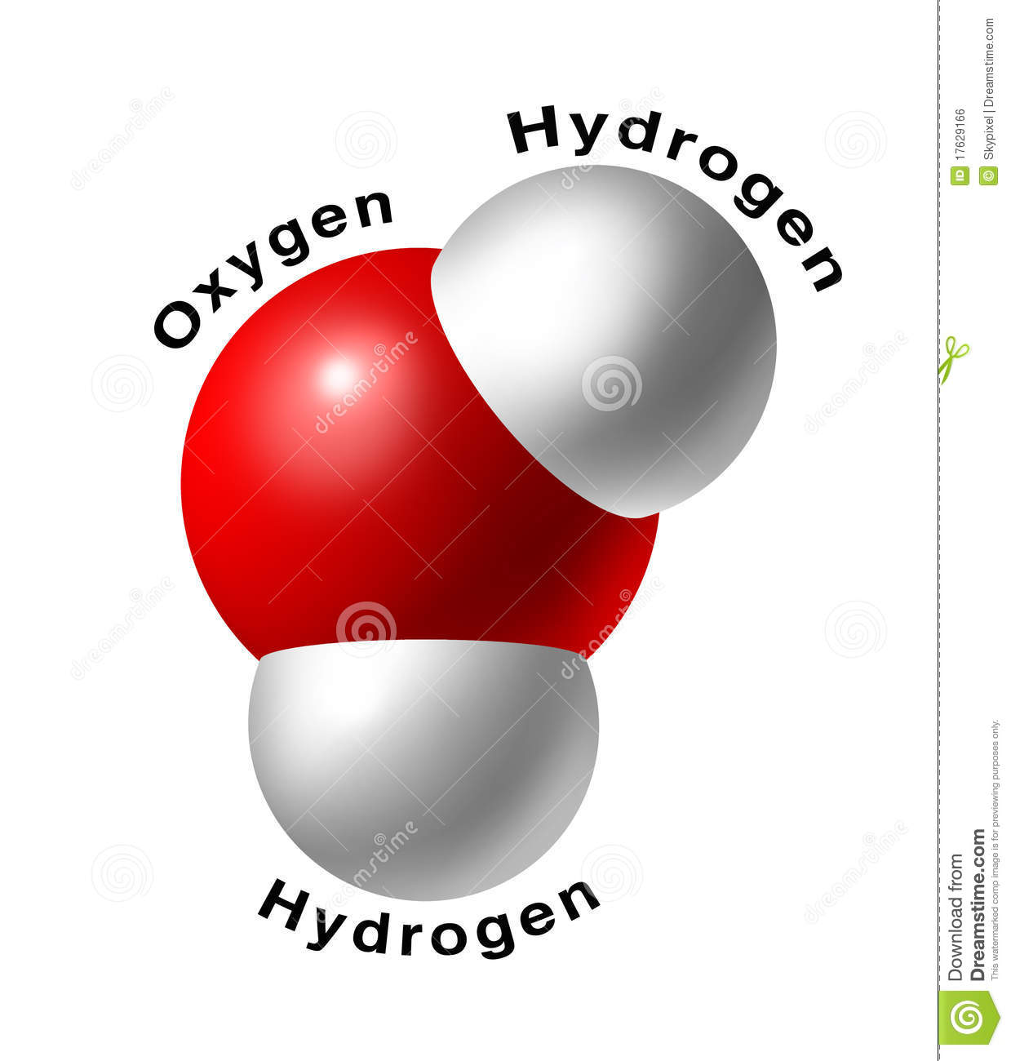
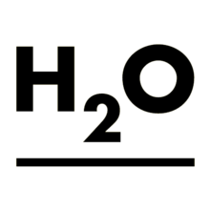
Chemical formula
5) A _________________ shows how many atoms of each element are in a unit of a substance. ________________ is a combination of chemical symbols and numbers that represent a substance.
Chemical formula

Slide 9
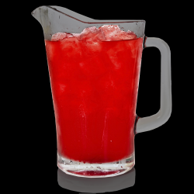
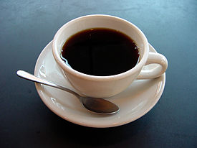
6) Describe a mixture --
a combination of two or more substances that are not chemically combined.

Slide 10
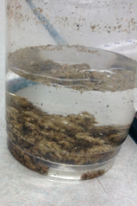
7) How do mixtures differ from Pure substance?
Mixtures do NOT chemically combine the substances. Pure substance are ALWAYS uniform.

Slide 11
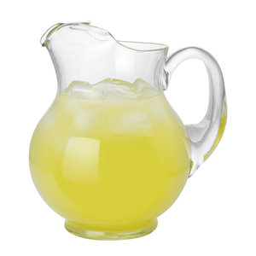
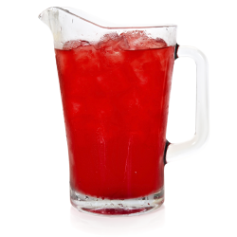
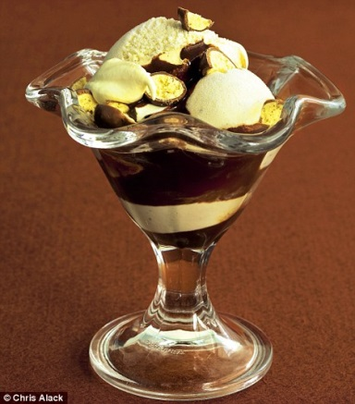
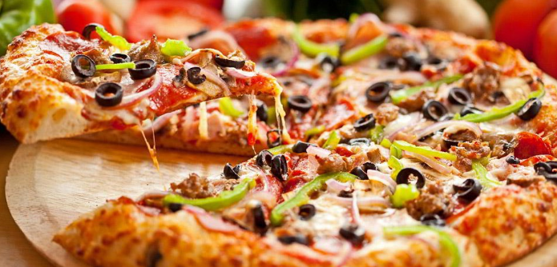
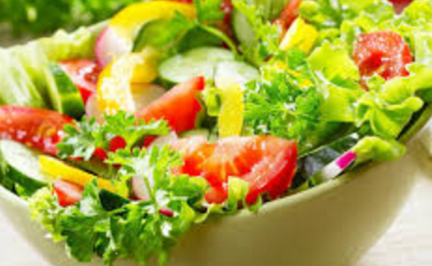
8) Define the following:
Homogeneous mixture – looks the same throughout
Heterogeneous mixture – NOT evenly distributed

Slide 12
Try pages 10, 12, and13. We’ll be around to help! ☺

