Slide 1
1. Get your bubble lab 2. Flip to the graph

Slide 2
Distance (cm)
0 2 4 6 8 10 12 14 16 18 20 22 24 26 28 30 32 34 36 38 40
1
2
3
4
5
6
7
8
9
10
11
12
13
14
15
16
17
Average Time (s)

Slide 3
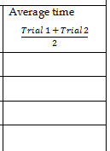
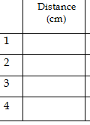
We are graphing the distance and average time columns on the last page. We can all use this data today!

Slide 4
Start with blue.
11
21
31
41
1.25
3.29
5.10
7.1

Slide 5
11
21
31
41
1.25
3.29
5.10
7.1
For the Blue Best Fit Line: Line your ruler up at the zero, then make the “best fit”– you DON’T have to connect the dots!!!
Distance (cm)
0 2 4 6 8 10 12 14 16 18 20 22 24 26 28 30 32 34 36 38 40
1
2
3
4
5
6
7
8
9
10
11
12
13
14
15
16
17
Average Time (s)

Slide 6
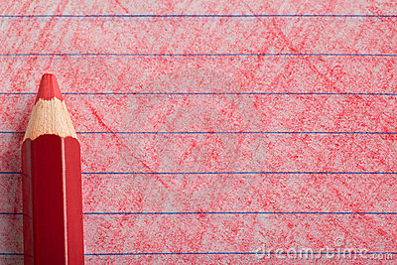
Now let’s do red.
11
21
31
41
0.60
1.50
2.90
4.10

Slide 7
11
21
31
41
0.60
1.50
2.90
4.10
Distance (cm)
0 2 4 6 8 10 12 14 16 18 20 22 24 26 28 30 32 34 36 38 40
1
2
3
4
5
6
7
8
9
10
11
12
13
14
15
16
17
Average Time (s)

Slide 8
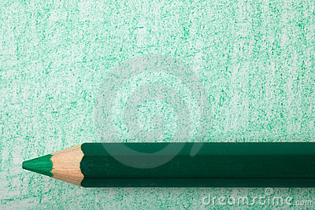
Now let’s do green.
11
21
31
41
2.40
5.32
7.40
10.01

Slide 9
11
21
31
41
2.40
5.32
7.40
10.01
Distance (cm)
0 2 4 6 8 10 12 14 16 18 20 22 24 26 28 30 32 34 36 38 40
1
2
3
4
5
6
7
8
9
10
11
12
13
14
15
16
17
Average Time (s)

Slide 10
Answer the questions on the back of the sheet.
When you are done, complete the review packet.

