Slide 1
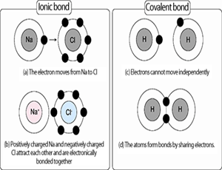
Bellwork 1. What do you remember about ionic bonds? 2. What do you remember about covalent bonds?

Slide 2
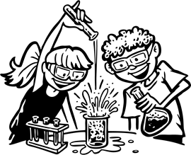
3. Remember that atoms bond together to have a full ________________ shell, and to create _________ substances. 4. This chapter, we will be looking at ________________ ______________, which is a process that one or more substances ______________ to form new substances. 5. There are many different types of chemical reactions. Can you give an example of two? Write the examples below.
valence
new
chemical
reactions
change

Slide 3
Complete the directed readings on the following pages, page numbers are provided. When you are done, you may move on to the vocabulary list.

