Slide 1
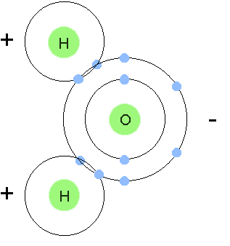
Bellwork: What happens in a covalent bond?
Nonmetals share electrons

Slide 2
Remind Me: How do we write a Lewis dot diagram of a covalent bond? Try H₂O.
ONLY the valence electrons, circle shared electrons.
H
H
O

Slide 3
1. We have seen sharing and transferring of electrons. Nonmetals share with each other, and metals and nonmetals transfer.
2. What do pure metals do?

Slide 4
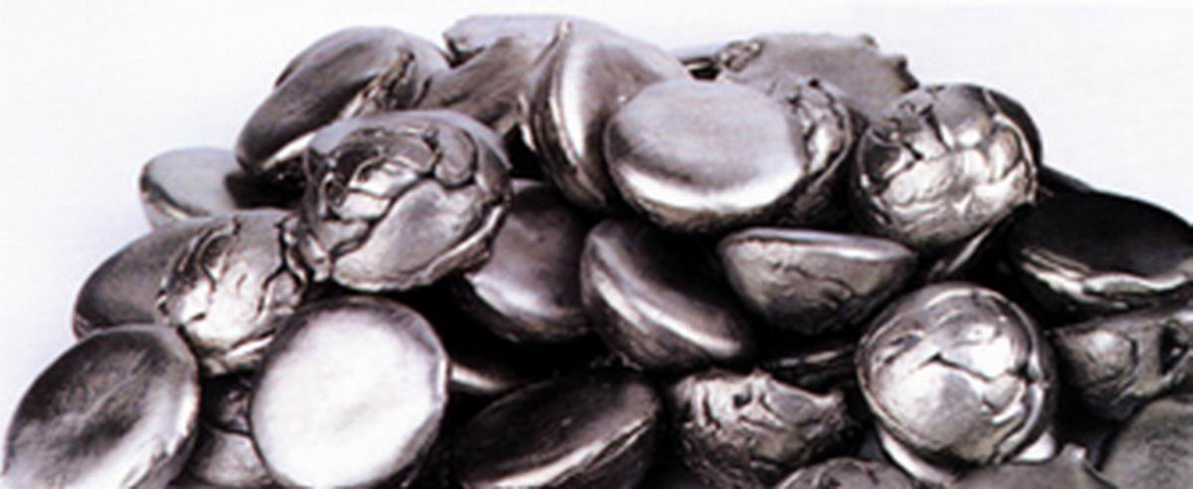
2. What do pure metals do?
Metals have metallic bonds.

Slide 5
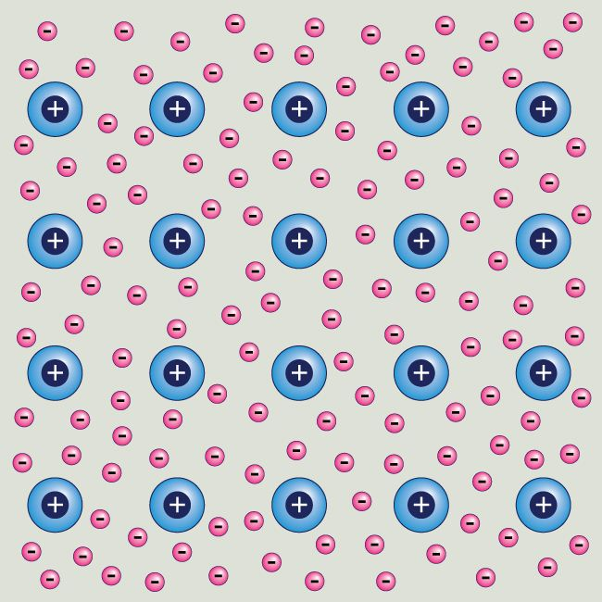
3. Metals hold onto their valence electrons very weakly. So the electrons move around the nucleus freely.

Slide 6
4. Metals in a metallic bond are like positive nuclei existing in a sea of electrons.

Slide 7
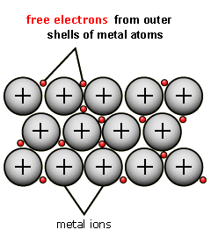
5. Let’s watch a quick video to see metallic bonding in action! Follow along in your notes.
https://www.youtube.com/watch?v=Bi0rUNV8mEw - 2:54 – 5:-05

Slide 8
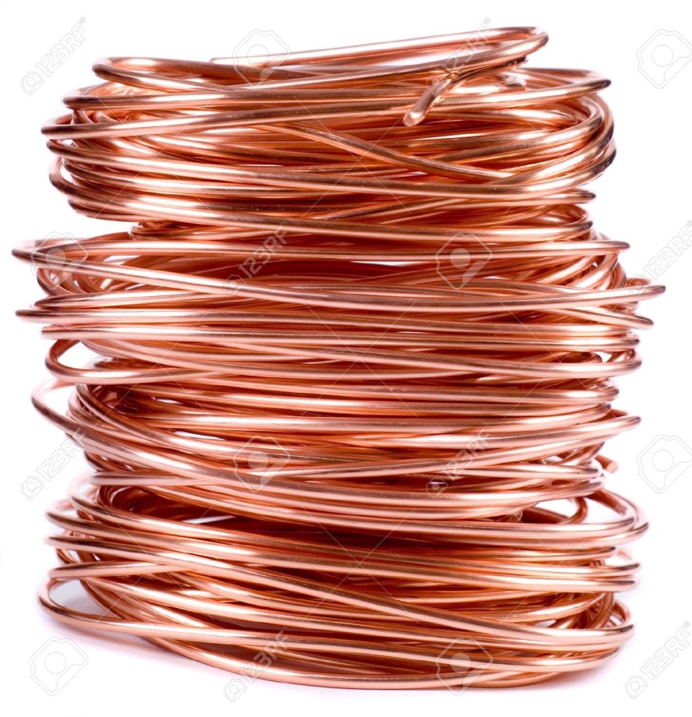
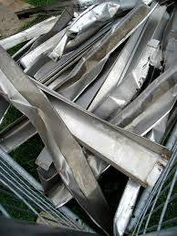
6. This is why metals conduct electricity, are malleable, are ductile, and shiny.

Slide 9
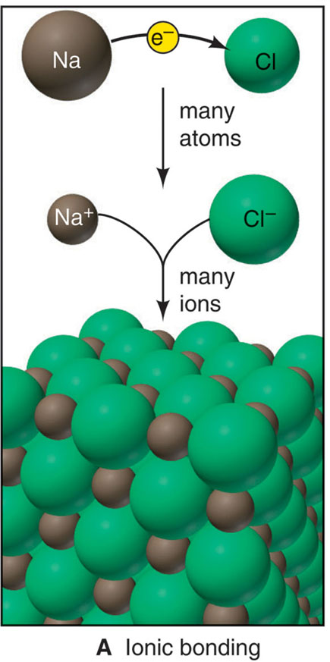
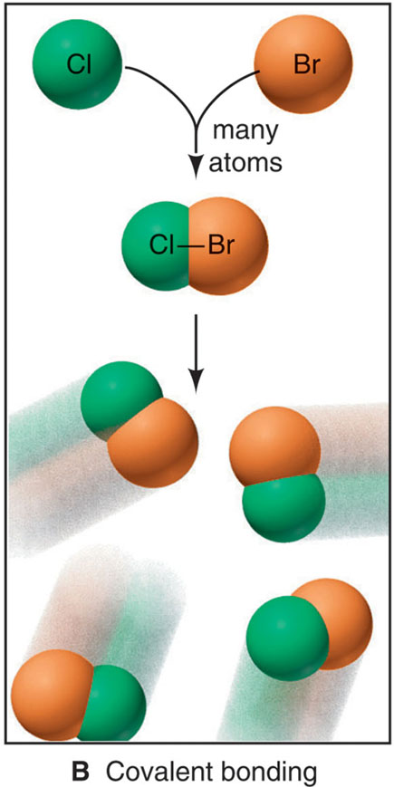
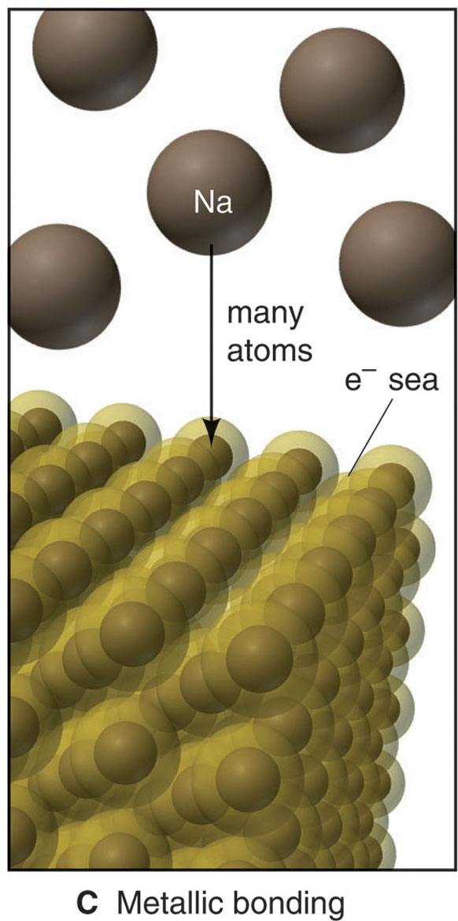
7. Three models of chemical bonding
Ionic
Covalent
Metallic
Electron transfer
Electron sharing
Electron pooling

Slide 10
Work on the next worksheet. DUE AT THE END OF THE PERIOD. Tomorrow we will review. TEST FRIDAY.

