Slide 1
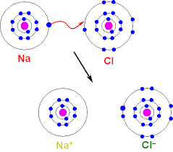
Bellwork: What happens in an ionic bond?
Nonmetal gains an electrons from a metal; electron TRANSFER

Slide 2
Remind Me: How do we write a Lewis dot diagram? Try Be.
ONLY the valence electrons.

Slide 3
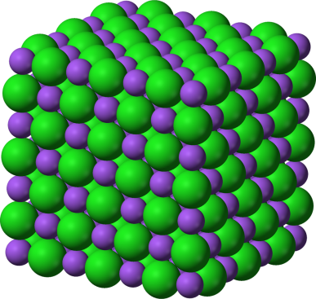
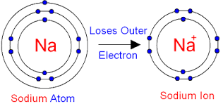
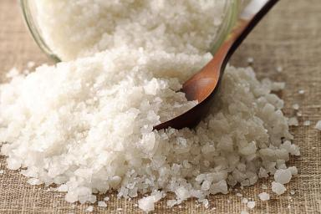
1. In ionic bonding, metals and nonmetals transfer electrons. The result of an ionic bond is charged particles called ions.
2. We found in the lab that ionic compounds are crystals that dissolve and conduct.

Slide 4
3. Not all atoms gain or lose electrons. Sometimes they share. This is called a covalent bond.
Ionic
Covalent

Slide 5
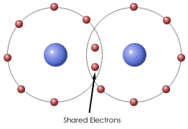
4. A covalent bond occurs when two or more nonmetals share electrons to have a full outer shell.

Slide 6
5. Which of the following are ionic and which are covalent?
Metal and nonmetal - ionic
CaCl₂→
CH₄→
H₂O→
NaF→
Nonmetal and nonmetal - covalent
Nonmetal and nonmetal - covalent
Metal and nonmetal - ionic

Slide 7
6. Let’s review how to show an ionic bond with Lewis dot structures. Use the chart for help!
Li
Cl

Slide 8
7. Let’s try a covalent bond. Use the chart for help!
F
F
Circle the shared electrons

Slide 9
8. Let’s try another covalent bond. Use the chart for help!
H
H
O
Circle the shared electrons

Slide 10
9. Some atoms bond with a double bond. Let’s try one.
O
O
Circle the shared electrons

Slide 11
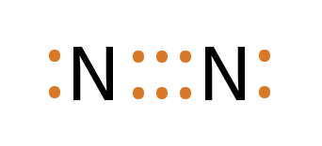
10. Some atoms bond with a triple bond. Here’s an example.
Circle the shared electrons

Slide 12
Try some on your own! Work on the next worksheets. DUE AT THE END OF THE PERIOD.

