Slide 1
Bellwork
Why do atoms bond?
To become more stable!

Slide 2
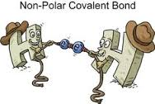
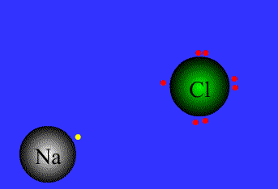
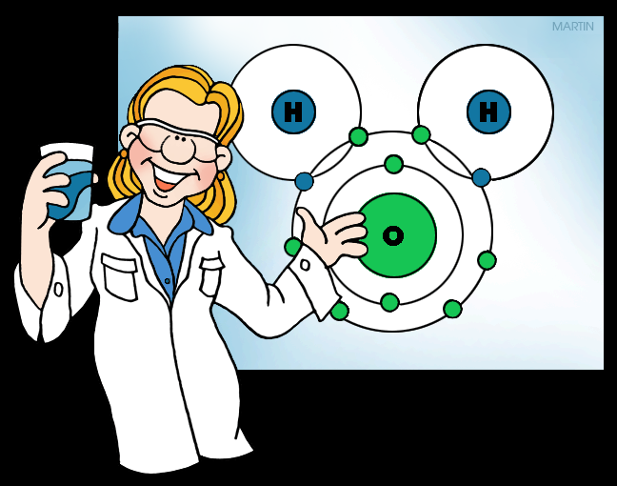
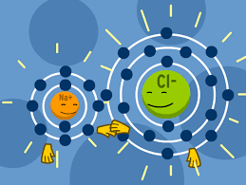
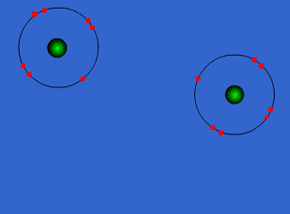
Chemical Bonding!

Slide 3
1) What is a Chemical Bond?
the joining of atoms to form new substances. The properties of these new substances are different from the properties of the original elements.
What are all atoms trying to achieve?
All atoms trying to achieve a stable octet.

Slide 4
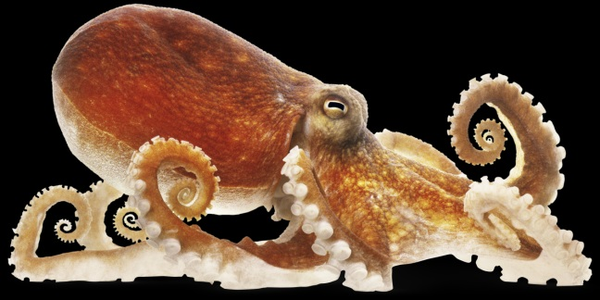
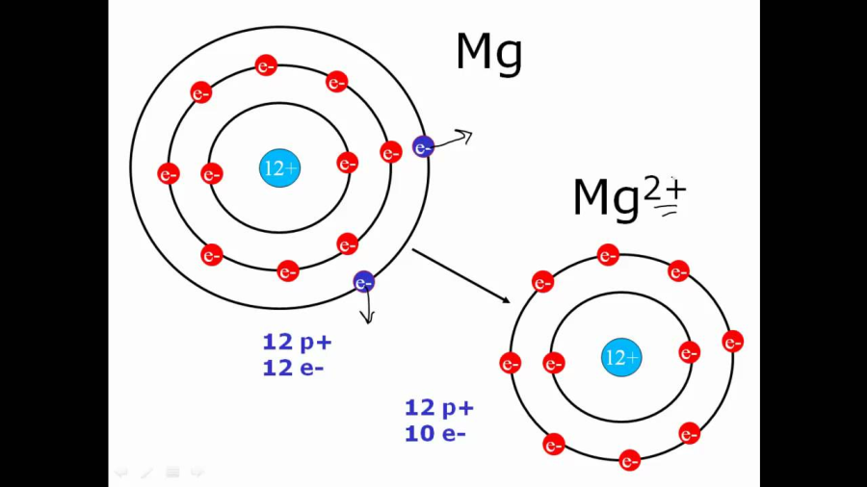
2) Describe the Octet rule.
Atoms strive to 8 valance electrons.
(except H and He)
3) How do atoms fulfill the Octet Rule?
Atoms will lose, gain, or share electrons.

Slide 5
Law of Electric Charges
Things that are negatively charged and things that are positively charged pull on (attract) each other. This makes electrons and protons stick together to form atoms. Things that have the same charge push each other away (they repel each other). This is called the Law of Charges
4) Now, put it in your own words.

Slide 6
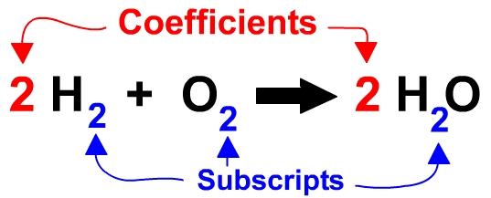
5) What is a coefficient?
Number before a molecule
Tells you number of molecules
6) What is a subscript?
Small number after an element
Tells you number of that ATOM in a molecule

Slide 7
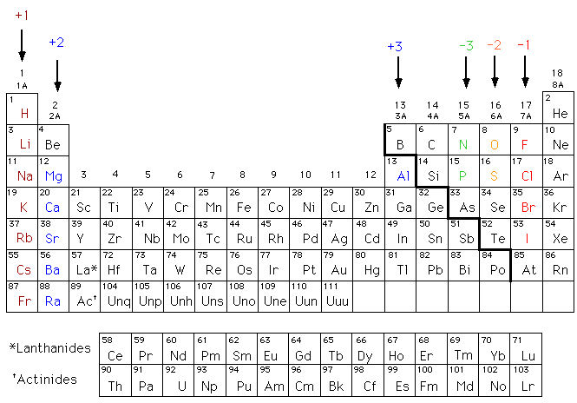
7) What is an oxidation number?
Charge for an element to become stable
**write them on the periodic table

Slide 8
CHEMICAL BONDING
IONIC BONDS
COVALENT BONDS
METALLIC BONDS

Slide 9
8) How do you form an ionic bond?
A nonmetal takes electron(s)
from an atom of a metal
a. What’s the action happening in an ionic bond?
Transferring of Electrons

Slide 10
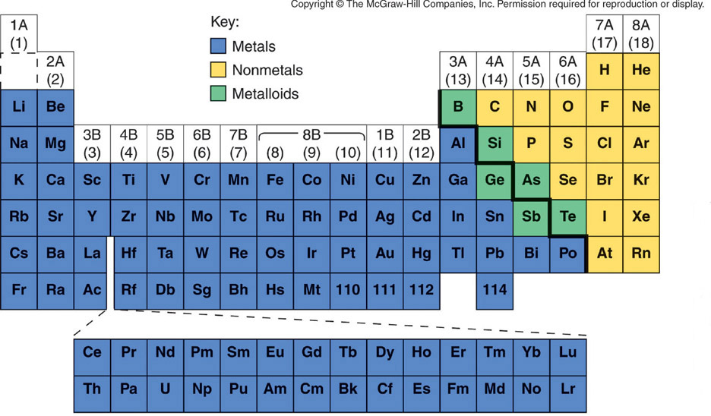
Metals and Nonmetals

Slide 11
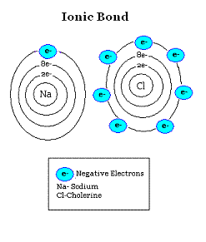

Slide 12
9) What two types of substances form ionic bonds?
Non-Metal
Metal

Slide 13
10) What particles form ionic bonds?
ION – any atom with more or
less electrons that it is
supposed to have*

Slide 14
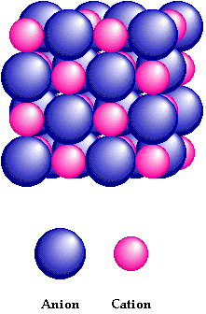
11) What type of substances do atoms with ionic bonds form?
Salts
And
crystals
Anion (-) Cation (+)

Slide 15
12) Properties of Ionic Compounds
Crystalline structure
Strongly bonded
Rigid
High melting points

Slide 16
IONIC BONDING
IS THE COMPOUND
AN IONIC COMPOUND?
Mg N
METAL
NONMETAL
3
2
SUBSCRIPTS

Slide 17
13) What is the name for an ion with a positive charge?
Metals will tend to lose electrons and become
POSITIVE CATIONS
+
+
11 p
11 e
1e
-
Na
11 p
10 e
Na
-
=
-
-
Normal sodium atom
loses one electron
to become sodium ion

Slide 18
14) What is the name for anion for an ion with a negative charge?
Nonmetals will tend to gain electrons and become
NEGATIVE ANIONS
+
+
17 p
17 e
1e
-
17 p
18 e
Cl
Cl
+
=
-
-
Normal chlorine atom
gains an electron
to become a chloride ion

Slide 19
Work on the worksheet in your packet. Use your periodic table.

Slide 20
IONic Bonding
electrons are transferred between valence shells of atoms
ionic compounds are
made of ions
NOT MOLECULES
ionic compounds form substances called Salts or Crystals

Slide 21
IONic bonding
Always formed between metals and non-metals
[METALS ]⁺ [NON-METALS ]⁻
Lost e⁻
Gained e⁻

Slide 22
IONIC BONDING
Na⁺¹ is called a sodium ion
The +1 symbol means it
has lost one electron

Slide 23
IONIC BONDING
Mg⁺² is called a magnesium ion
The +2 symbol means it
has lost two electron

Slide 24
IONIC BONDING
S⁻² is called a sulfide ion
The -2 symbol means it
has gained two electron

Slide 25
IONIC BONDING
Cl⁻¹ is called a chloride ion
The -1 symbol means it
has gained one electron

Slide 26
Crystalline structure
The POSITIVE CATIONS stick to the NEGATIVE ANIONS, like a magnet.
+
+
-
-
-
-
+
+
-
+
-
+
-
+
-
+
-
+

Slide 27
Ionic Bonds…Do they Conduct?
Conducting electricity is allowing charges to move.
In a solid, the ions are locked in place.
Ionic solids are insulators.
When melted, the ions can move around.
Melted ionic compounds conduct.
First get them to 800ºC.
Dissolved in water they conduct.

Slide 28
Ionic solids are brittle
+
-
+
-
-
+
-
+
+
-
+
-
-
+
-
+

Slide 29
Ionic solids are brittle
Strong Repulsion breaks crystal apart.
+
-
+
-
-
+
-
+
+
-
+
-
-
+
-
+

Slide 30
COVALENT BONDING

Slide 31
COVALENT BONDING
When an atom of one nonmetal
shares one or more electrons
with an atom of another
nonmetal so both atoms
end up with
eight valence electrons

Slide 32
COVALENT BOND FORMATION
When one nonmetal shares one or more electrons with an atom of another nonmetal so both atoms end up with eight valence electrons

Slide 33
COVALENT BONDING
IS THE COMPOUND
A COVALENT COMPOUND?
C O
NONMETAL
NONMETAL
2
YES since it is made of only nonmetal elements

Slide 34
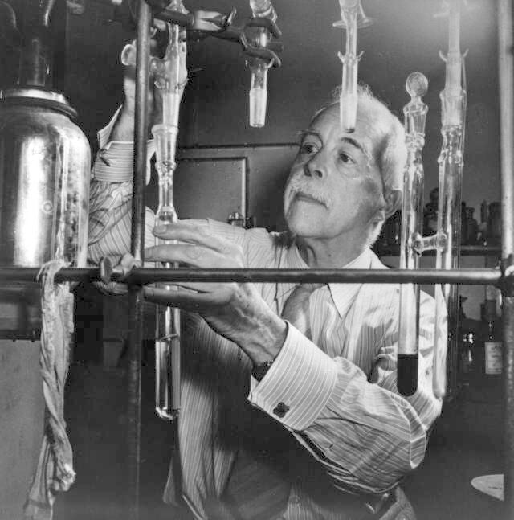
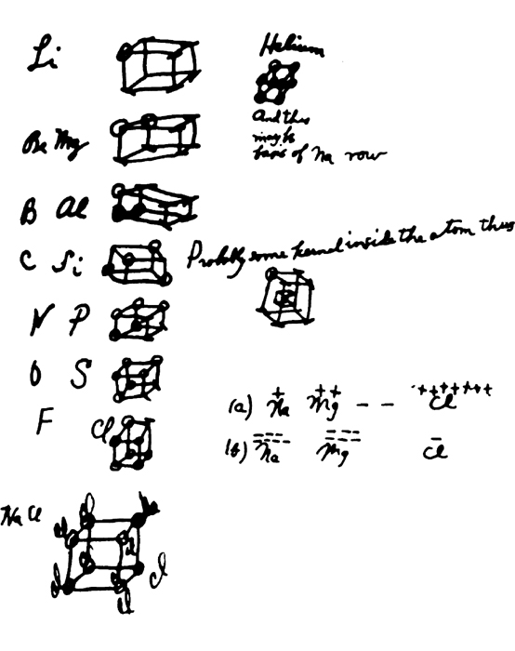
Lewis Structures
Developed the idea in 1902.
G. N. Lewis

Slide 35
Lewis Dot Symbols
Place one dot per valence electron on each of the four sides of the element symbol.
Pair the dots (electrons) until all of the valence electrons are used.
Nitrogen, N, is in Group 5A and therefore has 5 valence electrons.
.
:
.
.
:
N
.
.
N
.
.
N
:
.
N
.
.
.
.
:

Slide 36
Lewis Dot Symbols

Slide 37
The Octet Rule
Chemical compounds tend to form so that each atom, by gaining, losing, or sharing electrons, has eight electrons in its highest occupied energy level.
The same number of electrons as in the nearest noble gas…
The first exception to this is hydrogen, which follows the duet rule.
The second exception is helium which does not form bonds because it is already “full” with its two electrons

Slide 38
Covalent Bond
A chemical bond in which two or more electrons are shared by two atoms.
How should two atoms share electrons?
F
+
F
F
F
7e⁻
7e⁻
8e⁻
8e⁻
Lewis structure of F₂
single covalent bond
lone pairs
F
F
lone pairs
single covalent bond
lone pairs
F
F
lone pairs

Slide 39
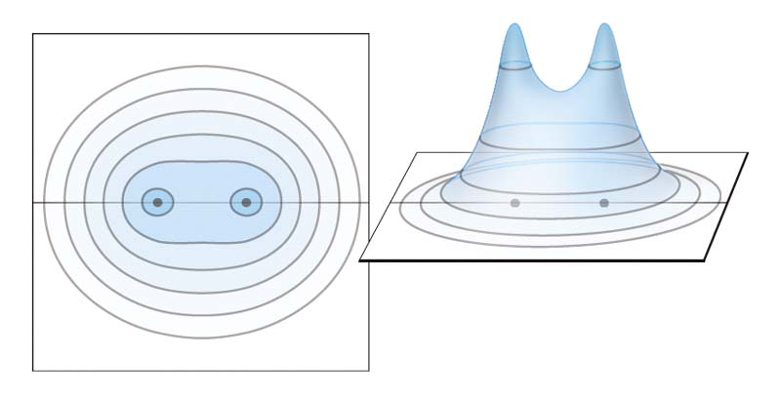
Distribution of electron density of H₂
H
H

Slide 40
Lewis structure of water
single covalent bonds
H
+
O
+
H
H
O
H
or
H
O
H
2e⁻
8e⁻
2e⁻
Double bond – two atoms share two pairs of electrons
O
C
O
or
O
C
O
8e⁻
8e⁻
8e⁻
double bonds
double bonds
Triple bond – two atoms share three pairs of electrons
N
N
or
N
N
8e⁻
8e⁻
triple bond
triple bond

Slide 41
Covalent bonding
Fluorine has seven valence electrons
F

Slide 42
Covalent bonding
Fluorine has seven valence electrons
A second atom also has seven
F
F

Slide 43
Covalent bonding
Fluorine has seven valence electrons
A second atom also has seven
By sharing electrons
F
F

Slide 44
Covalent bonding
Fluorine has seven valence electrons
A second atom also has seven
By sharing electrons
F
F

Slide 45
Covalent bonding
Fluorine has seven valence electrons
A second atom also has seven
By sharing electrons
F
F

Slide 46
Covalent bonding
Fluorine has seven valence electrons
A second atom also has seven
By sharing electrons
F
F

Slide 47
Covalent bonding
Fluorine has seven valence electrons
A second atom also has seven
By sharing electrons
F
F

Slide 48
Covalent bonding
Fluorine has seven valence electrons
A second atom also has seven
By sharing electrons
Both end with full orbitals
F
F

Slide 49
Covalent bonding
Fluorine has seven valence electrons
A second atom also has seven
By sharing electrons
Both end with full orbitals
F
F
8 Valence electrons

Slide 50
Covalent bonding
Fluorine has seven valence electrons
A second atom also has seven
By sharing electrons
Both end with full orbitals
F
F
8 Valence electrons

Slide 51
Water
Each hydrogen has 1 valence electron
Each hydrogen wants 1 more
The oxygen has 6 valence electrons
The oxygen wants 2 more
They share to make each other happy
H
O

Slide 52
Water
Put the pieces together
The first hydrogen is happy
The oxygen still wants one more
H
O

Slide 53
Water
The second hydrogen attaches
Every atom has full energy levels
H
O
H

Slide 54
Carbon dioxide
CO₂ - Carbon is central atom ( I have to tell you)
Carbon has 4 valence electrons
Wants 4 more
Oxygen has 6 valence electrons
Wants 2 more
C
O

Slide 55
Carbon dioxide
Attaching 1 oxygen leaves the oxygen 1 short and the carbon 3 short
C
O

Slide 56
Carbon dioxide
Attaching the second oxygen leaves both oxygen 1 short and the carbon 2 short
O
C
O

Slide 57
Carbon dioxide
The only solution is to share more
O
C
O

Slide 58
Carbon dioxide
The only solution is to share more
O
C
O

Slide 59
Carbon dioxide
The only solution is to share more
O
C
O

Slide 60
Carbon dioxide
The only solution is to share more
O
C
O

Slide 61
Carbon dioxide
The only solution is to share more
O
C
O

Slide 62
Carbon dioxide
The only solution is to share more
O
C
O

Slide 63
Carbon dioxide
The only solution is to share more
Requires two double bonds
Each atom gets to count all the atoms in the bond
O
C
O

Slide 64
Carbon dioxide
The only solution is to share more
Requires two double bonds
Each atom gets to count all the atoms in the bond
8 valence electrons
O
C
O

Slide 65
Carbon dioxide
The only solution is to share more
Requires two double bonds
Each atom gets to count all the atoms in the bond
8 valence electrons
O
C
O

Slide 66
Carbon dioxide
The only solution is to share more
Requires two double bonds
Each atom gets to count all the atoms in the bond
8 valence electrons
O
C
O

Slide 67
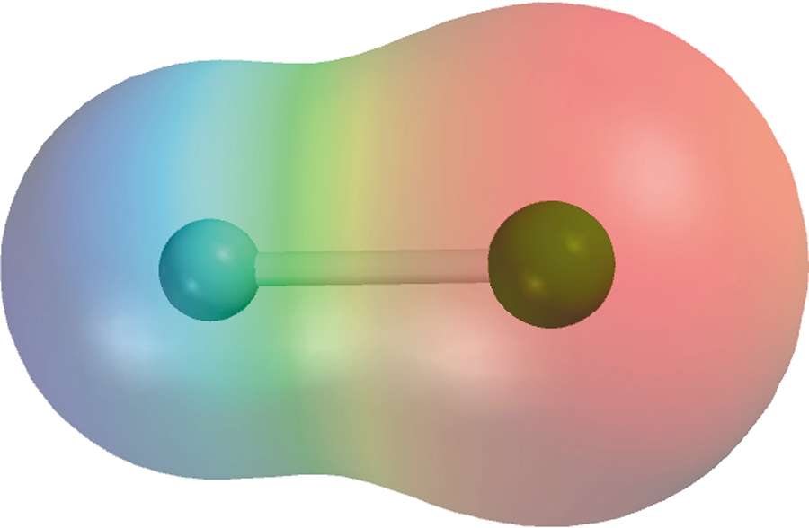
Polar Covalent Bond
A covalent bond with greater electron density around one of the two atoms
electron rich
region
electron poor
region
e⁻ poor
e⁻ rich
H
F
H
F
δ⁺
δ⁻

Slide 68
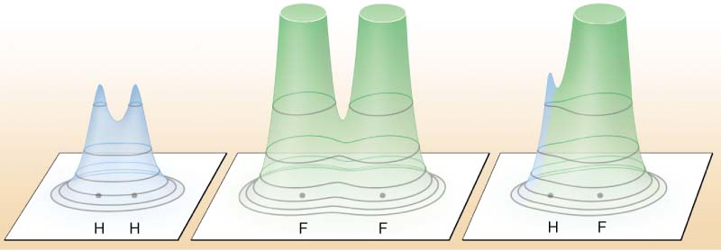
Electron density distributions in
H₂, F₂, and HF.

Slide 69
Metallic Bonds
How atoms are held together in the solid.
Metals hold onto there valence electrons very weakly.
Think of them as positive ions floating in a sea of electrons.

Slide 70
Sea of Electrons
Electrons are free to move through the solid.
Metals conduct electricity.
+
+
+
+
+
+
+
+
+
+
+
+

Slide 71
Metals are Malleable
Hammered into shape (bend).
Ductile - drawn into wires.

Slide 72
Malleable
+
+
+
+
+
+
+
+
+
+
+
+

Slide 73
Malleable
Electrons allow atoms to slide by.
+
+
+
+
+
+
+
+
+
+
+
+

Slide 74
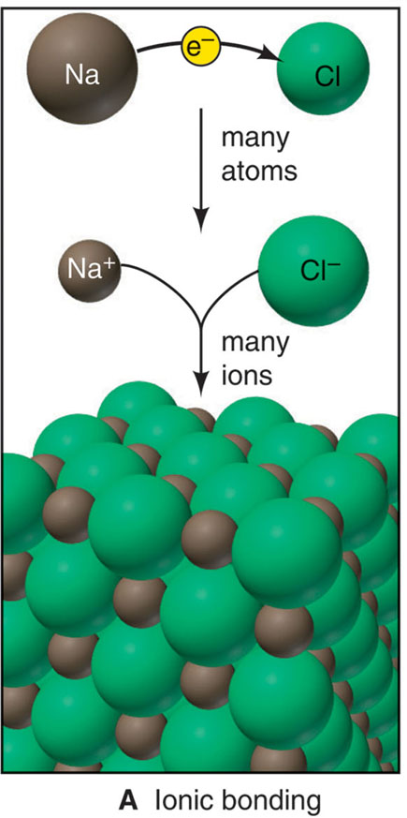
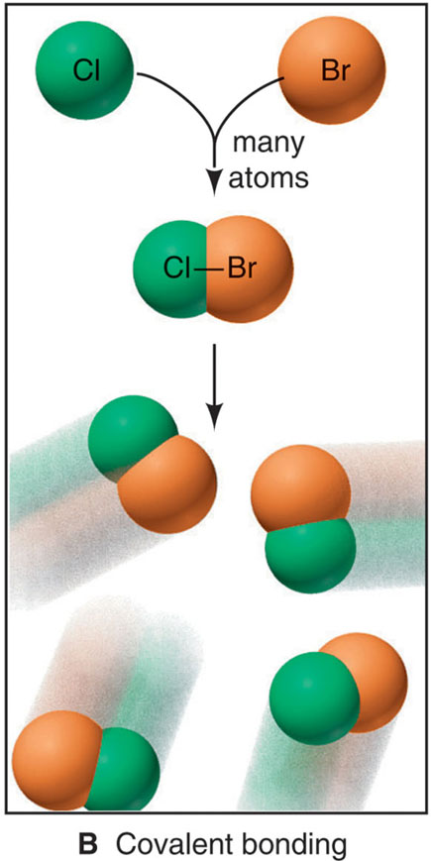
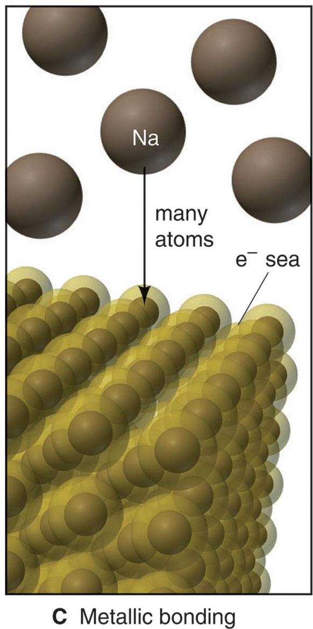
Three models of chemical bonding
Ionic
Covalent
Metallic
Electron transfer
Electron sharing
Electron pooling

Slide 75
THE
END

