Slide 2
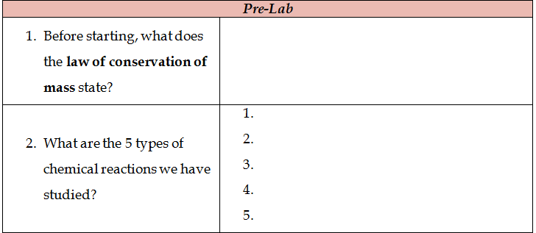
In a chemical reaction, mass cannot be lost or gained.
synthesis
decomposition
single-displacement
double-displacement
combustion

Slide 3
Reactants are the original substance, products are what is produced

Slide 4
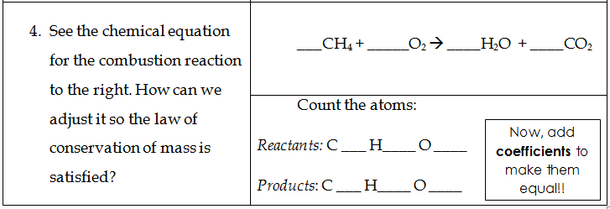
2
2
1
4
4
2
4
1
2
4
3

Slide 5
You try some! You will need a computer and a calculator.
Follow the instructions on your lab sheet!
When make sure you have at least 1 molecule of each!!!!

