Slide 1
W = F x d
F = (0.145) x 9.8=1.421N
W = (1.421) x 0.98
= 1.39 J

Slide 2
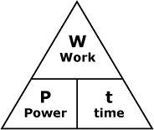
t = W/P
t = 2110/600
= 3.52 s
Complete the work faster – less time!!!

Slide 3
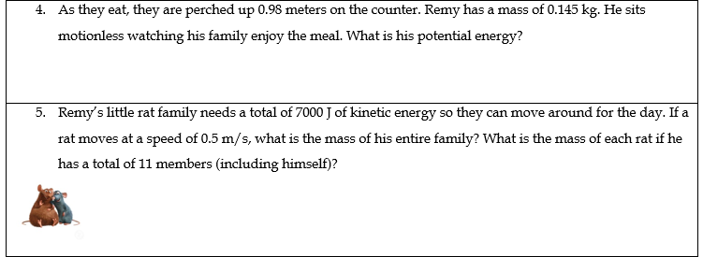
PE = mgh
= (0.145)(9.8)(0.98)
= 1.39 J
2.01
KE = 0.5mv²
2.01 = 0.125m
16.08/11 = m of each rat
0.125 0.125
1.46kg = m of each rat
2.01 = 0.5m(0.5)²
16.08kg = m

Slide 4
KE = 0.5mv²
10110 = 0.5(16.08)v²
1257.46 = v²
10110 = 0.5(16.08)v²
10110 = (8.04)v²
35.4m/s = v²
8.04 8.04
Wow super fast…

Slide 5
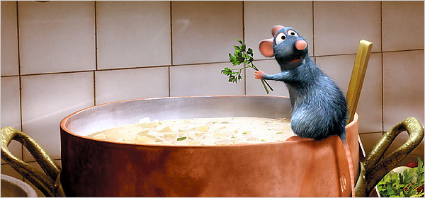
In your Quarter 2 lab groups – work through all 3 stations with 10 minutes at each station!
When you are all done, text in on the poll on the board!

