Slide 2
A deflated hot-air balloon weighs a total of 8000 N. Filled with hot air, the balloon rises to a height of 1000 m. How much work is accomplished by the hot air?
Work = F d
Work = (8000N) (1000m)
Work = 8,000,000 J

Slide 3
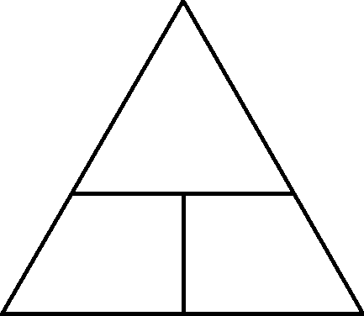
A horse can do 3100 J of work by applying 600 N of force to the carriage it is pulling. How far can it pull the carriage?
W
d = W/F
F
d
d = (3100J) / (600m)
d = 5.17 m

Slide 4
Cheryl is a young girl climbing up a 3 m flight of 10 stairs. She is essentially “carrying” herself up the stairs, and her weight is 50 N. What is the total work done? What is the work done per step?
Work = F d
Work = (50N) (3m)
Work = 150 J / 10 = 15 J per step

Slide 5
How long does it take Cheryl to cut the grass if her lawnmower has 400 watts of power and she needs to do 16,000 J of work?
W
Power = W / t
P
t
t = W / P
t = (16000J) / (400W)
t = 40 s

Slide 6
Cheryl’s friend James weighs 49 N and wants to push Cheryl in a shopping cart which weighs 38 N across the parking lot. The parking lot is 62 meters long, and it takes James 3 minutes to push her all the way across.
Work = (50N+38N) (62m)
Work = 5456 J
Power = (5456 J)/(3x60)
Power = 30.3 W
Horsepower = 30.3 W / 746 = 0.04hp

Slide 7
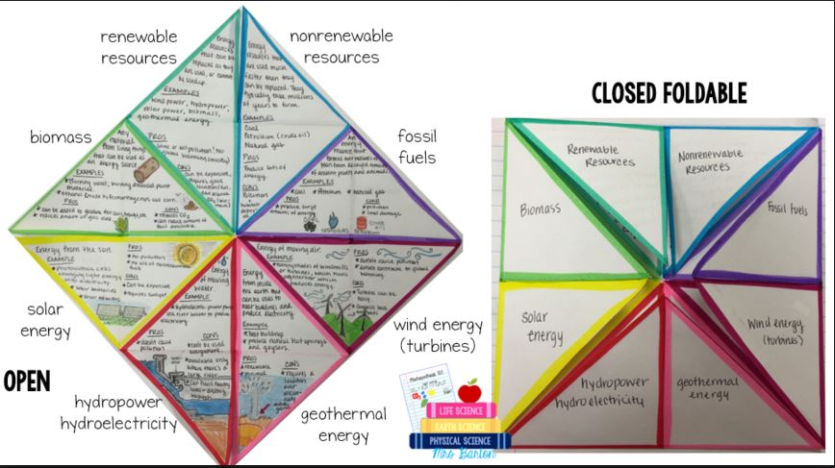
Using your book – or the online readings (15.3) – make the foldable. Replace wind energy with nuclear plants.

