Slide 1
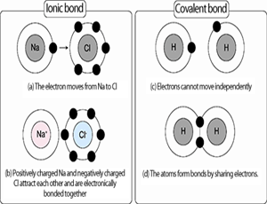
Bellwork 1. What do you remember about ionic bonds? 2. What do you remember about covalent bonds?

Slide 2
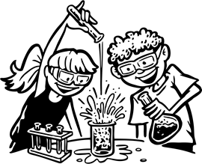
3. Remember that atoms bond together to have a full ________________ shell, and to create _________ substances. 4. This chapter, we will be looking at ________________ ______________, which is a process that one or more substances ______________ to form new substances. 5. There are many different types of chemical reactions. Can you give an example of two? Write the examples below.
valence
new
chemical
reactions
change

Slide 3
6. What are some things that show a chemical reaction is happening?
Gas formation
Energy Change
Solid formation
Color change

Slide 4
7. What do we call a solid formation in a chemical reaction?
precipitate
Let’s watch a precipitate.

Slide 5
8. What is are the parts in a chemical reaction?
Reactants are the original substances in a chemical reaction.
Products are the substances that are created in a chemical reaction.

Slide 6
9. Label the formula for a reaction
2Al + 3Br₂ → 2AlBr₃
Reactants
Product

Slide 7
10. What are the five types of reaction?
synthesis
Single-displacement
decomposition
Double-displacement
Combustion

Slide 8
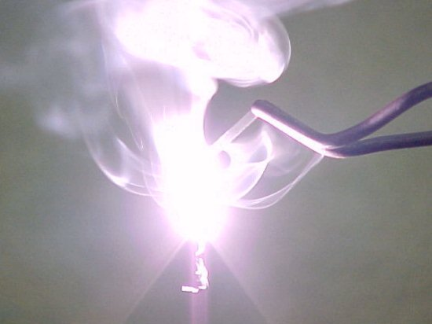
A + B → AB
11. A synthesis reaction occurs when two substances, usually two elements combine and form one compound.
Example: 2H₂ + O₂ → 2H₂O
Example: C + O₂ → CO₂

Slide 9
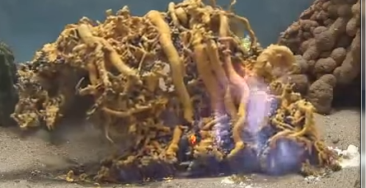
AB → A + B
12. A decomposition reaction occurs when one larger compound is broken down into two smaller substances.
Example: 2 H₂O → 2H₂ + O₂
Example: 2 HgO → 2Hg + O₂

Slide 10
A + BC → B + AC
13. A single-displacement reaction occurs when one element takes the place of another in a compound.
Al(s) + CuCl2(aq) → AlCl3(aq) + Cu(s)

Slide 11
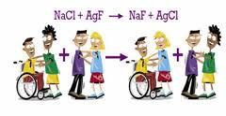
AB + CD → AD + CB
14. A double-displacement reaction occurs when ions exchange places in two compounds.

Slide 12
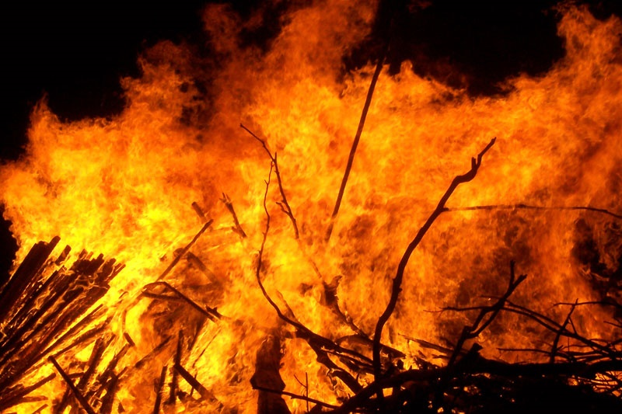
15. A combustion reaction is a reaction of a carbon-based compound with oxygen.
Combustion of propane:
C3H8 + O2 → CO2 + H2O
Combustion of ethanol:
CH3CH2OH + O2 → CO2 + H2O

Slide 13
Now, work on the vocabulary and the worksheets attached. You will need colored pencils!

