Slide 1
Bellwork: What do you think the difference between accuracy and precision?

Slide 2
1. Significant figures
We can only be as precise as our least precise measurement.
0.00034 m – 2 significant figures
0.001 m – 1 significant figures

Slide 3
2. Scientific Notation
We are lazy… we don’t want to write a ton of zeroes.
A way of expressing a value as a number between 1-10 and a power of ten.
Example: speed of light 300,000,000 m/s
Scientific notation = 3.0 x 10⁸ m/s
The exponent indicates how many places the decimal moved.

Slide 4
2. Scientific Notation
Exponent is positive: greater than 1
Exponent is negative: less than 1 (decimal)
Example: 0.00086
8.6 x 10⁻⁴

Slide 5
2. Scientific Notation
4.2 x 10⁴
3.9 x 10⁻⁶
450,000
42000
0.0000039
4.5 x 10⁵

Slide 6
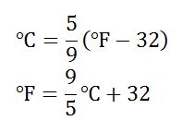
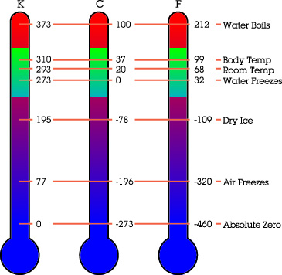
3. Temperature conversions
or 5F˚ = 9C˚ + 160
SI Unit: Kelvin
K = C˚ + 273
C˚ = K – 273
MUST be in Celsius to get to Kelvin
0K = absolute zero

Slide 7
5. Metric Conversion
King Henry Died by Drinking Chocolate Milk
kilo hecta deka BASE deci centi milli
meter, liter, gram
1000 100 10 1 0.1 0.01 0.001

Slide 8
6. Factor Label Method
1) Write given number over 1.
39 cm
1

Slide 9
6. Factor Label Method
2) Multiply the given by a fraction set up with the unit you were given on the bottom, and the unit you need to convert to on the top.
39 cm
m
1
cm

Slide 10
6. Factor Label Method
3) The larger unit gets a 1. The other unit gets the conversion factor.
1
m
39 cm
100
cm
1

Slide 11
6. Factor Label Method
4) Multiply the numbers on top, divide by the numbers on the bottom.
1
m
39 cm
0.39
100
cm
1

Slide 12
6. Factor Label Method
5) Cancel out units that appear on the top and bottom.
1
m
39 cm
0.39
100
cm
1

Slide 13
6. Factor Label Method
6) Rewrite with the final units.
1
m
39 cm
0.39
m
100
cm
1

Slide 14
Metric Conversions
A dose of placebo is 2000 mg of sugar. How many grams is this?
2000 mg x ________ = ________g
1 g
2
1000 mg

Slide 15
Metric Conversions
You run a 104 km race. (WHOA)
How many meters is this?
104 km x ________ = ________g
1000 m
104,000
1 km

Slide 16
Work on rest of classwork packet
Homework sheet DUE TOMORROW
Measurement lab due tomorrow too!!!

