Slide 1
Chapter 1 Review!
http://shhsphysicalscience.weebly.com
Key for Review is posted– it is in YOUR best interest to attempt the questions and THEN check yourselves!!

Slide 2
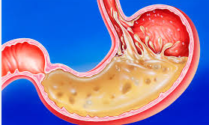
Chapter 1 Review!
Branches of Natural Science
Biology
Earth and Space
Physical science
Physics
Chemistry
Do they overlap?

Slide 3
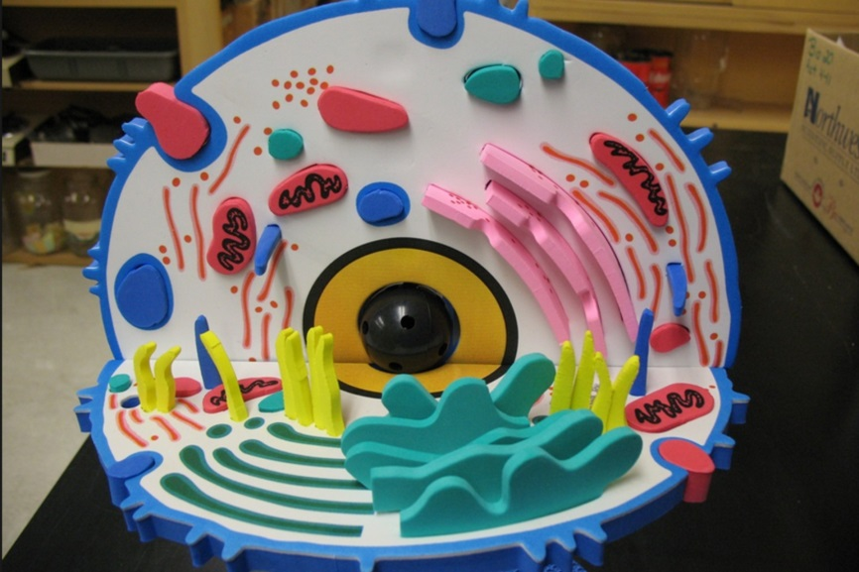
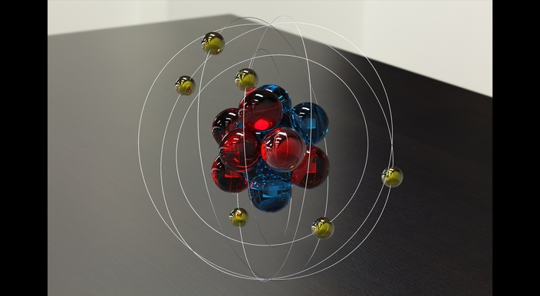
Chapter 1 Review!
Scientific Method and Concepts
Scientific Method
Technology
Precision vs. Accuracy
Models
larger
smaller

Slide 4
Chapter 1 Review!
Measurement
Metric prefixes
SI Measurements
Base Units
Derived units
Area --- m²
Volume --- m³
Density --- kg/m³

Slide 5
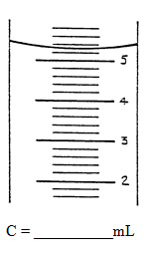
Chapter 1 Review!
Graduated cylinder
2.3
~5.1
___ cm?

Slide 6
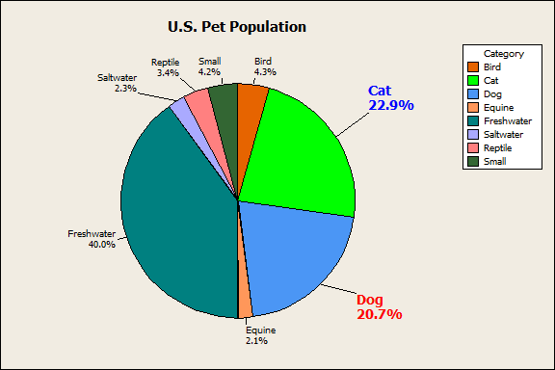
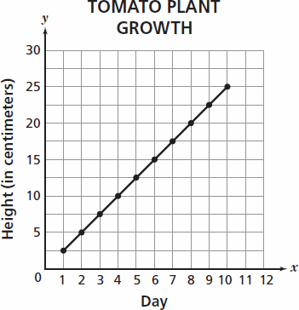
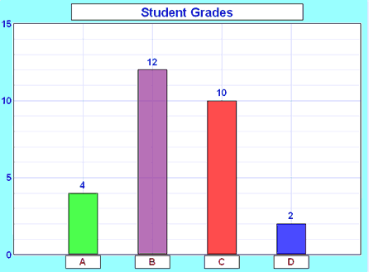
Chapter 1 Review!
Graphs
Pie Chart
Bar Graph
Line Graph

Slide 7
Chapter 1 Review!
Calculations
Scientific notation
0.000027 =
Metric Conversions
See review from yesterday!!
2.7
x 10
⁻
⁵

Slide 8
Chapter 1 Review!
Work on your Chapter 1 Review or other Packet
Use your book
REST OF PACKET DUE TOMORROW!!!

