Slide 1
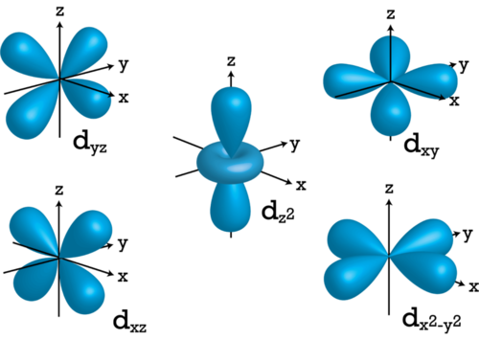
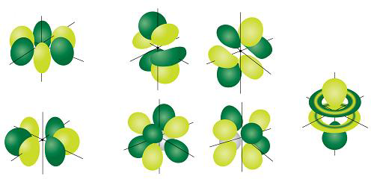
Bellwork: What are the types of orbitals?
s, p, d, f

Slide 2
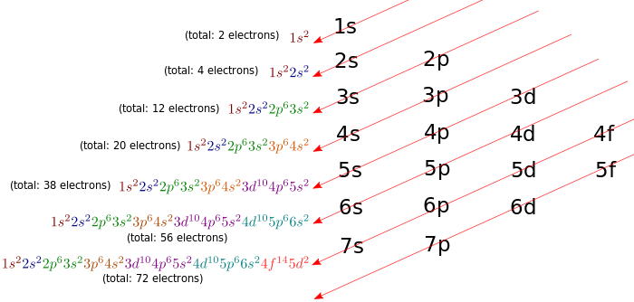
Remind Me: How can an electron configuration be compared to an address?
Probable energy levels/orbitals the electrons

Slide 3
Remind Me: How can an electron change its “address”?
Absorb or release energy

Slide 4
1. Electrons in the outmost energy levels are called valence electrons. They are important to an atom’s reactivity and bonding.

Slide 5
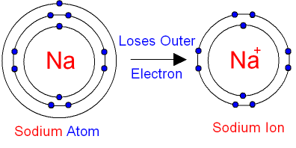
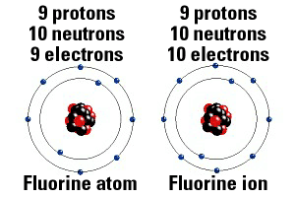
An atom is more stable if it has 8 electrons in its outermost energy level. (There are two exceptions; hydrogen and helium only need two electrons to fill their outermost energy level)
2. Ions
To become more stable, an atom will gain or lose electrons. It now has a net charge.
Atoms with 8 valence electrons have a complete octet.

Slide 6
3. Ions can be positive (cations) or negative (anions).
Group 1 elements have one electron in their outer shell and tend to lose that electron to form positive ions.
Group 17 elements have 7 electrons in their outer shell and tend to gain one electrons and form negative ions.
What do you think happens to group 2 and group 16 elements?
Group 2 – loses 2 → +2
Group 16 – gains 2 → -2

Slide 7
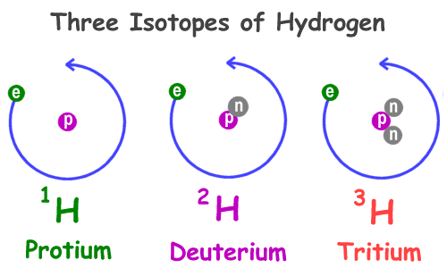
4. For a neutral atom the atomic number is equal to both the number of electrons and number of protons in the atom.
What is the atomic number for Hydrogen?
What is the atomic number for Uranium?
5. Every different element has a different number of protons, however two or more atoms of the same element may have a different number of neutrons.

Slide 8
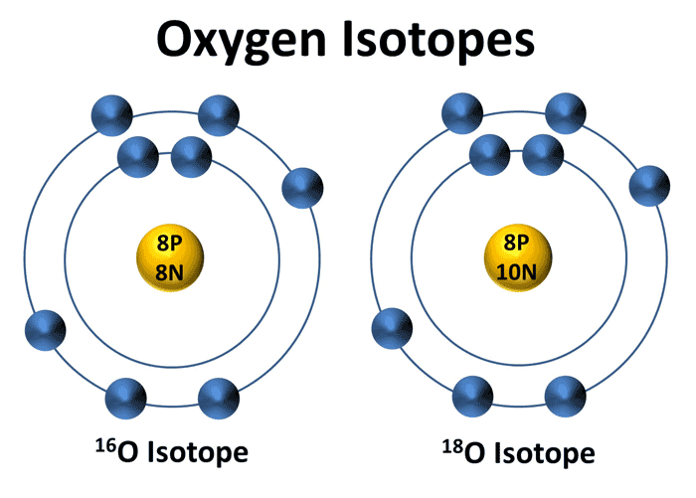
6. Isotopes are atoms of the same elements that have different numbers of neutrons.

Slide 9
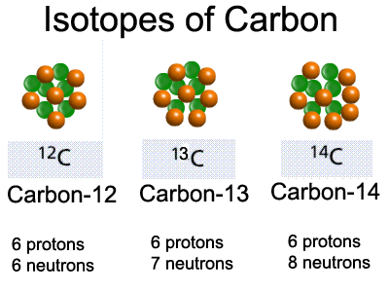
7. The mass number distinguishes between isotopes and is the total number of protons and neutrons in the atom. Eg.: Carbon-12 and Carbon-13

Slide 10
8. We can also express isotopes with chemical symbols. Let’s do Carbon-12.
Mass number
Chemical symbol
12
C
6
Atomic number
Mass number – atomic number = neutrons
12– 6= 6 neutrons
How many neutrons does ²³⁵U have?
⁹²
235-92 = 143 neutrons

Slide 11
Try some on your own! Work on the Homework packet. Then, complete the exit ticket and turn it in.

