Slide 1
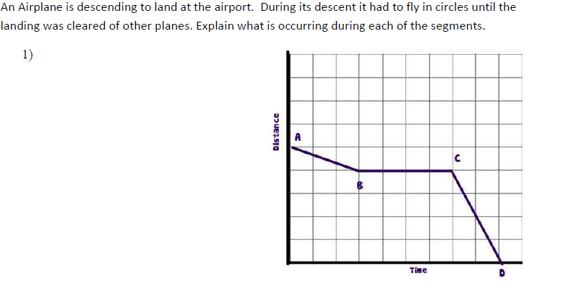
AB –
BC –
CD –
Descending slowly
stationary
Landing quickly, Lands

Slide 2
Try pages 3-6 on your own (~20 minutes)

Slide 3
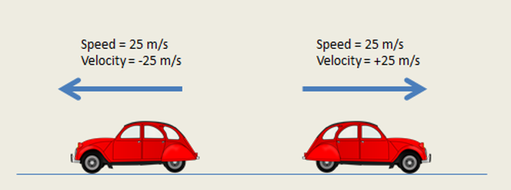
Bellwork
How is velocity different from speed? Give an example.

Slide 4
Acceleration
_______________________ can be described as changes in __________________, changes in ___________________, or changes in both. This means acceleration is a _____________.
An example of change in ___________ is a ____________________.
speed
direction
vector
speed
free fall

Slide 5
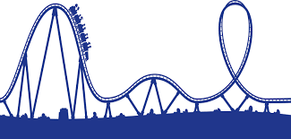
3. A change in direction example would be a ______________________________.
4. A __________________________ shows both of these changes.
carousel
roller coaster

Slide 6
5. The formula for acceleration is shown below:
∆
change in velocity
$acceleration=a= \frac{ }{ }=\frac{(vf−vi)}{t}$
Time interval

Slide 7
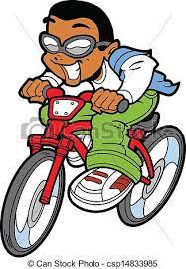
Little Timmy rides his bicycle north to school each day. His initial velocity is 0 m/s. After 2 minutes, his velocity is 6 m/s. Find the kid’s acceleration in meters per second squared (m/s²). Remember to include direction.
V_{i}= 0m/s
t= 2 min
Given:
Unknown:
a =?
V_{f}= 6m/s
Conversions:
2 min x $\frac{60 s}{1 min}$
= 120 s
Solve:
a = $\frac{(vf−vi)}{t}=\frac{6−0}{120}=$
0.05
m/s²
Write acceleration including direction:
0.05m/s² north

