Slide 1
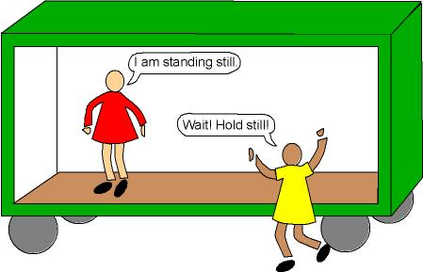
Bellwork
What is frame of reference?

Slide 2
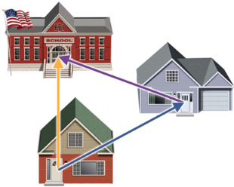
Motion
_______________________ is an object’s change in position relative to a _______________________.
_______________________ is the change in the position of an object.
_______________ measures the total path taken.
Displacement is the change of an object’s position. Displacement must always indicate _____________________.
reference point
Displacement
Distance
direction
This is called a vector!

Slide 3
Let’s make a motion graph from a scenario.
A squirrel walks from a tree (position 0 m) to his hole in a log (position 1 m) in 1 sec. He hears a dog coming and sprints to another tree (position 5 m). The squirrel remains in the tree for 2 sec until he feels safe enough to return to the log (1 m) in 1 sec.
0m
1m
2m
3m
4m
5m
t=0
t=1
t=2
t=3
t=5
t=4

Slide 4
0m
1m
2m
3m
4m
5m
t=0
t=1
t=2
t=3
t=5
t=4
What was the squirrel’s total displacement?
1m +
What was the squirrel’s total distance?
9 m

Slide 5
6. Let’s make a position vs. time graph.
A squirrel finds acorns at a log (position 4 m) and wants to return to his own log. In 1 sec he walks halfway (3m) then finds his log after another sec (1m). He stays at his log for 1 more sec, then meets a squirrel friend for lunch at the nearest mushroom (2m).
0m
1m
2m
3m
4m
5m
t=2
t=3
t=1
t=0
t=4

Slide 6
6. Let’s make a position vs. time graph.
0m
1m
2m
3m
4m
5m
Position (m)
t=0
0 1 2 3 4 5
t=1
t=2
t=3
t=5
t=4
0 1 2 3 4 5
Time (s)

Slide 7
Speed
7. ___________________ is the distance traveled divided by the _________________ interval
during which the motion occurred. Speed describes how _________ an object moves.
8. Speed measurements involve _________________ and _______________.
9. The SI units for speed are _________________ per _____________ (m/s).
When an object covers equal distances in equal amount of time, it is moving at a ______________________________.
time
fast
distance
time
meter
second
Constant speed

Slide 8
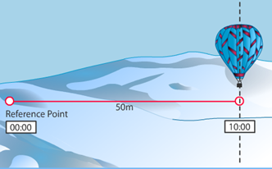
$$Speed= \frac{distance}{time}= \frac{ }{ }= \frac{ }{ }$$

Slide 9
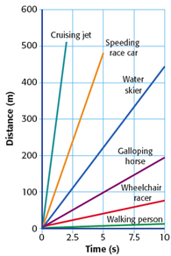
11. Speed can be studied with graphs and equations. Speed can be determined from a distance-time graph. When an object’s motion is graphed by plotting _______________ on the y-axis and __________ on the x-axis, the slope of the graph is speed.
distance
time

Slide 10
velocity
__________________________ is the speed of an object in a particular _____________________.
Velocity describes both __________________ and the ___________________.
direction
speed
direction

Slide 11
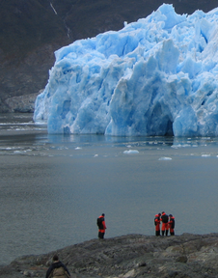
Velocity – Metal stakes are sometimes placed in glaciers to help measure glacier’s movement. For several days in 1936, Alaska’s Black Rapids glacier surged as swiftly as 89 meters per day down the valley. Find the glacier’s velocity in meters per second (m/s). Remember to include direction.

Slide 12
Let’s try page 4 together…
Pages 5-8 with a partner or alone.

Slide 13
Try the other scenario, then check with a partner.
0m
1m
2m
3m
4m
5m
t=2
t=3
t=1
t=0
t=4
Position (m)
0 1 2 3 4 5
0 1 2 3 4 5
Time (s)

Slide 14
Finally, we also looked at velocity v. time graphs in the Moving Man lab, which look at changes in speed and direction over time.
What is happening in this graph?
Stationary for 2 sec
Speeds up to 2 m/s for 2 sec
Constant velocity of 2 m/s for 1 sec
Constant velocity of 4 m/s for 1 sec
Velocity(m/s)
0 1 2 3 4 5
0 1 2 3 4 5
Time (s)

Slide 15
A fish is swimming at a constant velocity of 3 m/s for 2 sec until she speeds up immediatly to escape a predator to 5 m/s for 1 sec. Unfortunately, she does not outswim the predator and the velocity drops immediately to 0 m/s.
Velocity(m/s)
0 1 2 3 4 5
0 1 2 3 4 5
Time (s)

Slide 16
On Your Own
Try out these practice problems in your notes. They will not be collected, but these will be helpful for the quiz tomorrow! ☺

