Slide 1
Triple bond

Slide 2
2 single bonds

Slide 3
H₂O _____________________________________
Na _____________________________________
C₁₂H₂₂O₁₁ _____________________________________
MgF₂ _____________________________________
covalent
metallic
covalent
ionic

Slide 4
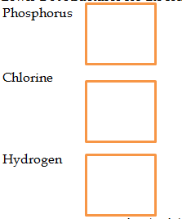
P
Cl
H

Slide 5
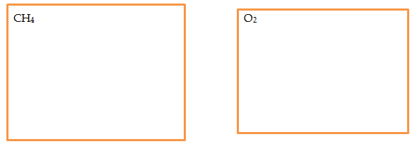

Slide 6
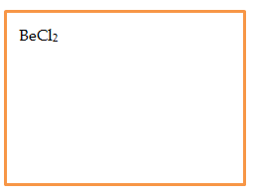

Slide 8
What would describe a metallic bond?
Metals bonding with a sea of electrons

Slide 9
What would describe a covalent bond?
Nonmetals sharing electrons

Slide 10
What would describe an ionic bond?
Nonmetal taking electron from metal; rigid crystalline structure

