Slide 1
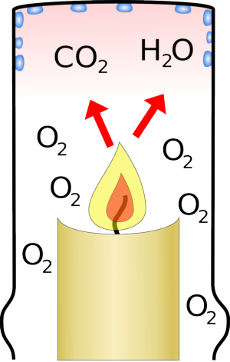
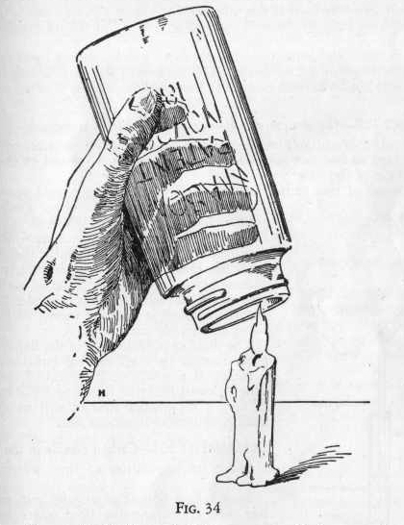
Bellwork: What did you notice from the candle lab? How did you revise your hypotheses?

Slide 2
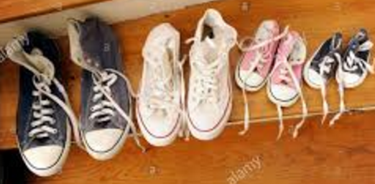
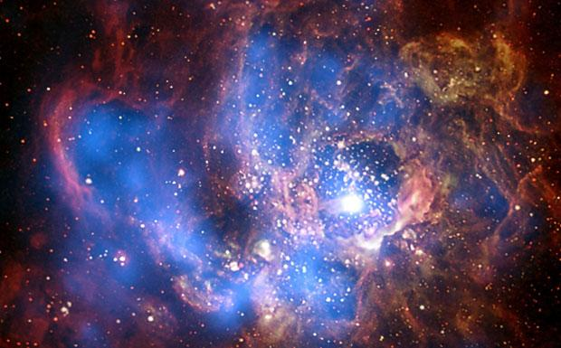
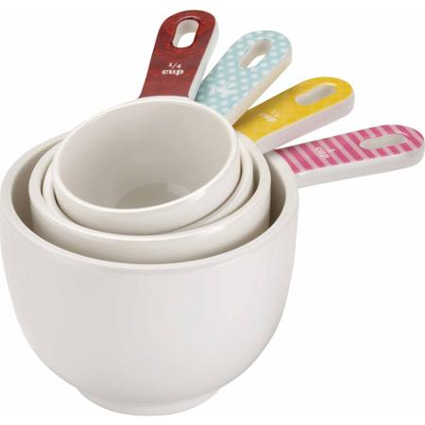
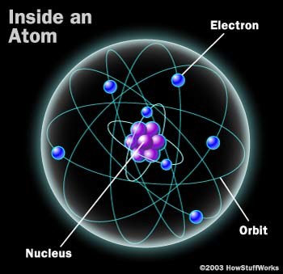
1. What are some things you measure in your daily life? Why?
2. What are some things we measure in science?

Slide 3
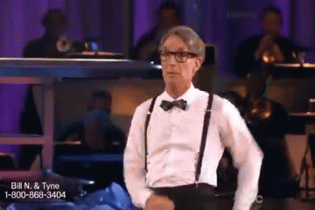
3. Let’s hear what Bill Nye has to say about measurement. ☺

Slide 4
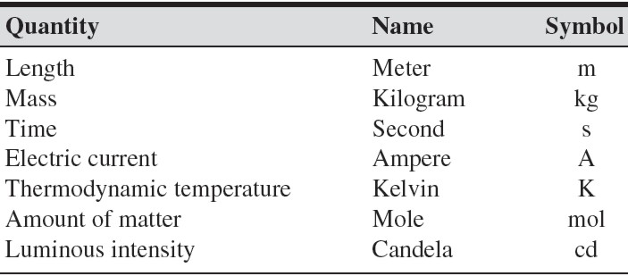
4. Why is it important to have a standard system of measurement?
Système Internationale
Derived Units

Slide 5
Metric Conversion
King Henry Died by Drinking Chocolate Milk
kilo hecta deka BASE deci centi milli
meter, liter, gram
1000 100 10 1 0.1 0.01 0.001

Slide 6
Metric Conversion
King Henry Died by Drinking Chocolate Milk
kilo hecta deka BASE deci centi milli
meter, liter, gram
1000 100 10 1 0.1 0.01 0.001

Slide 7
Metric Conversions
A dose of placebo is 2000 mg of sugar. How many grams is this?
2000 mg x ________ = ________g
1 g
2
1000 mg

Slide 8
Metric Conversions
You run a 104 km race. (WHOA)
How many meters is this?
104 km x ________ = ________g
1000 m
104,000
1 km

Slide 9
Weekly Agenda
Class website (http://shhsphysicalscience.weebly.com)
Candle Lab – points available!
Quiz 2 – sign up if you were absent
Progress Reports – MISSING WORK DUE BY FRIDAY
Independent work: Measuring Liquids, Measuring Length, Metric System, Scientific Notation

