Slide 1
Object at rest stays at rest,
object in motion stays in motion unless acted on my external force.
Person was traveling at a speed with the car. Car comes to a stop, but inertia keeps the person moving. Seatbelt stops you at the external force.

Slide 2
F = ma
a = F/m
F
m
a
a = 50 N/ 5kg a = 10 m/s²

Slide 3
When you kick an object (ball or furniture), the object pushes back with equal and opposite force. Don’t you feel it??

Slide 4
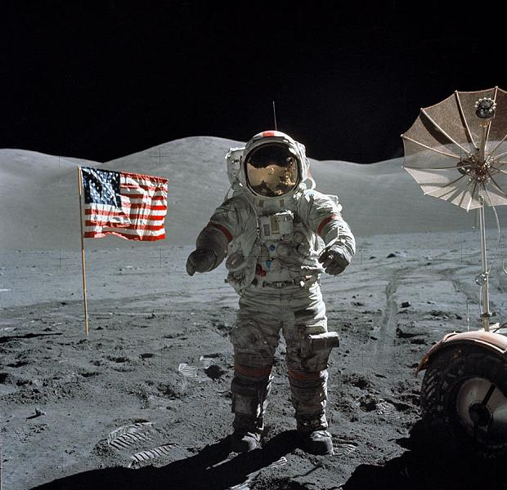
How would mass change?
How would weight change?
Mass would not – weight would decrease.

Slide 5
1. What is an object’s mass?
Mass is the amount of matter. It is the measure of inertia.

Slide 6
2. What is an object’s weight?
Weight is the force of gravity acting on an object. Product of mass and acceleration due to gravity.

Slide 7
3. How do we measure weight?
The same way we measure ____________________ with the unit __________________ since 1 ___________ equals 1 _________________.
forces
Newton
kg x m/s²
Newton

Slide 8
4. How do we calculate weight?
Using the formula:
Weight = mass x gravity

Slide 9
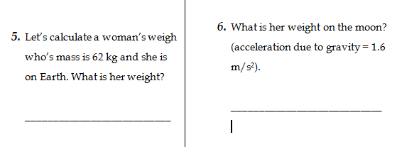
Weight = 62kg x 1.6m/s²
Weight = 62kg x 9.8m/s²
Weight = 99.2 N
Weight = 607 N

Slide 10
7. What is momentum?
Momentum is the product of an object’s mass and its velocity.

Slide 11
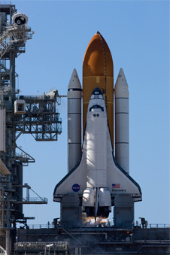
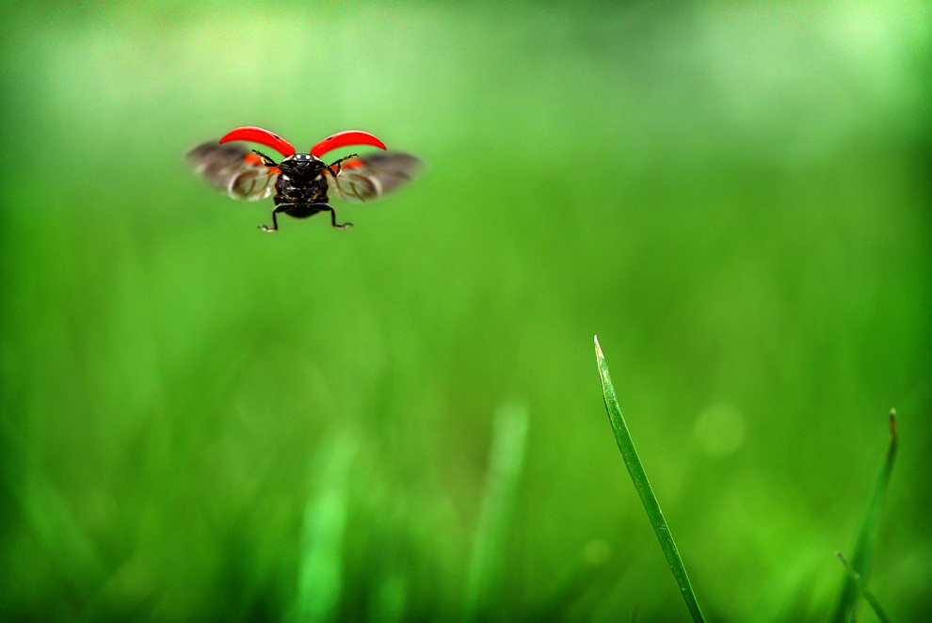
8. Which has higher momentum?
Insect – the ship is not moving, therefore velocity is 0 m/s.

Slide 12
9. We can calculate momentum with the following formula:
Momentum = mass x velocity
10. So what is the unit for momentum?
kg x m/s

Slide 13
11. What happens to momentum when objects collide? _______________________________________states that in a ______________ system (which means no _________________ acting on the system), the _________________________________ of the system does not change. Momentum is ________________________.
Law of Conservation of Momentum
closed
net force
total momentum
conserved

Slide 14
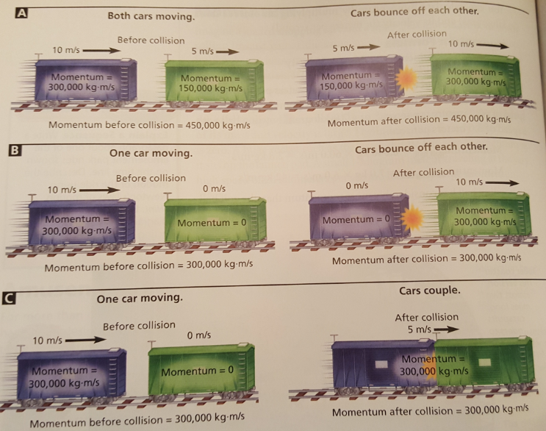

Slide 15
Practice on your own then we will check our answers!
Momentum practice problems for homework

