Slide 1
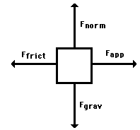
What is the “net force”? What does it tell us?

Slide 2
Notes:
Poll Title: Rate yourself on a scale of 1-5 (1=I still need lots of help! to 5=I am a pro!) on the following statement: I can define all of the common forces in a free-body diagram. https://www.polleverywhere.com/multiple_choice_polls/EEnt6KR8V0ggAOE

Slide 3
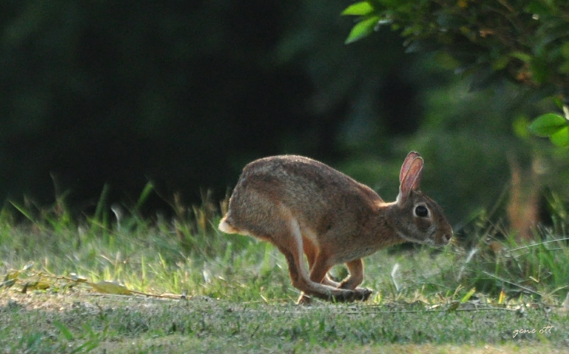
What would the free-body diagram look like for a rabbit accelerating rightward?
F_{n}
F_{f}
F_{a}
F_{g}

Slide 4
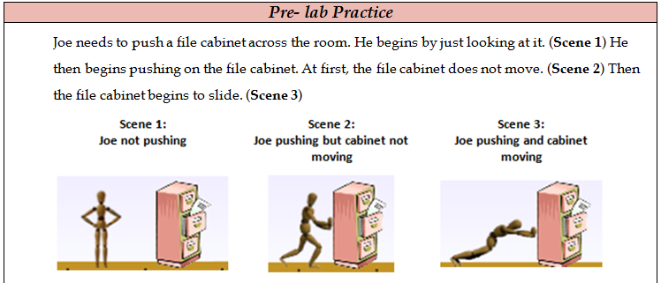
Take 3-4 minutes to complete the Pre-lab activity then check with a neighbor.

Slide 6
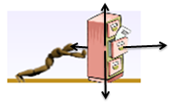
2.Why do you think the file cabinet moves in scene 3 but not in 1 or 2?
Unbalanced!

Slide 7
3. If the floor were covered with ice, how would the motion of the cabinet change?

Slide 8
Grab a computer
Go to http://shhsphysicalscience.weebly.com
Mouse- over Foundations Physical Science → Click Week 8 → Click “Forces and Motion Virtual Lab”
At the end we will reflect on our goals.

Slide 9
Notes:
Poll Title: Rate yourself on a scale of 1-5 (1=I still need lots of help! to 5=I am a pro!) on the following statement: I can create and interpret free-body diagrams. https://www.polleverywhere.com/multiple_choice_polls/xXnhRjU8uwzMMiu

