Slide 1
I can…
Define forces. Explain types of friction.

Slide 2
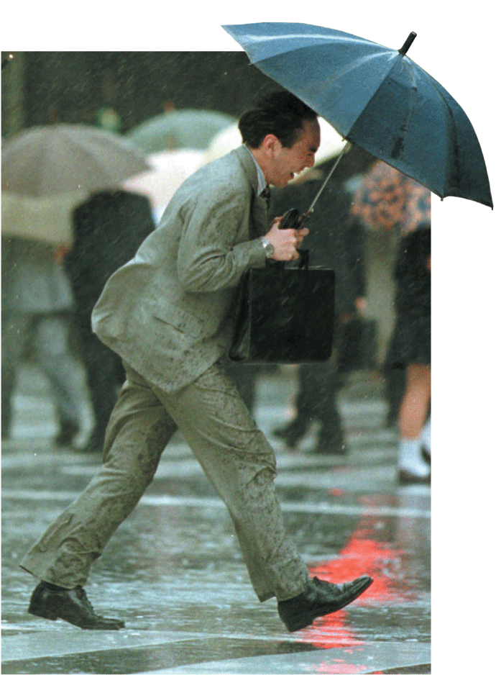
Complete the Bellwork section

Slide 3
1. A force is a push or a pull that acts on an object.
2. A force can cause a resting object to move, or it can accelerate a moving object by changing the object’s speed or direction.

