Slide 1
I can…
Distinguish between types of energy. Define conservation and conversion of energies.

Slide 2
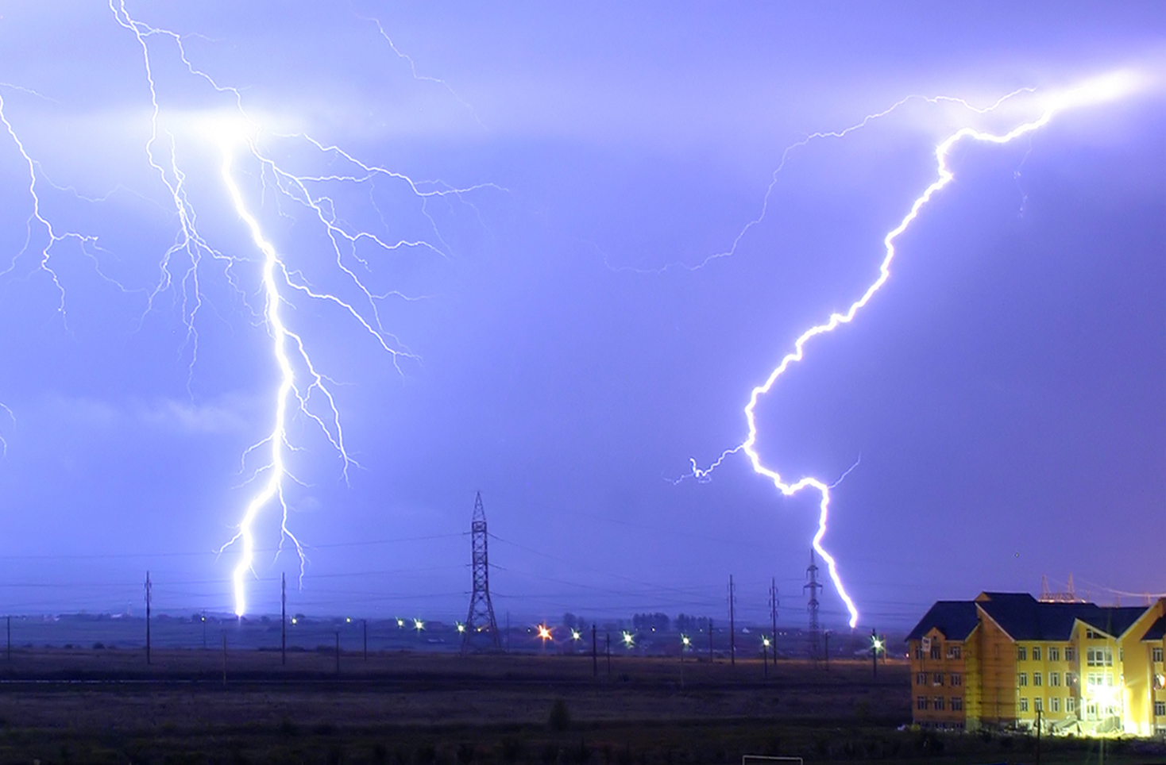
List as many types of energies as you can.

Slide 3
1. What are the forms of potential energy?
A – Gravitational potential energy
B – Elastic potential energy

Slide 4
2. What is elastic potential energy?
Potential energy of an object that is stretched or compressed.

Slide 5
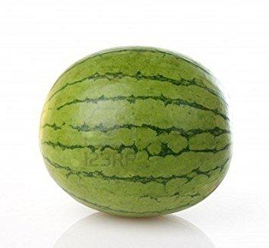
3. a-Predict b-Observe c-Explain
4. How does the experiment demonstrate elastic potential energy?

Slide 6
4. How does the experiment demonstrate elastic potential energy?
WHY

Slide 7
5. What are the major forms of energy?
-Mechanical
-Thermal
-Chemical
-Electrical
-Electromagnetic
-Nuclear

Slide 8
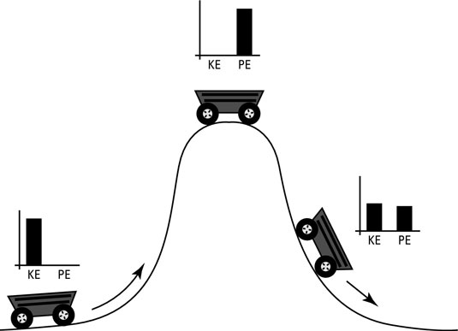
6. ____________________ is the ______ of _____________________.
Mechanical energy
sum
potential and kinetic energy

Slide 9
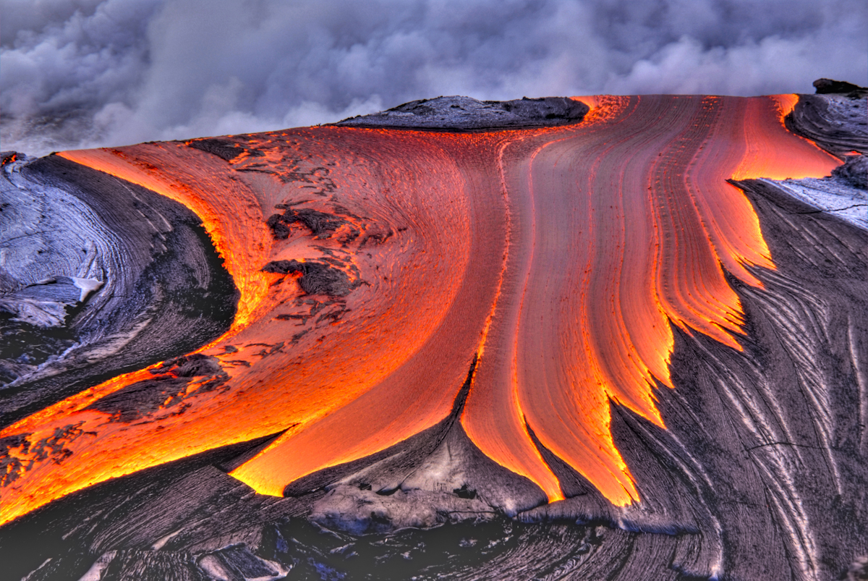
7. _____________ is the total potential and kinetic energy associated with the _____________ of all the ___________ in an object.
Thermal energy
motion
particles

Slide 10
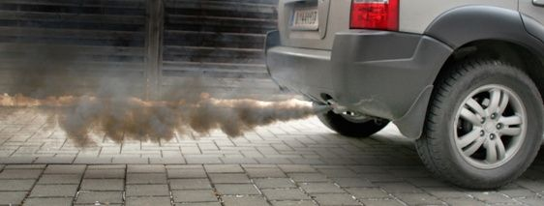
8. ______________ energy is the energy ___________ in chemical __________.
Chemical
stored
bonds

Slide 11
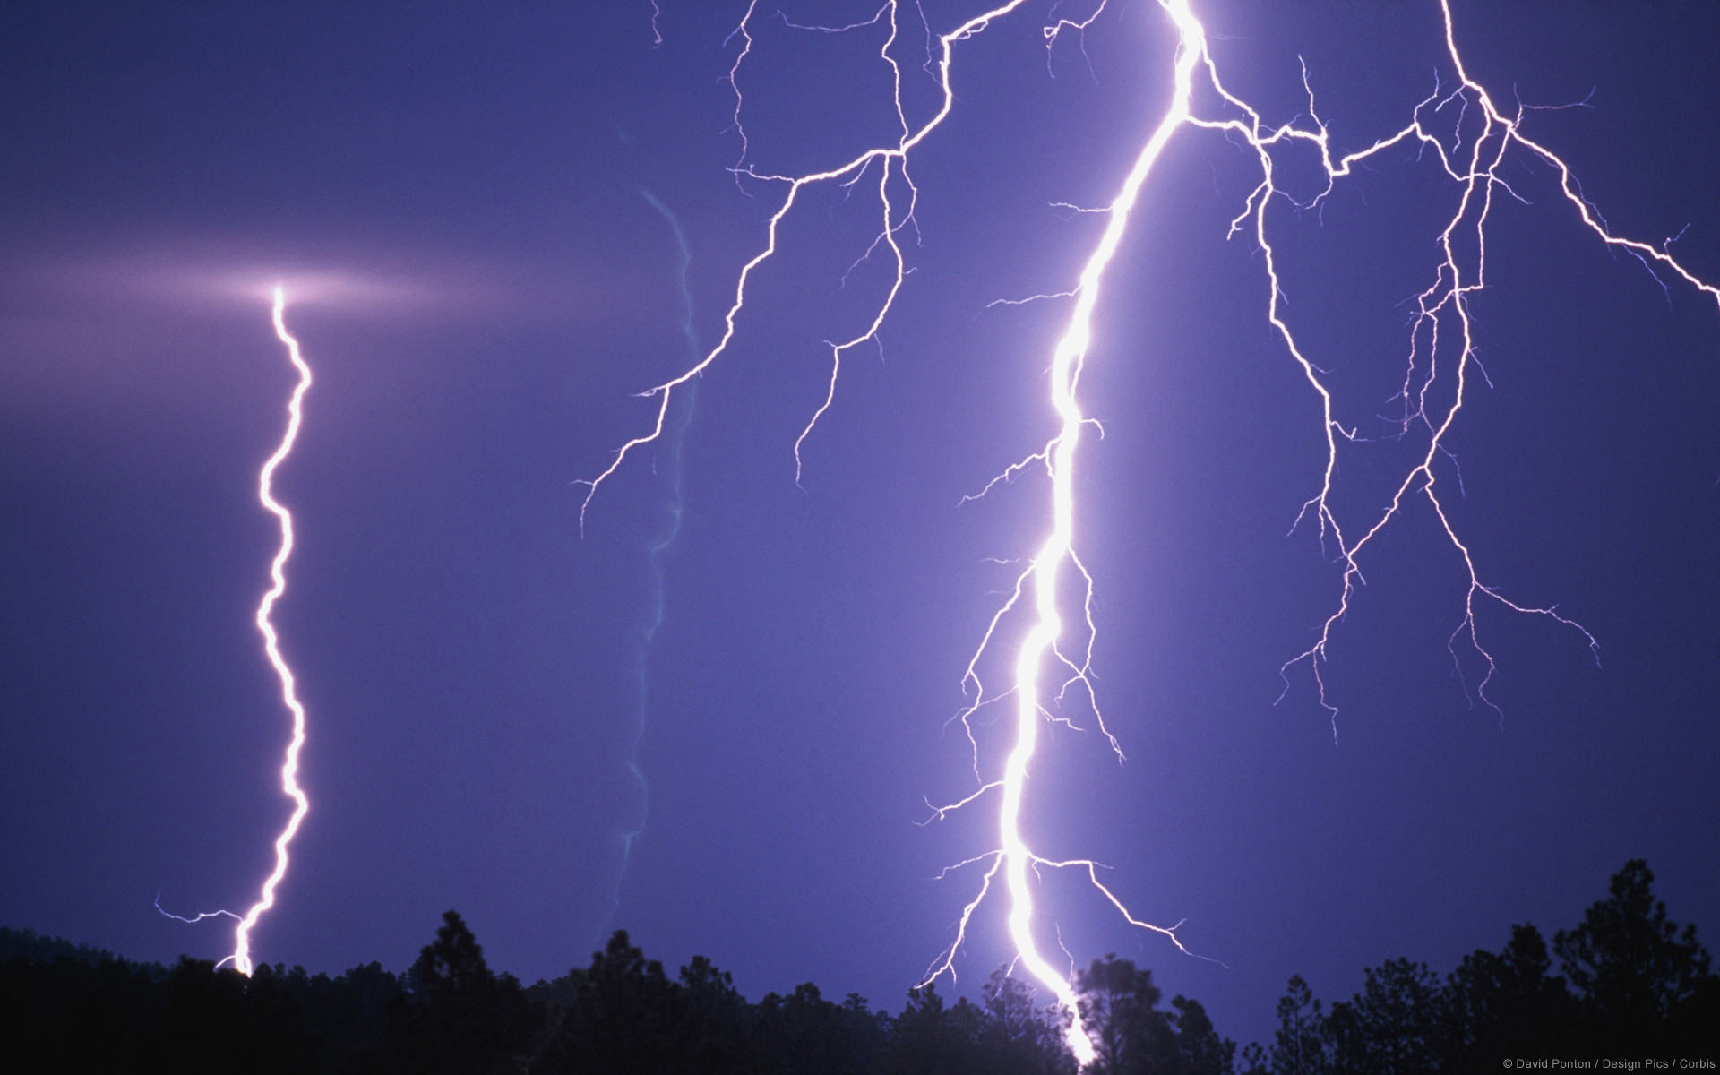
9. _____________ energy is the energy associated with _____________________that do work.
Electrical
electric charges

Slide 12
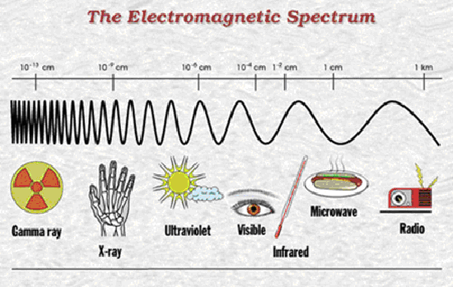
10. ____________________ is the energy that _________________ in the form of _______________.
Electromagnetic energy
travels through space
waves

Slide 13
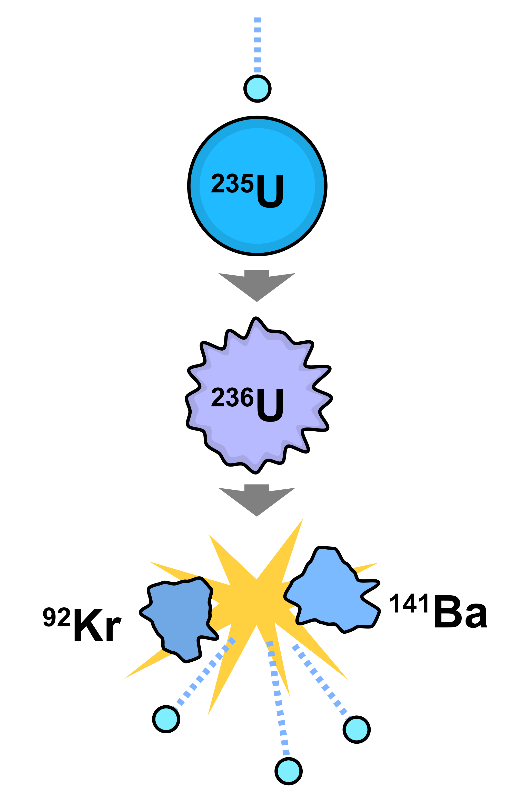
11. _____________ energy is the energy ___________ in atomic _____________. Energy is __________ during nuclear __________ and ____________.
Nuclear
contained
nuclei
released
fission
fusion

Slide 14
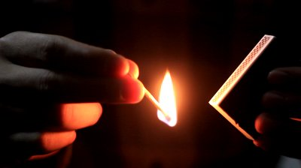
12. Energy can be ___________ from one ________to another.
converted
form

Slide 15
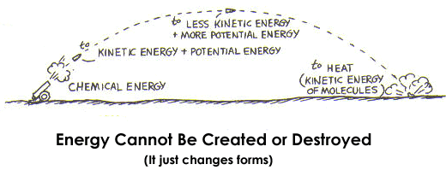
13. The ________________________ states that energy cannot be _______ or _____________.
Law of Conservation of Energy
created
destroyed

Slide 16
Do the practice questions on your own and then check with a neighbor!
Then we will check them as a class.
Afterwards, we will review our quiz.

