Slide 1
Bellwork
What is required for electric current to flow?

Slide 2
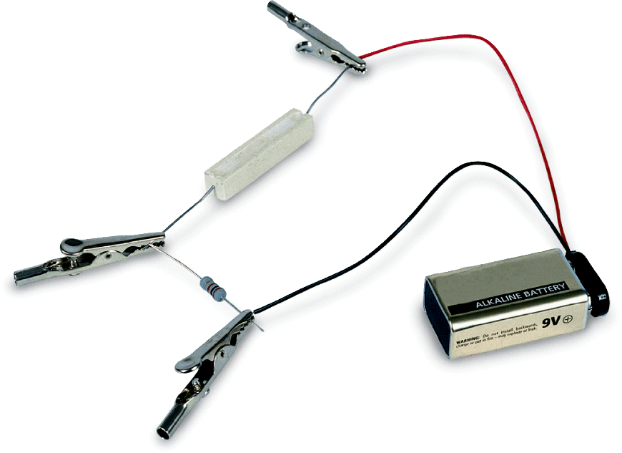
An electric current can only flow when there is a closed path in which electrons can move.

Slide 3
Electric Current
1. What are the two types of current?
direct current and alternating current

Slide 4
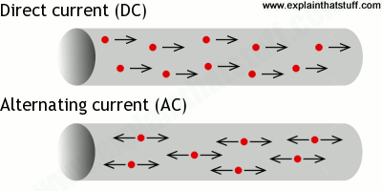
Electric Current
2. The continuous flow of electric charge is an electric current.
Charge flows 1 direction in direct current (DC). Example: battery-operated devices
Alternating current (AC) regularly reverses Example: home and school

Slide 5
Electric Current
The SI unit of electric current is the ampere (A), or amp, which equals 1 coulomb per second.
Even though electrons flow in an electric current, scientists define current as the direction in which positive charges would flow.

Slide 6
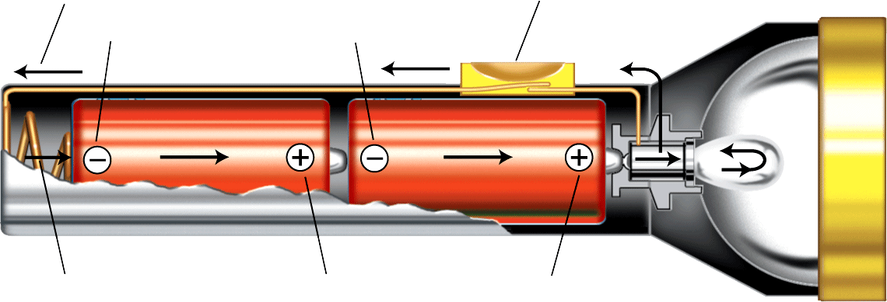
Electric Current
3. A complete path is required for charge to flow in a flashlight. Batteries must be placed so that charge can flow from negative to positive, passing through the bulb.
Flow of current
Switch
Negative terminals
Spring
Positive terminals

Slide 7
Resistance
3. Resistance is opposition to the flow of charges in a material.
As electrons move through a conducting wire, they collide with electrons and ions. These collisions convert some kinetic energy into thermal energy, and the current is reduced.
The SI unit of resistance is the ohm.

Slide 8
Resistance
4. What factors affect electrical resistance?
A material’s thickness, length, and temperature affect its resistance.

Slide 9
Voltage
5. Potential Difference
Water falls spontaneously from a higher to a lower height. Likewise, electric charges flow from a higher to a lower potential energy.
Potential difference is the difference in electrical potential energy between two places in an electric field.
Potential difference is measured in joules per coulomb, or volts. Because it is measured in volts, potential difference is also called voltage.

Slide 10
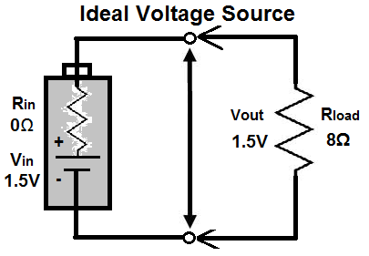
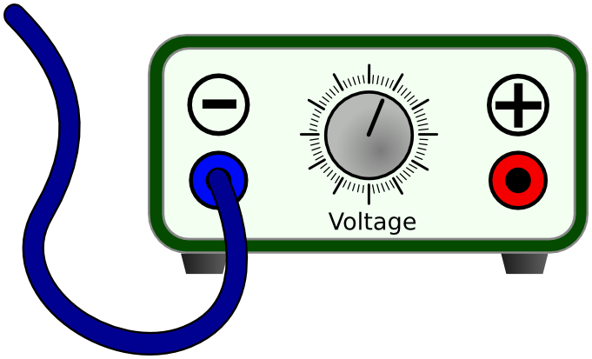
Voltage
6. Voltage Sources
A source of voltage does work to increase the potential energy of electric charges. Three common voltage sources are batteries, solar cells, and generators.
A battery is a device that converts chemical energy to electrical energy.

Slide 11
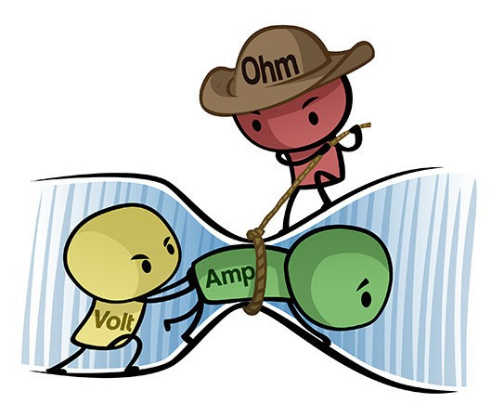
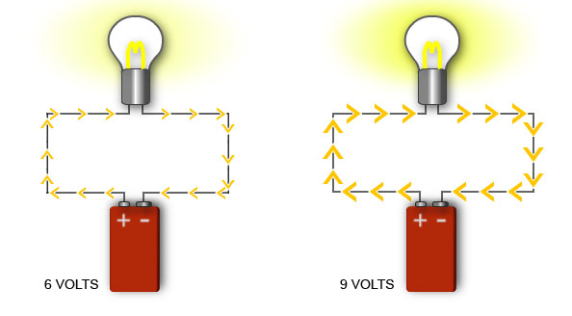
Ohm’s Law
7. How are voltage, current, and resistance related?
Increasing the voltage increases the current. Keeping the same voltage and increasing the resistance decreases the current.

Slide 12
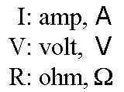
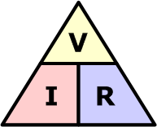
8. Ohm’s Law
According to Ohm’s law, the voltage (V) in a circuit equals the product of the current (I) and the resistance (R).

Slide 13
9. Let’s review
How can we lower the resistance of a wire?
What does the voltage between two points in an electric field represent?
A 9-volt battery drives an electric current through a circuit with 4-ohm resistance. What is the electric current?
Lower thickness, decrease length, decrease temperature.
Potential difference.
9 / 4=
2.25
Amp

