Slide 1
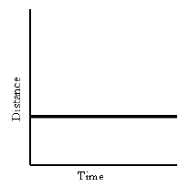
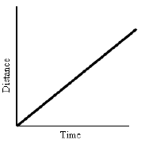
1. Distance vs. time graphs
Time is passing, but the distance does not change.
The object is stationary.
Distance and time increase constantly. Slope does not change.
The object is at constant speed.

Slide 2
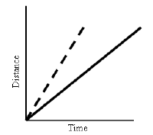
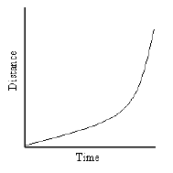
1. Distance vs. time graphs
Steeper line indicates higher speed. Both are constant.
Curved lines indicate an increase in speed. The object is accelerating positively.

Slide 3
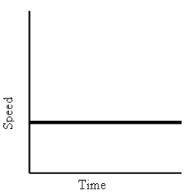
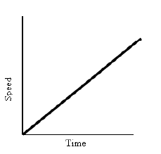
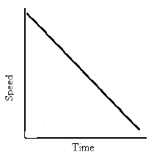
2. Velocity vs. time graphs
Horizontal line on the speed vs. time graph indicates speed is NOT changing as time passes. Constant speed.
Speed is increasing. Object is accelerating.
Speed is decreasing. Object is decelerating.

Slide 4
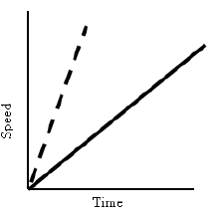
2. Velocity vs. time graphs
Steeper slope indicates greater acceleration.

