Slide 1
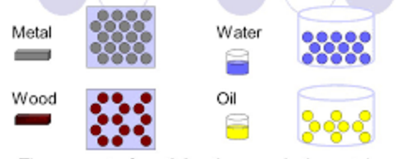
Bellwork…
How would you compare the density of the two items below?

Slide 2
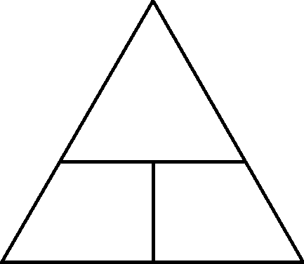

Introduction to Density
Density →
Formula for density
Using the triangle
how closely packed particles of a substance are; the ratio of mass to volume
$$D=\frac{m}{v}$$
Cover the variable you want to find… _________ if on top
_________ if side by side
m
divide
D
v
multiply

Slide 3
Let’s Practice!!
Complete page 5 on your own.
Complete pages 6-7 with a partner if you would like.

Slide 4
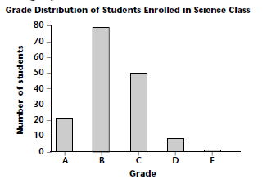
Introduction to Graphing Types of Graphs
A ___________ allows us to compare data between ___________.
bar graph
groups

Slide 5
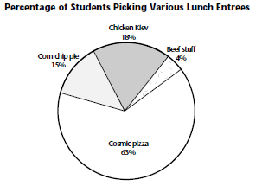
A ___________ allows us to compare ______ to the ___________, or percentages.
pie graph
parts
whole

Slide 6
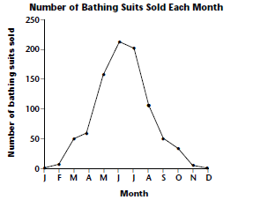
A ___________ allows us to track __________, often over __________.
line graph
changes
time

Slide 7
What should each graph have?
Graph Title
Axes titles
Consistent scale

Slide 8
Let’s Practice!!
Complete “Graphing Packet” on your own!! ☺

