Slide 1
1. What is density? 2. If a block of aluminum has a mass of 270 grams and a volume of 100 ml, what is its density? Will it sink or float in water?
Mass to volume ratio
270g/100 ml = 2.7 g/ml
It will sink!

Slide 2
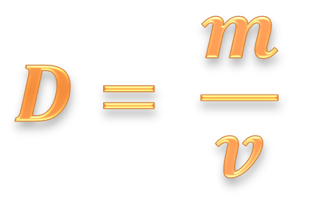
3. Density →
Mass to volume ratio; how tightly packed matter is
$$D= \frac{m}{v}$$

Slide 3
4. Density of water is __________ . If a material has a density ____________ it will _______________. If a material has a density ____________ it will _____________.
1 g/ml
less than 1
float
more than 1
sink

Slide 4
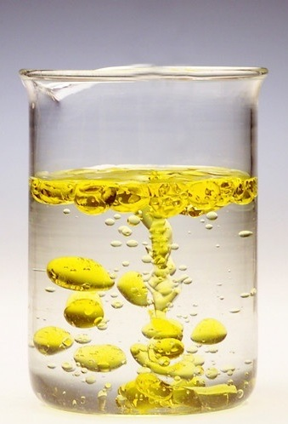
5. Immiscible →
Liquids that do not form a homogeneous mixture

Slide 5
6. Chemical formula→ Chemical symbol →
Proportion of atoms in a compound
Ex.: H₂O, CH₄
Code for an element name
Ex.: Mg, H

Slide 6
7. Answer the following questions using your notes.
Then, we will work on our projects.

