Slide 1
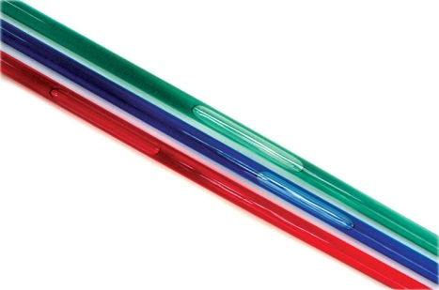
FPS – Bubble Tube Speed Lab
I can…
Calculate speed by measuring the slope & create distance-time graphs.
Pre-Lab
What is the speed of an object if it travels 20 centimeters in 12 seconds? What is the difference between velocity and speed? What do you think could affect an object’s speed during motion through fluid?

Slide 2
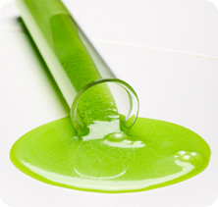
SAFETY
Bubble tubes are fragile and anyone who breaks or damages a bubble tube will receive a ZERO on the lab, end of story. At all times while holding the bubble tube, have both hands on the tube with your hands far apart! DO NOT lean them against the wall or leave them unattended on the table. DO NOT use them in anyway other than what is specified for the lab. Careless behavior with the tubes will result in a ZERO.

Slide 3
Bubble Tube lab
Materials -stopwatch -red tube -blue tube -green tube -meter stick
Procedure Measure the length of each tape mark on each tube. Select a tube to start with. One person should hold the tube with both hands far apart at all times. Hold the tube so that the bubble is at the bottom end of the tube. The group members should be timing with the stopwatch, watching the bubble, and recording the times. When the group is ready to time, they should hold the tube upright, with the bubble at the bottom and start the stopwatch. When the bottom of the bubble passes the first mark, stop the timers. Record the time. Record the distance to the first mark. Do this for all 4 marks on the tubes. Repeat two trials for each color tube.

Slide 4
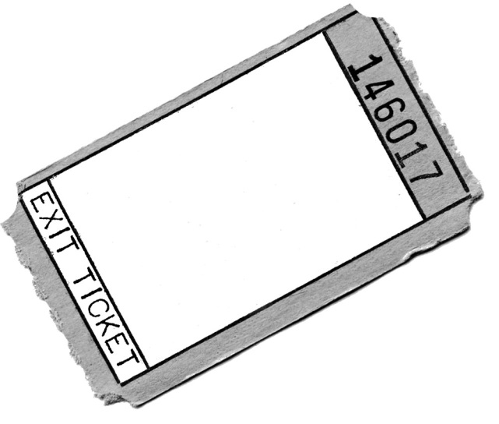
When you’re done with data…
Work in your groups on the graphs and analysis questions. Independently answer and turn in the exit ticket. If you finish with everything, work on the speed problems in the Weekly Packet.

